Slide 1
ReferNet Plenary meeting 2018
21-23 November 2018
Maite Santos
Notes:
Good afternoon from my side
We are approaching the end of the meeting after 2, and for some of you, 3 long days of intense meeting
I promise, my presentation won’t tire you more, it will be more visual, and perhaps more entertaiining …

Slide 2

Visibility survey 2014-17: Observing trends and sharing practices
Trends from 2014-17
Inspiring practices
Learning from each other
Notes:
The topic of this session is about another deliverable: visibility actions
We will be talking specifically about the visibility survey that you submit looking at your answers from the last 4 years, 2014-17
2014 was the last time we share with you feedback about it
Looking at some examples, some practices that might be an inspirationfor others

Slide 3
Visibility actions
Continuous activity – all year
Partners act as multipliers and dissemination channels
Raising the visibility of VET
Customisation at national level
Targeting various audiences
Notes:
Let’s put visibility actions in context, those are activities that you perform all year round
Where you partners act as multipliers and dissemination channels of VET related info and Cedefop products and activities
With the objective to raise the visibility of VET
Customised at national level, at your national needs and
Targeting your national audiences that you know best

Slide 4
Visibility survey
Annex of the financial report at the end of the year
30 Respondents – Survey monkey
Five actions:
  National websites
  Social media
  Networking & organisation of events
  Promotional material
  Translation
Notes:
Visibility survey is an annex that you submit together with the financial report at the end of the year where you report about the activities that you have performed that specific year.
All of you answer … We use survey monkey as the platform
It is divided into 5 main actions:
Now we will see some graphs taken from the questions and answer you have submitted during the last 4 years.

Slide 5
Which channel have you used to promote Cedefop’s products and activities?
Notes:
From this graph we see which platforms and channels you have used to promote Cedefop’s products and activities
We see that your national website is the main platform used for promotion, nearly all of you use it, as well as the institutional website
Some of you produce a digital newsletter
As well as organisation or participations in events, conferences, career fairs, open days, etc.

Slide 6
How have you promoted ReferNet activities?
Notes:
How do you promote RN activities?
Again we see that most of your energy goes to the national website, posting highlights there, but you also post content in social media, and not only, as you send email campaigns,
Some of you write articles in specialised press, in RN newsletters or in other institutions’ newsletters
Let’s have a closer look at the national websites

Slide 7
National websites
Which activity have you performed?
Notes:
From the graph we see that all of you make sure the content is updated, you also add new content on a regular basis, some of you produce digital newsletters.
Some partners have performed a complete redesign, we will see some examples later
We are happy to see that already 13 have started to apply the SEO recommendations we sent last year
You might remember that we had a workshop on digital marketing where an external consultant did a SEO audit giving some recommendations on how best to position your national website

Slide 8

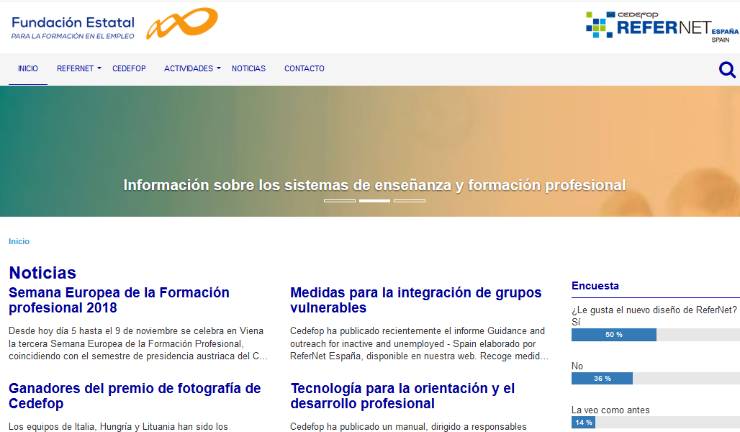
National websites
Notes:
Let me show some examples of partners that have recently redesign their national websites
Italy
Spain – A new design with a more secure server. They set up an online survey asking visitors for their opinion

Slide 9

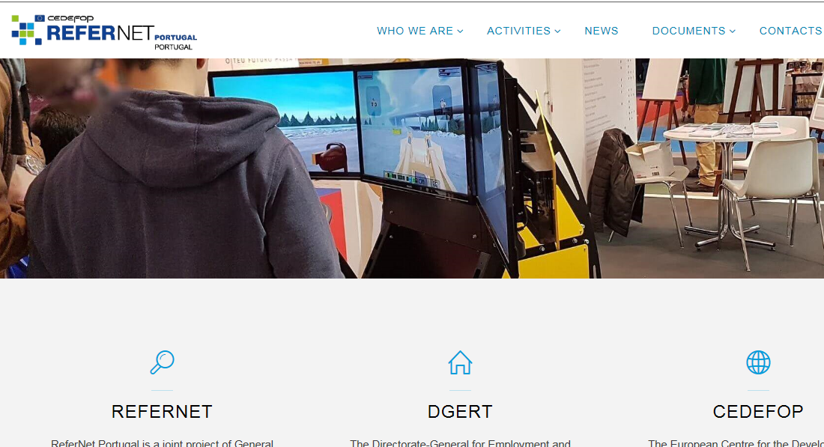
National websites
Notes:
Germany – new design – Implementation of SEO recommendations
Portugal – new design with new wireframes

Slide 10
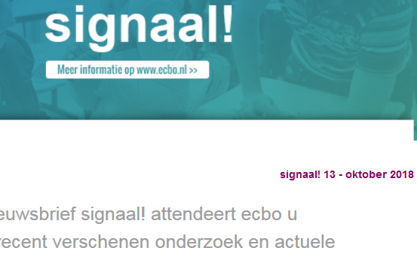
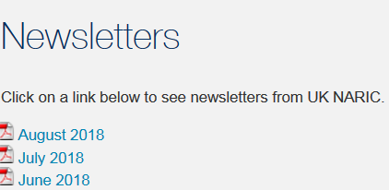
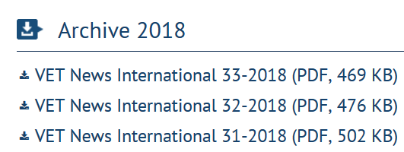
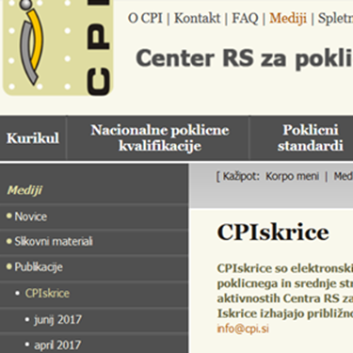
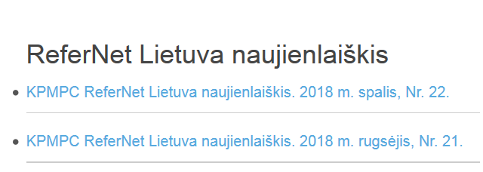
Digital newsletter
Notes:
Some other examples of digital newsletters that you produce or together with your institution
United Kingdom,
Netherlands,
Latvia
Germany,
Slovenia,

Slide 11
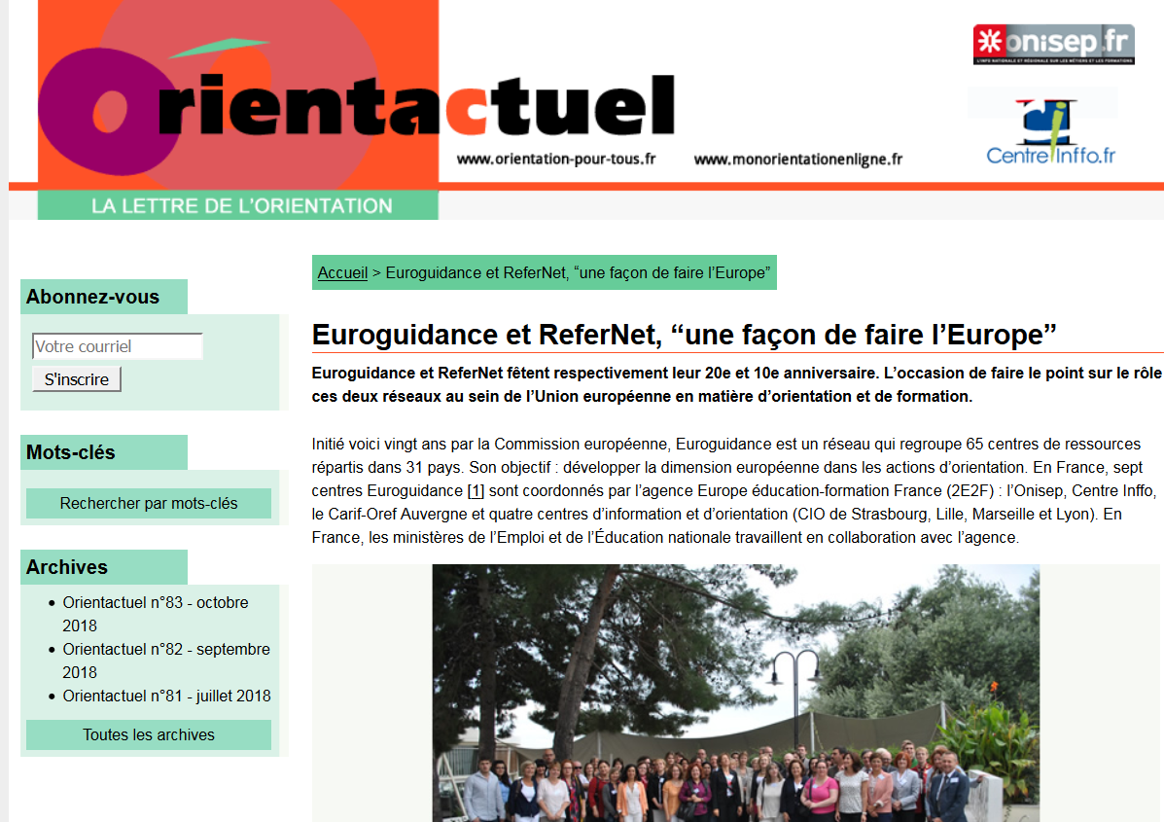
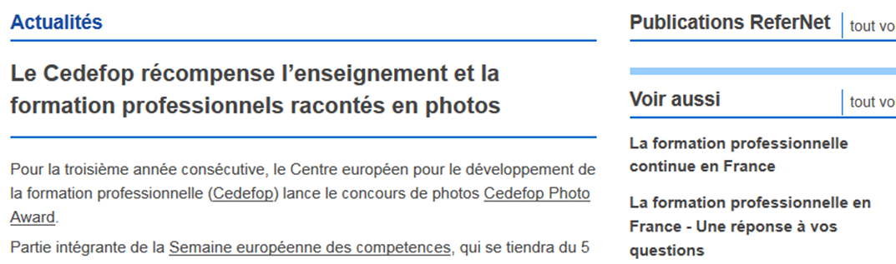
Digital Newsleters
Notes:
France
Article in newsletter
Tranlation of Cedefo news into French
Some of you said that social media posting works better that newsletters - Iceland
*Some of you create blog entries or dedicated news instead – Spain, Czech, Cyprus

Slide 12
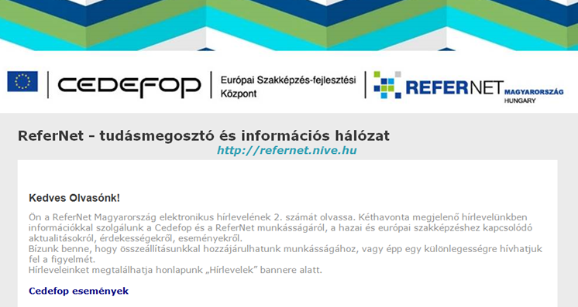

Digital newsletter
Notes:
Hungary – newsletter in Hungarian and news items in English

Slide 13
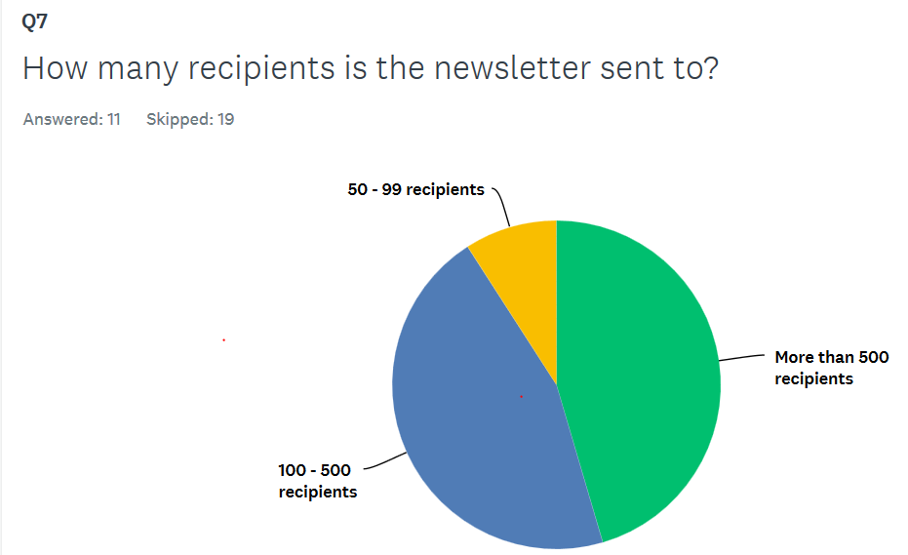
Digital newsletter 2017
Notes:
Regarding recipients to whom those newsletters have been sent .. You indicated an average of more than 500 recipients
As reference we can say that Cedefop newsletter is sent to 6,500 subscribers

Slide 14




Social media
Notes:
Let’s talk about another activity - Social media
Here I would like to ask the question: how many of us use social media in our personal life? I think most of us
However, from your answers we see that those partners that answer ‘no actiivity’ decrease from 2014, something positive, we would like to encourage to start using
I can tell you, it is easy, quick and iitcan be very fun as well….

Slide 15

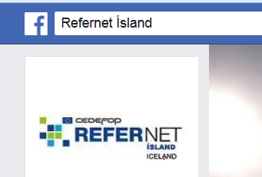
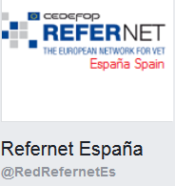
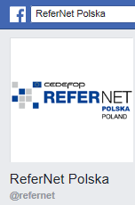
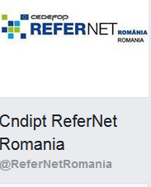
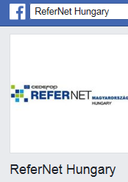
Social media – Facebook ReferNet accounts
Notes:
Some example of ReferNet facebook account are:
Iceland, - they use it very regularly as they declare that this works better that having a website, and address stakeholders better in this way
Spain,
Romania,
Hungary, P
oland

Slide 16

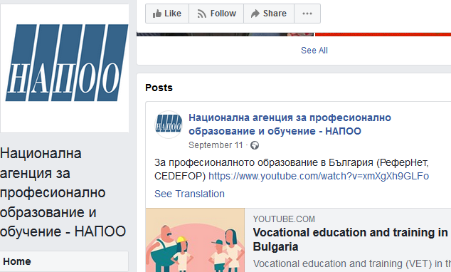




Social media – institutional accounts
Notes:
Other use the FCBK institutional accounts to promote Cedefop content
Bulgaria NAPOO
Lithuania, kmpc
Slovenia ,
Slovakia SIOV
Finland,

Slide 17


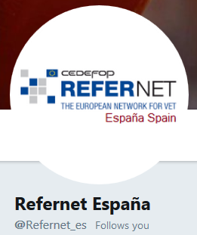
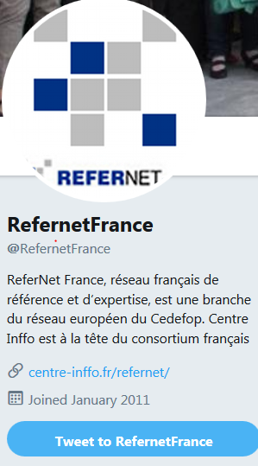
Social media – Tweeter ReferNet accounts
Notes:
Tweetr is another platform you use
I would like to encourage to create a profile, start posting items
NL
ES
FR some examples

Slide 18

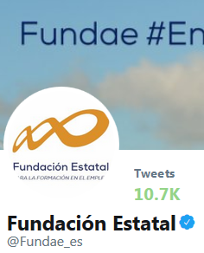




Social media – Tweeter institutional accounts
Notes:
Other partners use their Tweeter institutional account
NL
FR
DE
ES
UK

Slide 19




Social media - Tweeter
Notes:
Finland
Estonia
Latvia

Slide 20
Have you produced promotional material?
Notes:
Another activity included in your visibility actions is the production of promotional material
From your answers we see that not all of you use it but those that invest money you produce very nice corporate gifts, information brochures, videos, banners, posters, etc.
Let’s have a look the samples

Slide 21
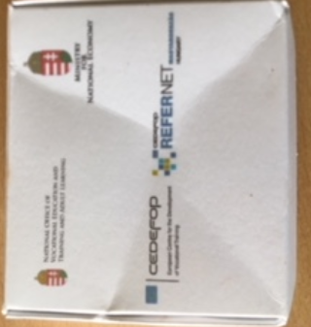
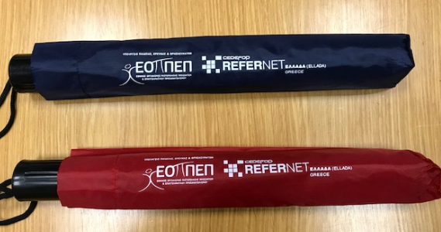
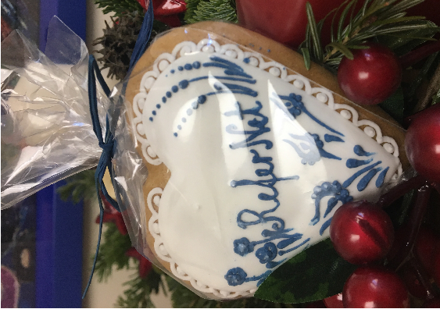

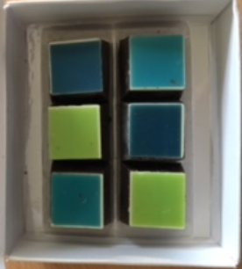
Promotional material
Notes:
Greece: umbrellas, USB
Hungary: Chocolate box, biscuits

Slide 22
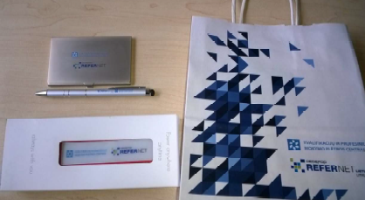
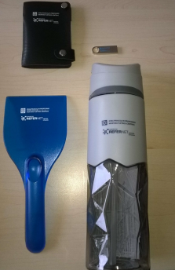
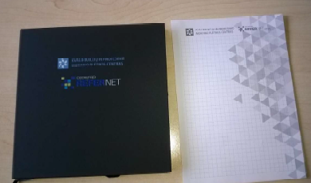
Promotional material – corporate gifts
Notes:
Lithuania: corporate gifts

Slide 23
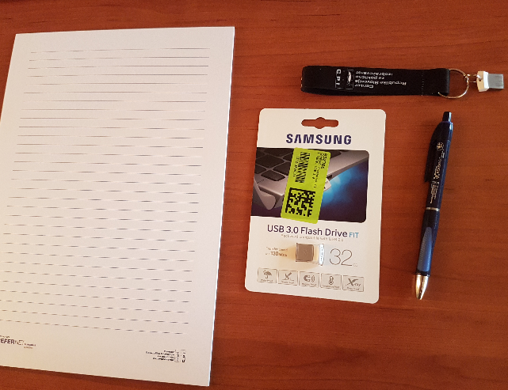

Promotional material – corporate gifts
Notes:
Slovenia: notebook, pen, usb, poster

Slide 24
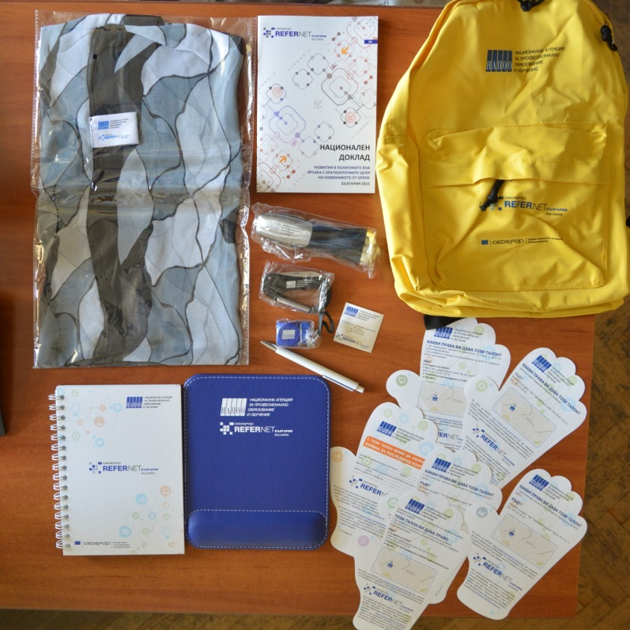
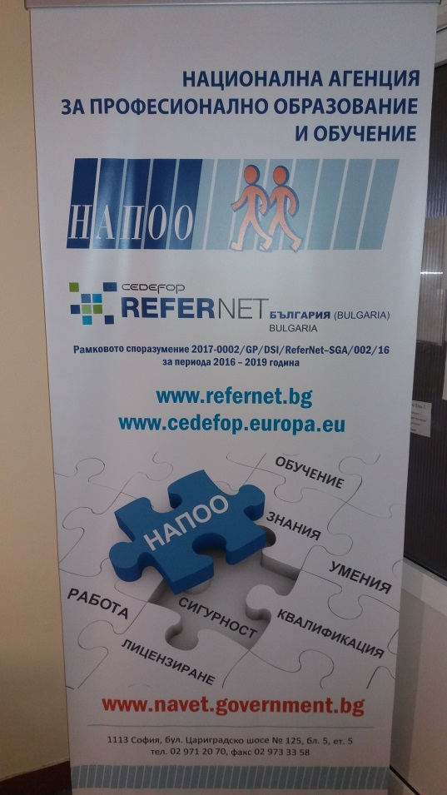
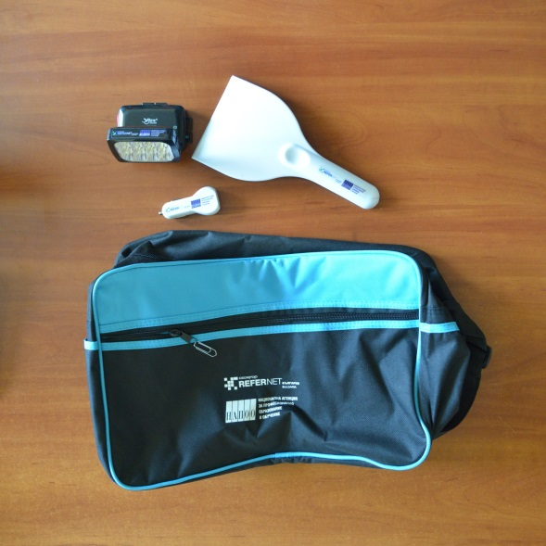
Promotional material
Notes:
Bulgaria: poster, bag, USB, notebooks, pens, USB, very nice material that stakeholders will be happy to receive

Slide 25
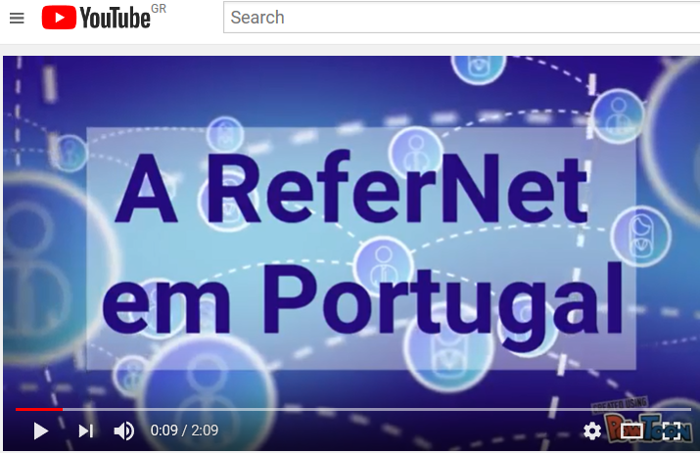
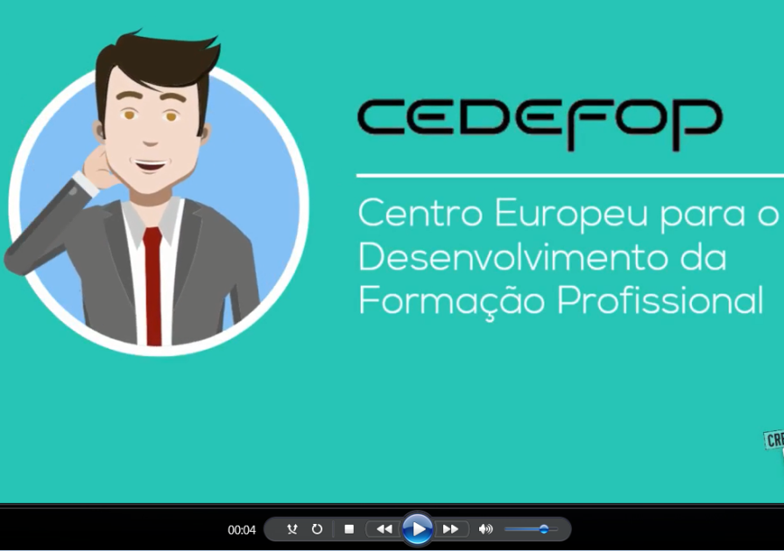

Promotional material – videos
Notes:
Portugal has produced very nice videos about ReferNet and Cedefop
Presentation from Loukas on the future of VET into Portuguese

Slide 26
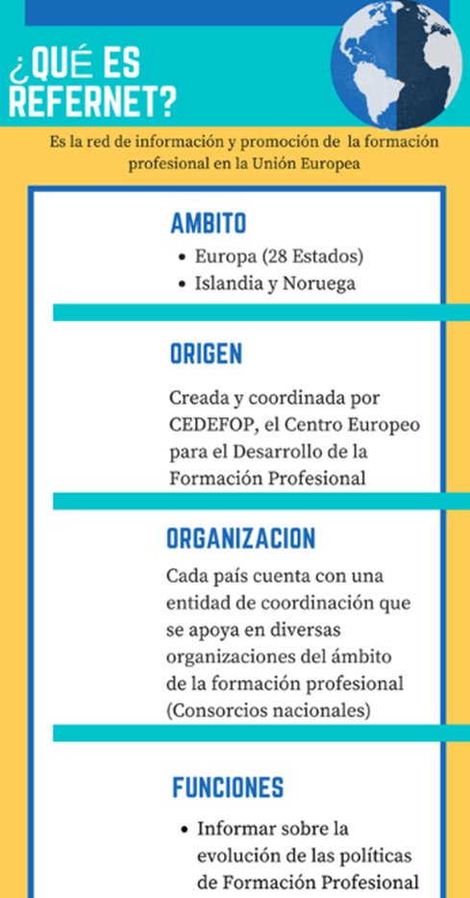
Promotional material
Spain – Infograph in social media
Notes:
Spain has produced a nice infograph, and it has been distributed in the social media

Slide 27
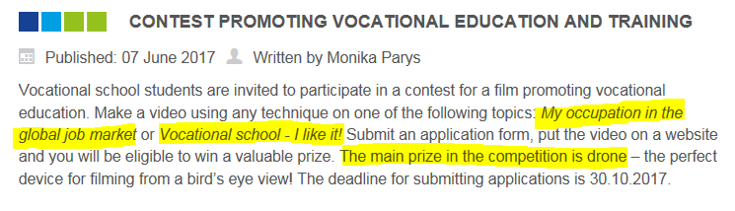
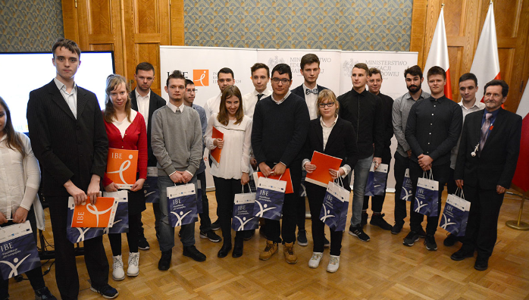
Promotional material
Poland - film contest
Notes:
Poland had a very original initiative
It is the organisation of a film contest for VET students to promote VET Within the frameworkf of VET week
Two topics were suggested: my occupation iin the global job market and vocational school I llike it
http://refernet.ibe.edu.pl/index.php/en/115-winners-chosen-in-poland-s-contest-for-the-best-video-promoting-ivet
64 entries were submitted
4 winners in the gala ceremonia
Very nice prize: a drone for the winner
Here is a picture of the winners where the Minsiter was also present
Very nice activity where I think you must have had fun in organising

Slide 28
Networking – Organisation of events
Notes:
Talking about networking within your country, we see that most of you organise events yourself, to promote Cedefop products, while others participate in other events

Slide 29
Networking – Strengthening local stakeholders
Notes:
Who are those local stakeholders you are strengthening links?
We see are mainly coordination unit of European programmes: Europass, Eurydice, NQF, ECVET,
Other say that not much contact with stakeholders as education system is decentralised

Slide 30
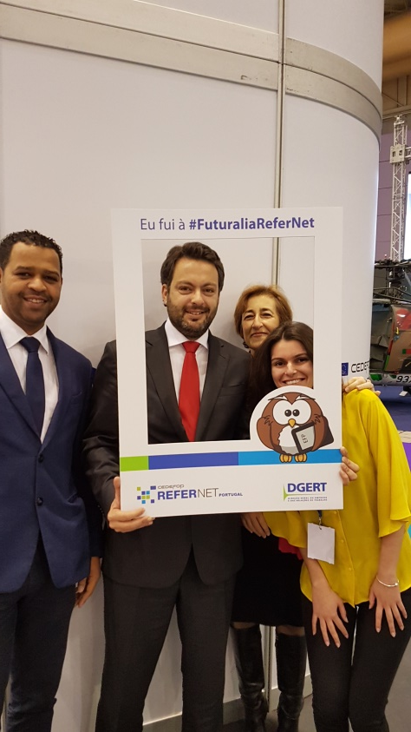
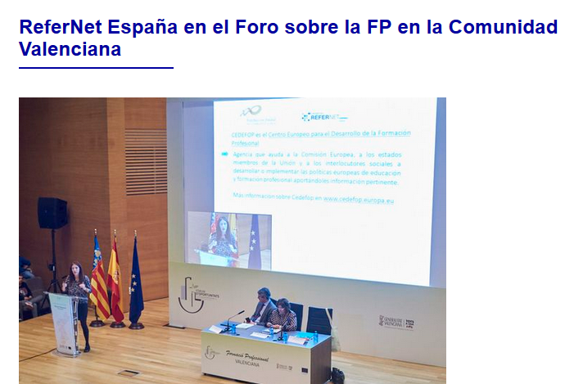
Networking – Local stakeholders
Futuralia – Portugal
Forum of Opportunities - Spain
Notes:
Some examples of events that you have organised or participated
We see Fernanda together with the Minister taking a photo with a nice frame Portugal prepared for the futuralia, one of the bigest event in Portugal
Photo of Spain in Valencia at the forum of opportunities - Sophia presenting the results of the opinion survey

Slide 31
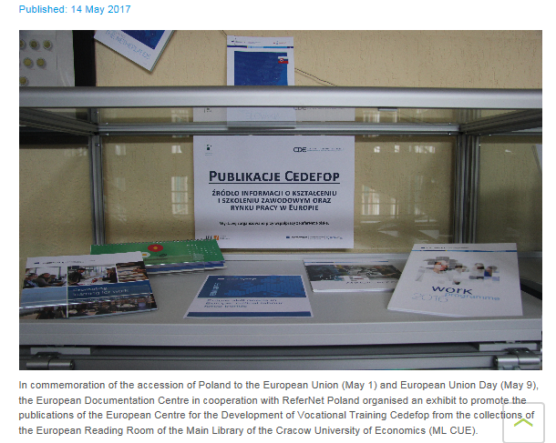
Networking – Local stakeholders
Poland – Exhibition in the University Library of Cracow
Notes:
Poland that inn commemoration of the accession of Poland to the UE they organise an exhibition at the University Library of Cracow

Slide 32
Translations
Notes:
Translations is another activity that you perform as Cedefop produces more of its content in English
Yorgos has already talked about it yesterday

Slide 33


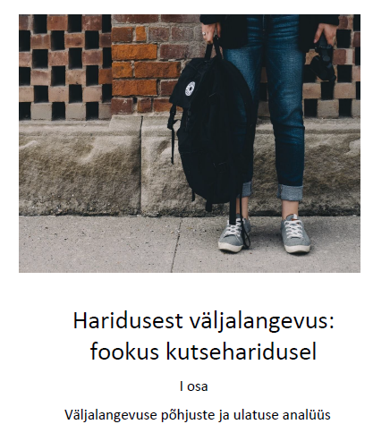
Translations
Notes:
Examples from
Germany: Flyer
Portugal – you can see on the display table outside
Estonia: 2 volumes on early leaving
Latvia: guidelines of validation, handbook on LO, Global inventory of NQFs

Slide 34


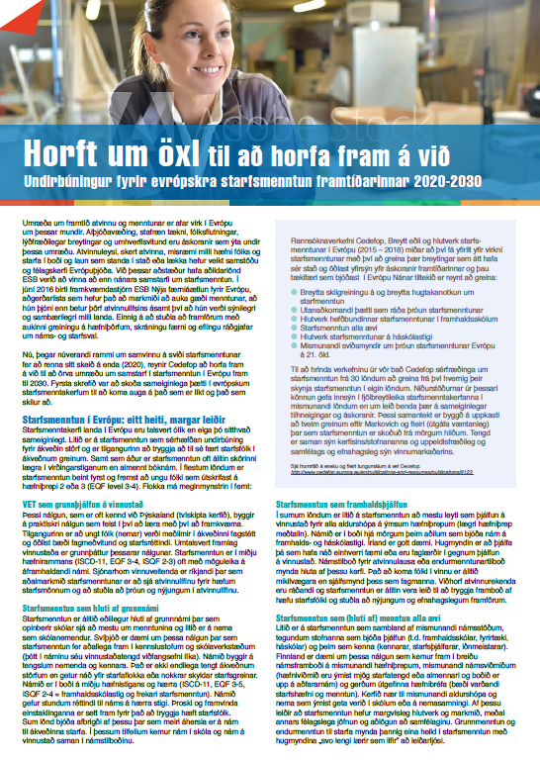
Translations
Notes:
France: Thematic perspective on innovation in VET
Spain: VET in Europe
Iceland – Briefing Note Looking back to look ahead although they say that is very expensice and they don’t do much
Belgium: outreach and guidance and key competences (FR and NL)

Slide 35

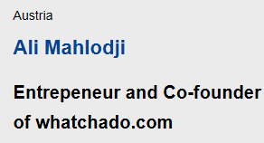
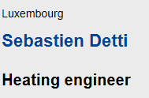
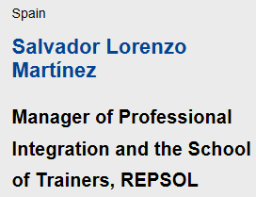
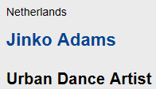
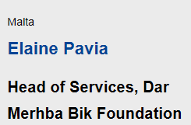
VET week ambassadors 2018
Notes:
Last I would like to talk about an activity of this year, 2018,
Commission put in place a network for VET week ambassadors in 2017 and asked ReferNet for candidates
ReferNet partners from 10 countries proposed 26 names and 5 names were selected to be Ambassadors.
Half of the countries that sent names were selected’

Slide 36
Visibility survey 2018
Survey questions?
How to improve visibility?
Guidelines for national websites
Your ideas !
Notes:
That’s about it …
I leave the floor to you about ideas on how to organise the 2018 survey, how to improve visibility for next FPA, updating guidelines for national websites or other ideas you might have and we can implement …
Thank you .. I leave the floor to you and Sylvie

