Slide 1
Use of big data techniques for skills anticipation
ReferNet Plenary Meeting
Thessaloniki, 22-23 November 2018

Slide 2
INDEX
FUNDAE’S BACKGROUND
CONTEXT
THE PROJECT
FUTURE STEPS

Slide 3
FUNDAE:
not-for-profit organization belonging to the public sector
Based in social dialogue (tripartite nature: state and regional administrations + main employers´ and trade unions´ organisations)
Core business: managing, promoting and disseminating continuing vocational training schemes mainly for employed workers on a state-wide basis
Funding resources come largely from a compulsory vocational training quota collected by the Social Security system and paid for by companies and workers
Operating, under different names and legal status, since 1993

Slide 4
Main schemes:
“Company training” initiative: training organized by companies for their employees. Companies receive discounts on their social security contributions, depending on their size.
Subsidised training initiatives: Training initiatives for employed workers (or unemployed to a lesser extent), including a wide range of vocational training programmes available in a modular regime. These schemes are referred to as “supply training” because there is a catalogue of training courses which workers can choose from and is financed through grants/aids which are distributed through different calls for proposals.

Slide 5
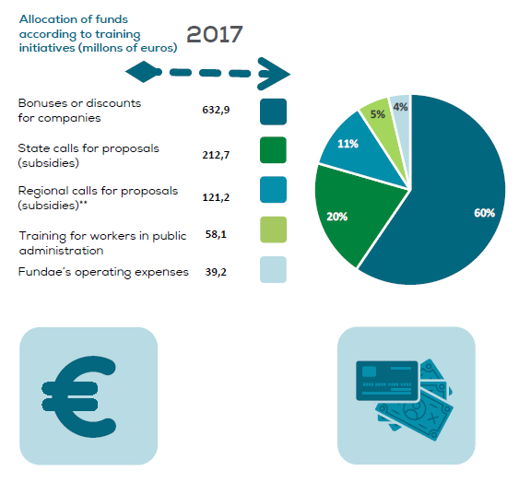
1,064.1 million EUR

Slide 6
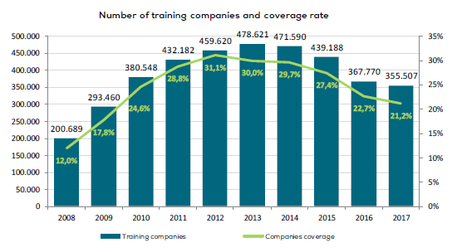

14/11/2018
N= 1,674,941 private companies in 2017

Slide 7
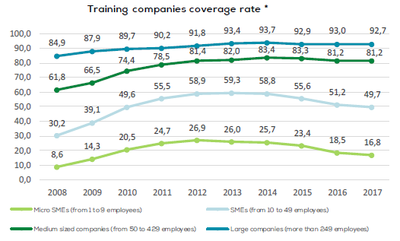

Slide 8
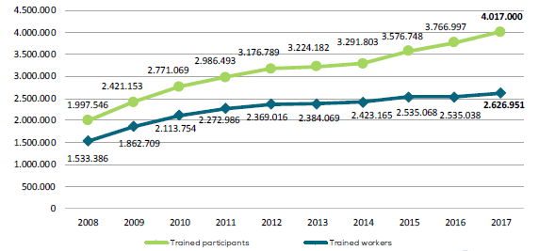
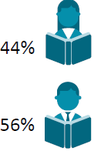
Evolution of trained workers and participants in Company training
N= 12,686,490 workers in 2017

Slide 9
CONTEXT in 2016:
Globalisation and technological changes bringing new trends
Labour authority reform paying more attention to skills anticipation
Desire to provide data intelligence to the entire VET system (IVET-CVET or Education-employment VET)
Starting point
  Companies are free to name training actions as they wish and to set learning contents and duration accordingly
  A classification already developed to be able to know what sort of training was being provided
  Companies decided how to classify each training action
Public procurement to test big data techniques applied to the wealth of training data accumulated in Fundae over the years: project carried out in a few months between 2016-2017

Slide 10
Number of training activities financed to companies
Company training

Slide 11

Structure, analyse and obtain value from the data generated by Fundae to use them as a tool to guide strategic management

Slide 12
Introduction
BACKGROUND AND OBJECTIVES
To study what categories emerge naturally from the specifications of training actions (TT.AA.) that companies demand in Fundae’s web portal to see which traditional categories are better or worse defined and to propose a new methodology.
Data from 2015, work carried out between 2016-2017
#1
Establish a methodology to statistically classify the training actions demanded (TT.AA.).
#1
Establish a categorization of TT.AA. consistent with what companies are demanding.
Methodological
goals
Business
goals
#2
Describe the TT.AA. using relevant keywords in the context.
#2
Analyse the quality of the categories that have been studied until now.
#3
Establish similarity metrics between AAFF and categories that allow the clustering of actions.
#3
Draw conclusions about the trends that emerge from companies’ training demands.

Slide 13
Introduction
PROJECT PHASES
Project was carried out in two phases:
Obtain a classification system;
Refinement and evaluation of the classification system to design the Classified Actions and analyse their sectoral significance.
Data pre-processing
Features
Item lexical of TTAA
Information from training demand
Dictionary of keywords
Quality of Classified Actions
Filtering actions
TTAA Vectorization
Redesign of actions
Clusterisation
Enrichment with occupations
Analysis of the new categories compared to the current ones
Final reports and tables
Phase 1
Phase 2

Slide 14
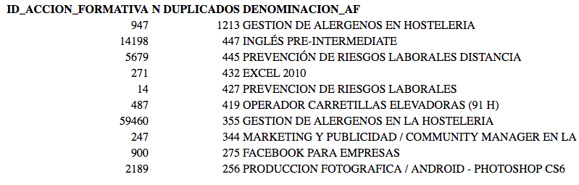
Methodology :: Pre-processing of data
ELIMINATION OF DUPLICATE TTAA
In the original database there were many TTAA that really have the same objectives and contents
Of the 360 thousand TTAA taken into account, more than 102 thousand follow this pattern, which represents a reduction of 32% of the TTAA, leaving 215 thousand for the analysis.

Slide 15


Methodology :: Analysis of themes and clustering
CLUSTERIZATION OF TRAINING ACTIONS
TTAA
Extraction of objectives and contents
Extraction of standardized ítem lexical
Detecting semantic groups
Vectorization of documents
We tried different clustering algorithms: Hierarchical SOM, KMeans, Hierarchical clustering, ...
The final approach is:
  A Top & Down approach that allows to define and validate the highest level groups and the lowest groups to, once fixed, perform the intermediate grouping
Algorithm LDA + CTM

Slide 16
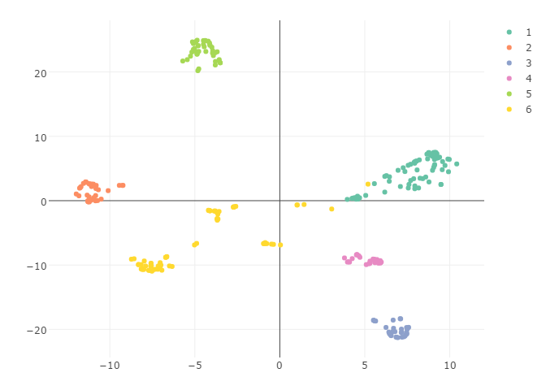
Methodology :: Analysis of themes and clustering
REFINEMENT: DETECTION OF SUBGROUPS
After a manual validation of the results, some level 4 groups contained different types of TTAA. From this validation, a process of automatic detection of subgroups was carried out to subsequently make the decision of whether i) to create new level 4 groups ii) integrate those AAFF into another or iii) to create a new level 1 group .
Level 1 "Forestry, Agriculture and Gardening"
Lifting equipment, machinery
Sanitation and pottery
Drilling and boring
Railways -
Construction and maintenance
Road surface

Slide 17
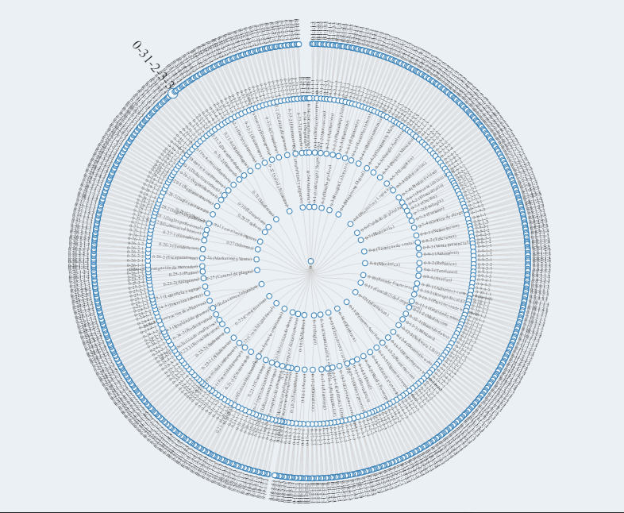
New Classification System
GENERAL RESULTS
Level 1
49 groups
Level 2
160 groups
Level 3
348 groups
Level 4
753 groups
Training actions
360 K TTAA

Slide 18
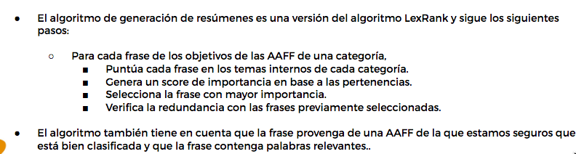
New Classification System
DESIGN OF CLASSIFIED ACTIONS
Level 4 groups are the basis for the Classified Actions that will result at the end of the whole process. For this, it is necessary to create a process of automatic creation of the titles of the Classified Actions, their objectives and their contents.
Algorithm for automatic generation of objectives and contents

Slide 19
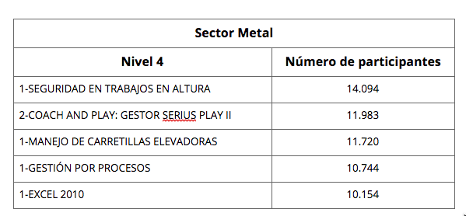
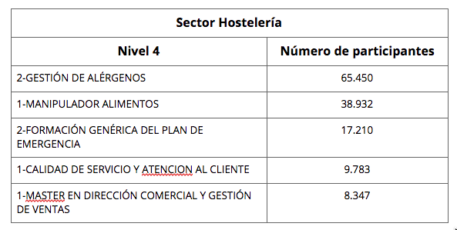
Sectoral significance of Classified Actions (CA)
COMPARISON WITH THE CATEGORIZATION OF FUNDAE
Once we have defined the Classified Actions, we compare classification results with the sectoral information contained in the FUNDAE’s databases, which allows us to analyse the sectors’ demand of the training actions.

Slide 20
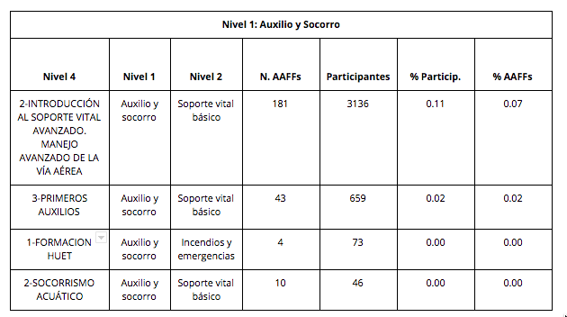
Classified Actions coverage versus Training Specialities
CROSSING WITH FUNDAE’S TRAINING SPECIALITIES
Apart from the TTAA demanded by the companies, there are Training Specialties, published by FUNDAE, resulting from sectoral structures priorities. One of the analyses carried out in the project was to discover those Classified Actions not covered by this offer, by means of the classification of the TTSS in the new classification system.
The following table show an example of CA which were not contained in the training specialities.

Slide 21

Identify the training actions provided by companies which are the most innovative and / or with the greatest impact
As reference for the provision of the entire system of Professional Training
Once they are identified, they are presented to the Joint Sectoral Structures that agree which of them are priorities to respond to the competency requirements of their sectorial scope.
These TTAA are included in the Catalogue of Training Specialties, a reference for training provision that the VET system in the labour strand (Public employment services) offer annually to employed and unemployed workers .
It supports the prospecting and identification of emerging training needs.

Slide 22

New Phase (currently working on it)
1. Automatic classification of the TTAA feeding into the databases of the different initiatives.
2. Manual reclassification of TTAA not automatically classified.
3. Identification of news contents in TTAA and expansion of the Hierarchy
4. Relationship of the group hierarchy with other classifications
5. Visualization of results

Slide 23
CONCLUSIONS
KEEP TRYING
Big data techniques are here and we better use them
Eliminates subjective criteria
Useful to identify new learning contents that otherwise would have passed unnoticed
New approach, different from tables and traditional databases
Move to in-house knowledge
Big data techniques, if combined with qualitative methods and other data sources can substantially support skills anticipation
Big data techniques are yielding promising results in terms of efficiency and quality of the training offer.

Slide 24
More info on company training:
VET in Europe: country report: Spain 2016 (2018 coming soon)
Key findings 2017
Key findings 2016
Key findings 2015
Infografía empresas 2017
THNKS
www.refernet.es refernet@fundae.es www.fundae.es

