Slide 1






Session 6: Spreading new around the world
Sector / occupation reports
(Focus on Future)
CEDEFOP
Production of Skills Supply and Demand Forecasts
Alphametrics
Tim Grebe
InterVal GmbH, Berlin
Skillsnet Technical Workshop, 24-25 November 2016, Thessaloniki

Slide 2
Aims and objectives
Present forecasting results in a more digestible format
Analytical Highlights on EUSP have provided basic idea for this product. New format is comparable but more detailed (≈ 10 pages)
Focus on specific industries and/or occupations on the NACE Rev. 2
Two-digit-level or for ISCO 08 Major or Sub-major groups
Use of country groups (formed using cluster analysis on KILMS indicators)
Target audience: Policy makers with an interest in specific sectors or occupational groups, sector representatives, researchers, ...
Format has been revised based on discussion during last year‘s Skillsnet workshop

Slide 3
Reports produced in 2016
Skills Supply and Demand Forecast 2016
Industry sectors
1. Health and Social Work
(86, 87, 88)
2. Wood, Paper and Print
(16, 17, 18)
3. Motor Vehicles
(29)
(NACE Rev. 2)
Occupational Groups
1. Elementary Occupations
(91, 92, 93, 94, 95, 96)
2. Personal Care Workers
(53)
3. Business & Admin.
Associate Professionals (33)
(ISCO 2008)

Slide 4
Structure of the reports
Structure | Main contents
Executive Summary | Short summary of main findings
Introduction to sector / occupation | Characteristics of sector / occupational group as current size, challenges etc. (forecast, other sources)
Forecasting results | Forecast of employment until 2030, e.g. Share of sector / occupation in all employment Share of qualification levels Forecast of replacement and expansion demand as well as total openings Important occupations in the sector or important sectors for the occupational group Indicators of imbalances (only for occupations)
Trends and Drivers | Trends that influence sector / occupation (forecast, other sources)

Slide 5
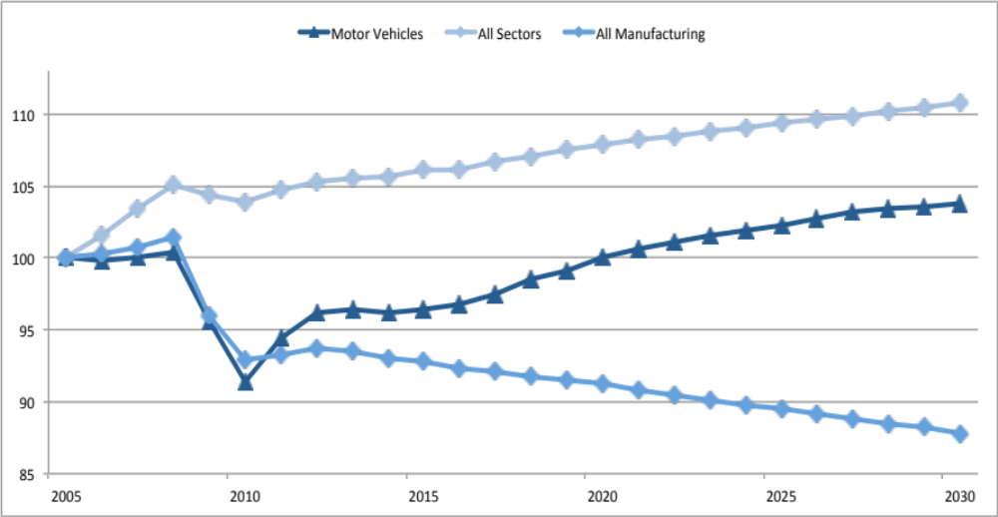
Illustration for Motor Vehicles
Employment level in comparison to all sectors / related sectors
.

Slide 6
Illustration for Health and Social Work (I)
Reports contain both country-by-country-presentations (see figure)
and presentations for country groups (next slide)
.

Slide 7
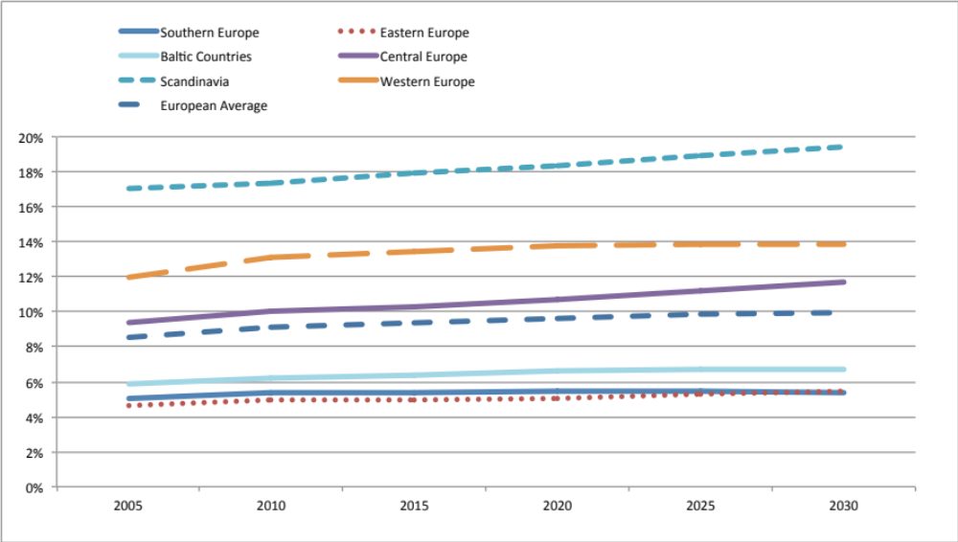
Illustration for Health and Social Work (II)

Slide 8
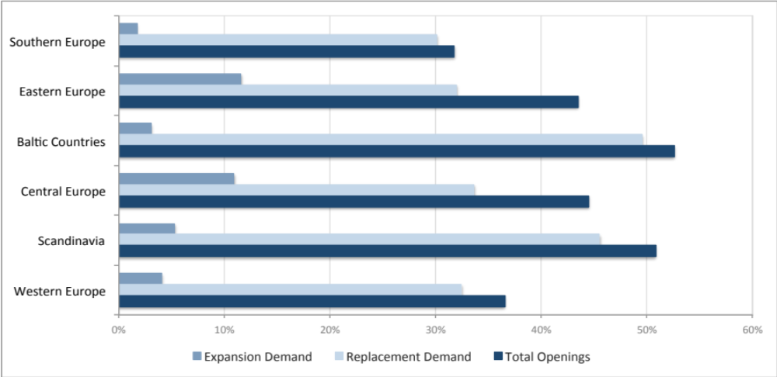
Illustration for Personal Care Workers
Expansion and replacement demand / total openings
.

Slide 9
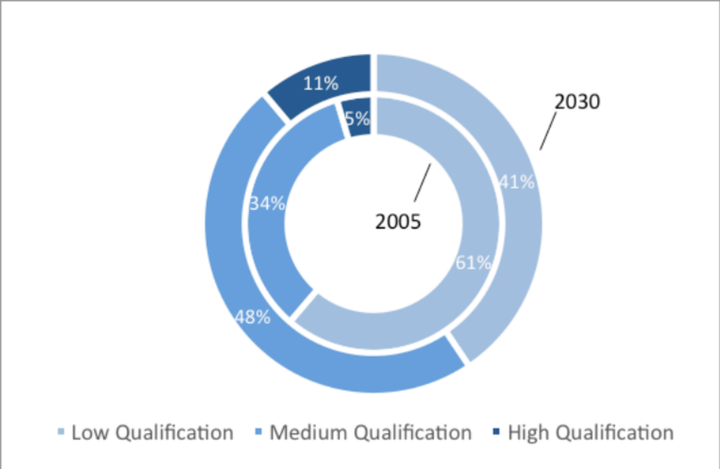
Illustration for Elementary Occupations
Qualification levels in employment
.

Slide 10
Questions / Discussion
Tim Grebe
t.grebe@interval-berlin.de
InterVal GmbH
Habersaathstraße 58
10115 Berlin
Tel. +49 30 3744337-0
Fax +49 30 3744337-29

