Slide 1






Session 4: Final look back
Skills mismatch and imbalances
CEDEFOP
Production of Skills Supply and Demand Forecasts
Alphametrics
Ben Kriechel
Economix Research & Consulting
Skillsnet Technical Workshop, 24-25 November 2016, Thessaloniki

Slide 2

Overview
Forecasting system has modules for supply and demand;
Reconciling demand and supply within the forecasting framework;
A set of indicators and a dedicated workbook of results using supply/demand imbalances.
Future: including RD in indicators?
Analysing policy issues with forecasts: Digitization

Slide 3
Imbalance indicators developed so far
Imbalance indicators were developed to summarize key outcomes with respect to the change in employment structures, shortages or surpluses.
Additional elements as wages and qualifications have been added to these indicators in the past years.
Main problem is the trade-off between level of detail and the availability of data.

Slide 4
A brief overview of imbalance indicators ..
Measure of change | Summarising changes in the qualification mix of employed
Measure of change | Overall change in qualification mix
Direction of change | Direction of change (growth / decline) in occupation
Change in average qualification by occupation | Change in average qualification based on three qualification levels.
Indicator of constraint | Based on reconciled supply / demand
Indicator of constraint | Measuring the impact of constrained demand relative to unconstrained demand (in final allocation)
Indicator of overeducation | Measuring the % of over (under) educated relative to unconstrained demand
Indicator of constrained skill level | Indication of skill level impacted by constrained demand
Indicator of future imbalances of demand | Based on weighted imbalances of qualification mix
IFIOD | Main indicator: qualification weighted imbalances by occ.
IFIOD w Qualification | Main indicator, using qualification shares within occupations
IRWEI | Using weighted imbalances allowing for lower influences of imbalances in high-wage occupations
Source: Economix.

Slide 5
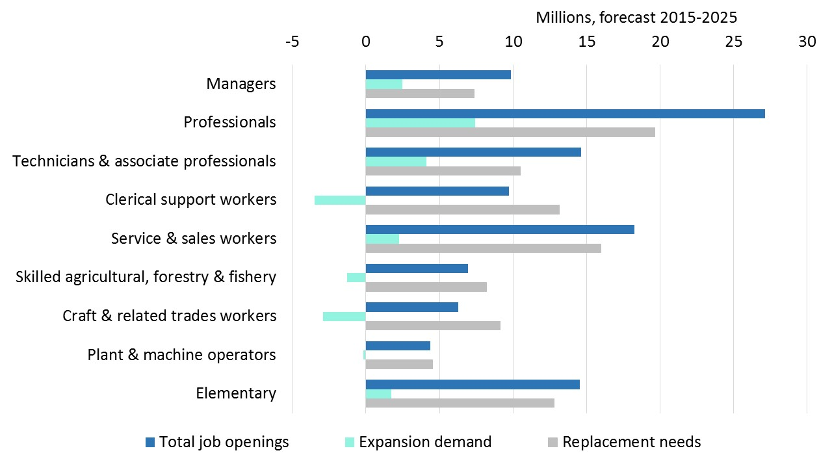
The Importance of replacement demand
Replacement demand is an important element of demand
Flow measure
Challenge:
Integrating flow measures in a supply / demand evaluation

Slide 6
The problem of stocks versus flows
Supply and demand in the main forecasting modules are interpreted as stocks, i.e. the amount of people available with a given qualification (supply), or the amount of people employed in occupations (demand).
This stock is the result of in- and outflows. Outflows are measured (partly) by replacement demand; inflows could be measured by changes in supply.

Slide 7
Using forecasts in policy discussion: digitization

Slide 8
Digitization and Polarisation
Technological change and digitization are important issues that have to be evaluated in the context of skills, qualifications and labour market developments.
Polarisation, i.e. the unequal development (in this case by skills / qualifications) on the labour markets is important to evaluate whether and where we might want to target policy interventions.
Forecasts allow to see likely future developments in the context of the issues analysed.
Combining qualitative & quantitative elements

Slide 9
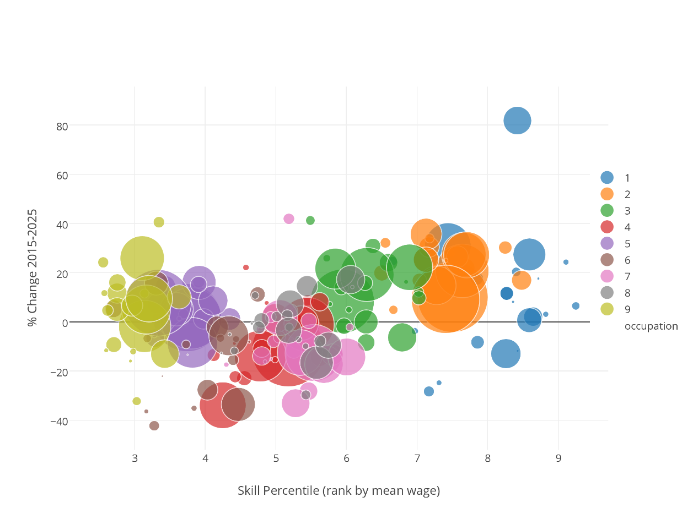
Analysing topical policy issues: Digitization
Polarization of the labour market
Using Skill Forecast combined with ‘skill measure’ (rank of mean wage)
Usually this analysis is done for historic data
Forecast allows to evaluate further future developments.
Faster growth in high skill jobs…
and in low skill jobs…
but not in medium skill jobs…

Slide 10
Conclusions
A stable set of imbalance indicators helps to summarize the findings of the forecasting model.
A shortcoming of the indicators so far is the lack of influence of replacement demand; potentially this can lead to biases.
Forecasting outcomes can be combined with other indicators to provide insights into the outcomes. Combining quantitative forecasts and qualitative insights.

