Slide 1






Session 2: Closer look at the roadmap
Forecasting occupations and qualifications
CEDEFOP
Production of Skills Supply and Demand Forecasts
Alphametrics
Robert Stehrer, wiiw, and
Terry Ward, Alphametrics
Skillsnet Technical Workshop, 24-25 November 2016, Thessaloniki

Slide 2
Overview
Concern to improve projections in two ways
  to produce more detailed projections of occupations - at ISCO 3-digit level rather than 2-digit - more meaningful
    Engineers professionals instead of Science and engineering professionals.
    Machinery mechanics instead of Metal, machinery and related trades workers
  to produce more detailed projections of education qualifications, or skills than present division into 3 broad levels
  Recent change of ISCED in LFS from 97 to 2011 makes this more possible
Problem in both cases - changes in classification systems mean not possible to assemble reliable time series to enable trends to be identified.
Usual means of generating projections not open
Alphametrics

Slide 3
Disaggregating occupations to the 3-digit level
130 3-digit occupational groups in ISCO 08 as against 43 ISCO 2-digit ones
Can be more meaningfully considered in terms of skill needs – engineers different skill-set than architects or actuaries
But cases where limited usefulness:
  especially for elementary occupations (different types of sales persons or cleaners)
  for occupations employing few people
Even if useful, problems in distinguishing them in practice because of sample nature of LFS data – only viable source available
  For some occupations, number of observations below level where data reliable – e.g. ‘Subsistence fishers and hunters’, Paramedic
Employment far from evenly distributed across 3-digit occupations …..
Alphametrics

Slide 4
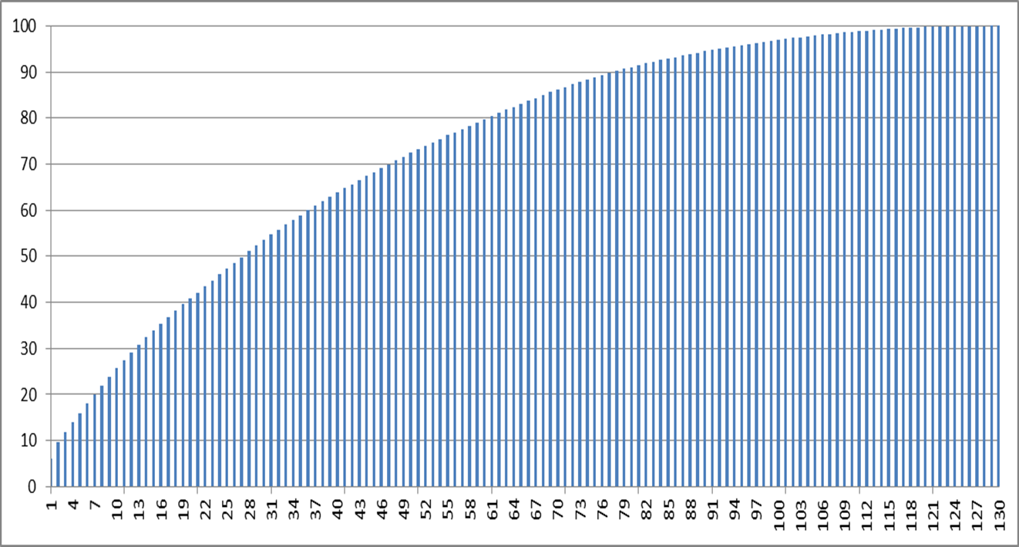
Cumulative share of employment in ISCO 3-digit occupations in EU, 2014
Half of total employment in 28 occupations
- 75% in 54
- 39 employed 5%
Alphametrics

Slide 5
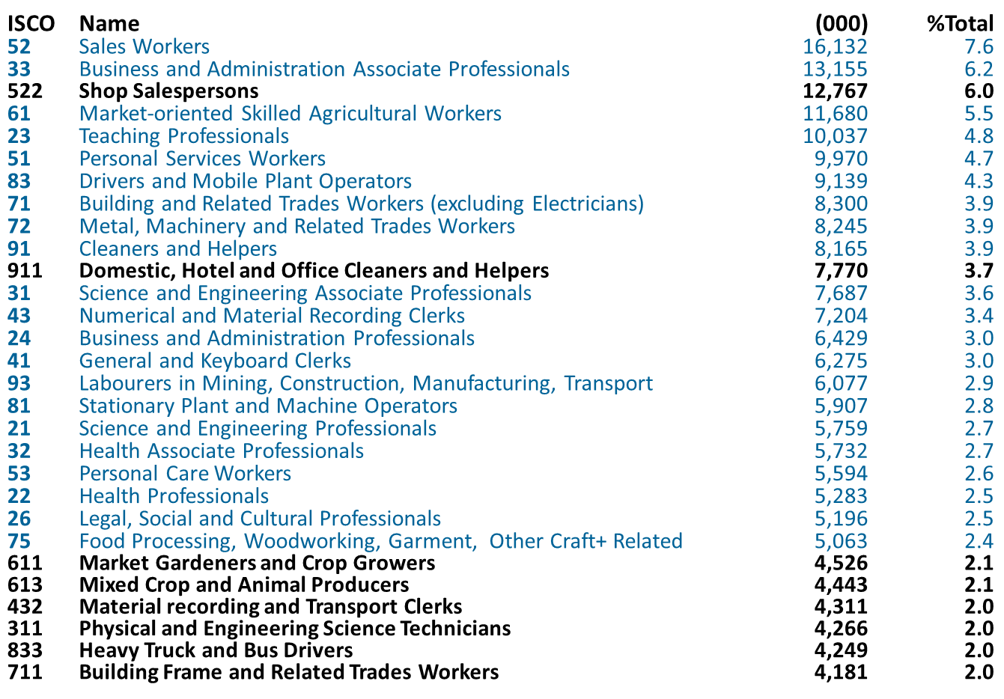
Mix of 2- and 3-digit occupations? – many 3-digit groups larger than 2-digit
Alphametrics

Slide 6
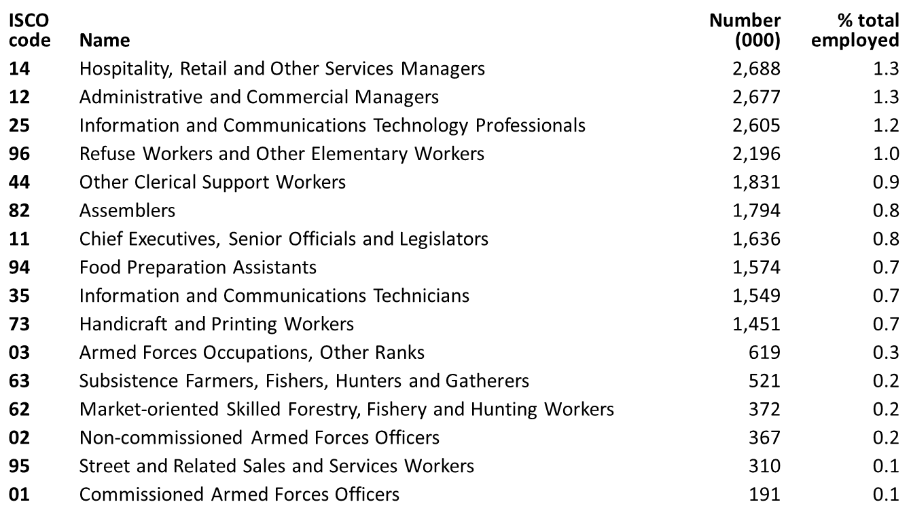
Mix of 2- and 3-digit occupations?
Many 2-digit groups very small:
- smallest 16 2-digit groups employed only 10% of total employed
in EU in 2014
- 6 with no 3-digit breakdown – other 10 divided into 24 3-digit,
each < 1% total employed
Alphametrics

Slide 7
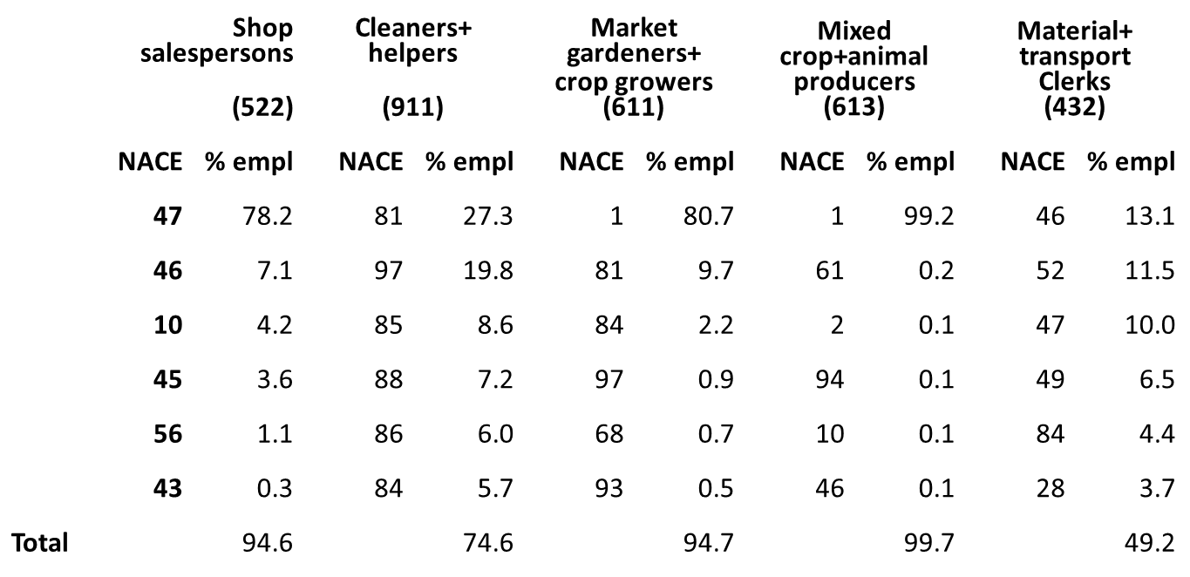
Sectoral concentration of occupations
Essential starting-point for projections is forecast employment
in different sectors
Employment in occupations highly concentrated in particular
NACE 2-digit sectors
Taking 5 largest 3-digit occupations:
Alphametrics

Slide 8
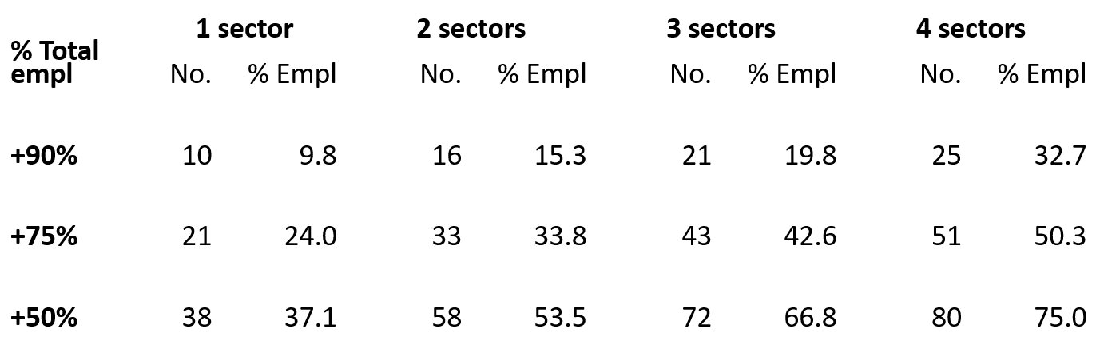
Sectoral concentration of occupations
In large number of occupations, most of employed concentrated
in only a few sectors…
E.g. 10 sectors, accounting for 9.8% of total employment
in which 90% or more of employed was in just one sector
Alphametrics

Slide 9
Sectoral concentration of occupations
Concentration of employment in occupations in a few sectors also evident in individual countries
To take 3 countries as examples…
May be that degree of sectoral concentration of occupations increases as size of countries declines because fewer sectors
Concentration means focus needs to be on only few sectors when making projections
Still need to project occupational shifts within sectors as well as development of sectors
% Total employed | Germany |  | Spain |  | Poland
 | No. | % Empl | No. | % Empl | No. | % Empl
+90% | 8 | 6.5 | 10 | 15.6 | 17 | 18.6
+75% | 13 | 11.6 | 20 | 28.4 | 23 | 29.2
+50% | 29 | 32.1 | 41 | 45.0 | 44 | 44.7
Alphametrics

Slide 10
Projecting employment in occupations
Task of projecting occupation breakdown of sectors complicated by change in ISCO – adoption of different philosophy plus reclassification of jobs by NSIs
Trends in structure of occupations evident before change may well not provide reliable guide to trends after change
But only short period of data since change - at present 4 years 2011-2015
Fluctuations in occupational shares suggest ‘teething problems’ of new classification – changes shown by data may be unreliable
Questionable whether makes sense to produce single set of projections of occupations for each alternative macroeconomic forecast
More useful – and fruitful – to produce variants on different assumptions about trend shifts within sectors – stimulate discussion on skill needs
Remains to decide on level of breakdown of occupations – strong case for mix of 2- and 3-digit division
Alphametrics

Slide 11
Projecting educational requirements
Change in ISCED - more disaggregation of education levels possible with new data:
  tertiary education split into 4 levels instead of two - short-cycle tertiary education (higher technical education, practically based and occupation specific) distinguished from standard university degree courses
  doctorates distinguished from other postgraduate education
Some NSIs reclassified programmes at upper secondary level (ISCED 3+4):
  apparent break in series in some countries in 2014 – may affect trends
New variable introduced into LFS to distinguish those with vocational education among those with upper secondary qualifications, but:
  only up to age 35 (or those obtaining qualifications <15 years earlier)
  all age groups reported in some countries doubts over reliability
Big differences in numbers concerned across countries
Alphametrics

Slide 12
Projecting educational requirements
New variable on vocational education needs investigation
Same applies to new data on ‘short-cycle’ tertiary education – together can potentially be used to identify those with VET qualifications
Also improvement in data on fields of study – claimed to be more coherent and comparable
Might be used to add further detail to education levels on areas of competence of work force as well as job requirements
But need examination to verify comparability, consistency and reliability
Work proposed on all above in coming year and beyond
In addition, detailed consideration proposed of possibility of using cohort approach to identify trends in education requirements over time
Education levels needed to do a job arguably reflected more in attainment levels of younger people employed than average levels of workforce
Trends reflected in changes in attainment levels across age groups…
Alphametrics

Slide 13
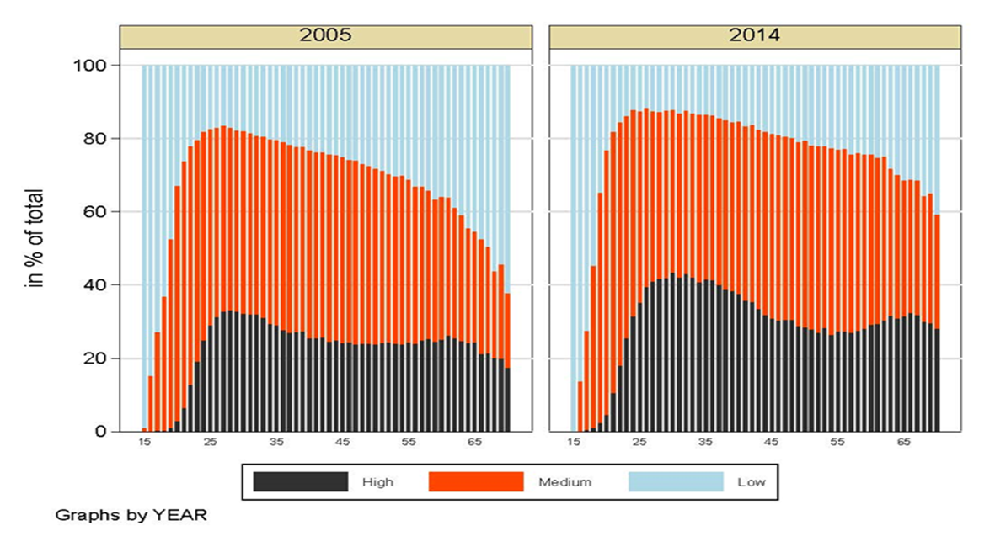
Projecting educational requirements
Clear education levels of people employed rising over time
Young entering employment more educated and older age groups become more educated as younger groups get older
Trend likely to vary across jobs – but seems important to consider when making projections of education (or skill) requirements – alternative to time series
Alphametrics

Slide 14
Conclusions: Occupations
More disaggregation of occupations desirable
But going down to ISCO 3-digit level poses practical problems without much gain
Mix of ISCO 2- and 3-digit seems way forward
Employment in most occupations concentrated in a few sectors
Reduces difficulty of projecting occupation trends
But change in ISCO classification means too short a period to identify trends reliably
Suggests need for alternative projections based on explicit assumptions of trends
Alphametrics

Slide 15
Conclusions: Educational requirements
More disaggregation of education attainment levels possible with new LFS data
Applies mainly to tertiary education
Those with VET qualifications distinguishable – but data reliability needs checking
Cohort approach provides potential means of projecting educational requirements
But more detailed investigation needed of different jobs (ISCO within NACE)
Alphametrics

Slide 16
Thanks for your attention
Robert Stehrer, wiiw
Terry Ward, Alphametrics
Alphametrics

