Slide 1

VET in Europe interactive tool:
planning for 2018
ReferNet Plenary meeting
29-30 November 2017
Session 11
Dmitrijs Kuļšs, VPS team

Slide 2

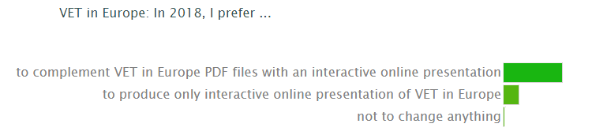

Slide 3
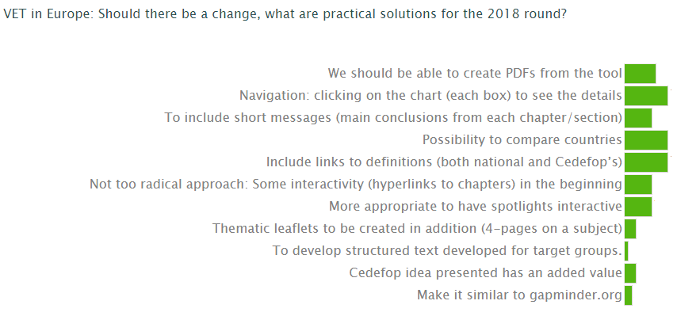

Slide 4
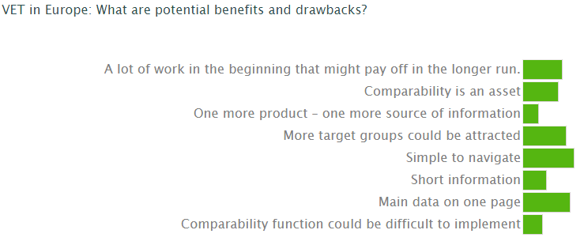

Slide 5
Interactive tool
Ex-ante evaluation (Feb-May)
Design of the interactive tool (July-December)

Slide 6
Ex-ante evaluation
Identification of the target groups and their needs through an online questionnaire
The questionnaire will be seeking to discover stakeholder expectations about the to-be-designed tool and its elements

Slide 7
ReferNet support
Fill in and submit the online questionnaire
In addition to ReferNet submission, identify 5-7 national stakeholders and ask them to participate in the survey (to send a link to the questionnaire with a short note in the national language(s))
Provide support/clarifications to the stakeholders; this may include assistance in translating questions/ answers
If needed, remind stakeholders of this exercise and ask them to submit responses to Cedefop

Slide 8
Questionnaire
Available for dissemination in February 2018
Data collection to be completed by April 2018

Slide 9
VET in Europe interactive tool:
planning for 2018
ReferNet Plenary meeting
29-30 November 2017
Session 11
Dmitrijs Kuļšs, VPS team

