Slide 1

ReferNet
in a nutshell
ReferNet Plenary meeting
Thessaloniki, 15-16 November 2016

Slide 2

ReferNet network
Notes:
2

Slide 3
Milestones
2002: Documentary network
2008-11: 1st Framework Partnership Agreement (FPA) – grant/broader work plan/consortium/national representative
2010: Internal evaluation
2012-15: 2nd FPA (focused on reporting)
2016-19: 3rd FPA (validation/quality tools)
2016: External evaluation

Slide 4
ReferNet actors - interaction?
National representatives
30 national partners
+ consortium
+ subcontractors
Cedefop

Slide 5
ReferNet national partners

Slide 6
National representatives
*Other Ministries: Ministries in charge of labour and social policies, employment, labour market and social affairs, national economy or Business, Innovation and Skills

Slide 7
SGA 2016
Framework
partnership
agreement
2016-19
SGA 2017
SGA 2018
SGA 2019
Notes:
7

Slide 8
Grant
Co-funding: Cedefop’s co-financing rate may not exceed 70 % of the eligible cost. Maximum amounts are further limited by country groups.
Eligibility of costs
Control (national audit + ex-ante operational and financial verification +ex-post control)

Slide 9
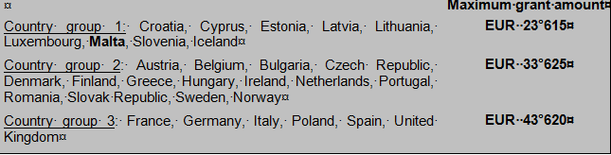
ReferNet grants by country group

Slide 10
2017 work plan
1
2
3
4
VET policy reporting
National news on VET
Spotlight
Article on outreach and guidance
+ 2nd article
Visibility actions…
…
including national ReferNet website and social media
IVET Mobility Scoreboard
.
Reporting on policy
Reporting on systems
Thematic support
Visibility actions

Slide 11
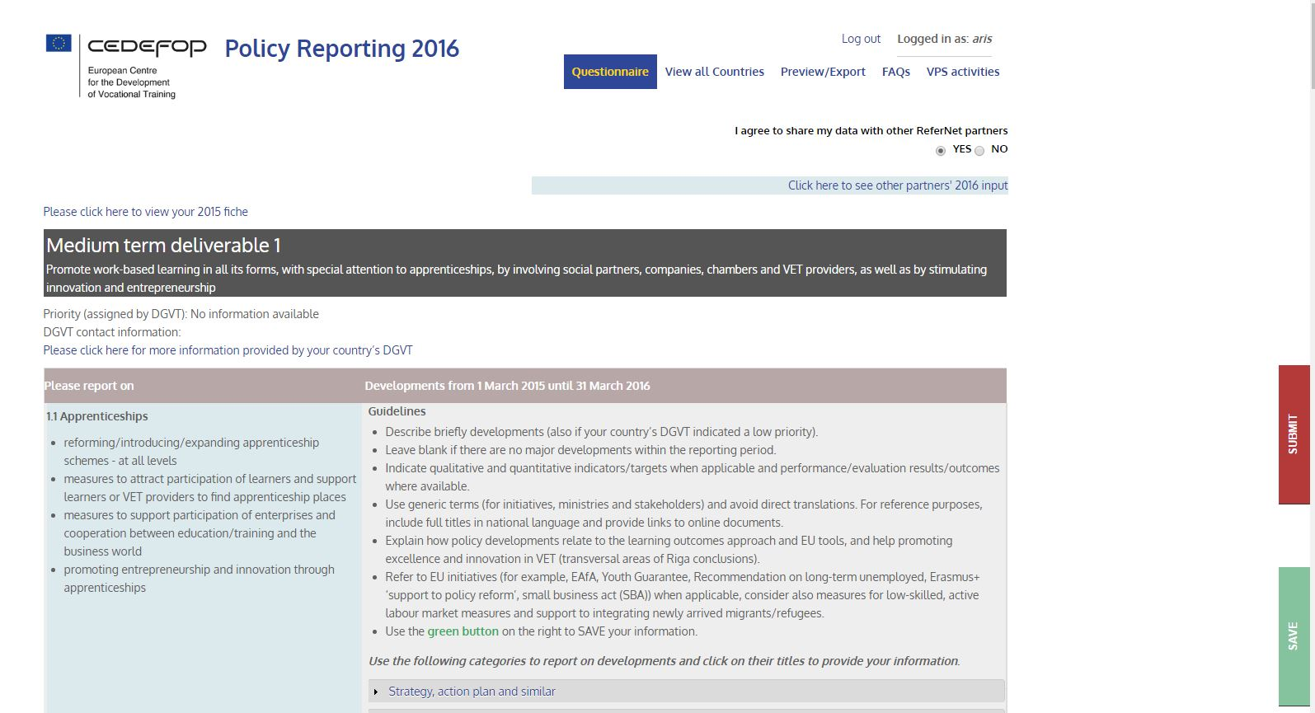

Slide 12
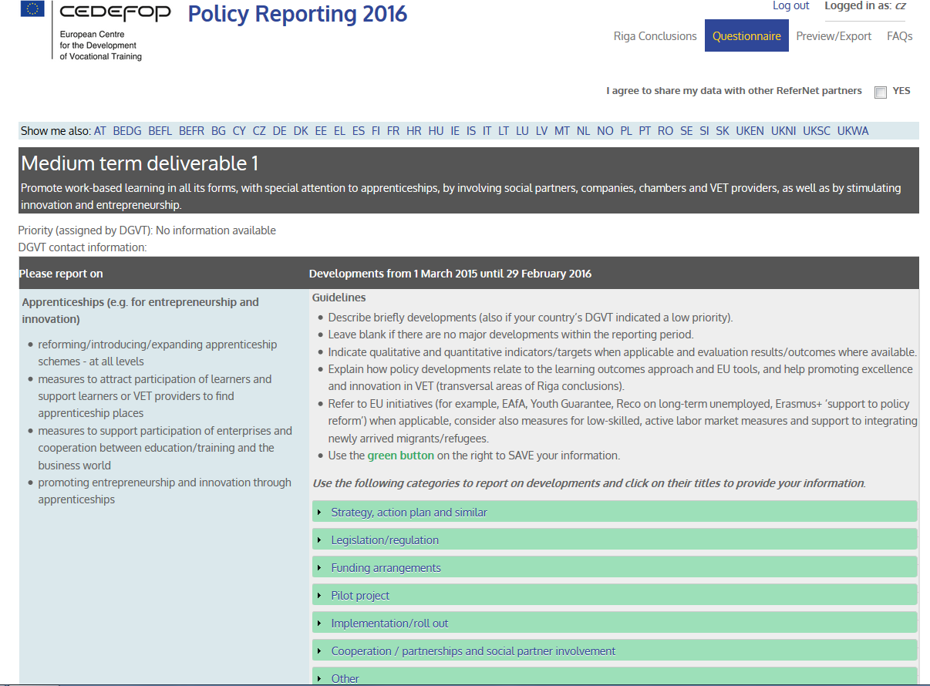

Slide 13


1b. National news on VET
http://www.cedefop.europa.eu/en/events-and-projects/networks/refernet/news

Slide 14


2. VET in Europe reports and Spotlights

Slide 15

3a. Survey on international mobility in IVET
Mobility Scoreboard

Slide 16
4a-b. Visibility actions
National ReferNet websites
National VET conferences including presentation of ReferNet deliverables
Articles
Social media
Marketing objects
…

Slide 17
Quality tools
Validation by the ‘national representative’
Peer review
Feedback by Cedefop experts
Visibility of outcomes
Communication (at individual and network level)
  Meetings (Plenary, Partnership forums, Workshops [Terminology, drafting, assistance to newcomers…], induction meetings)
  Extranet

Slide 18
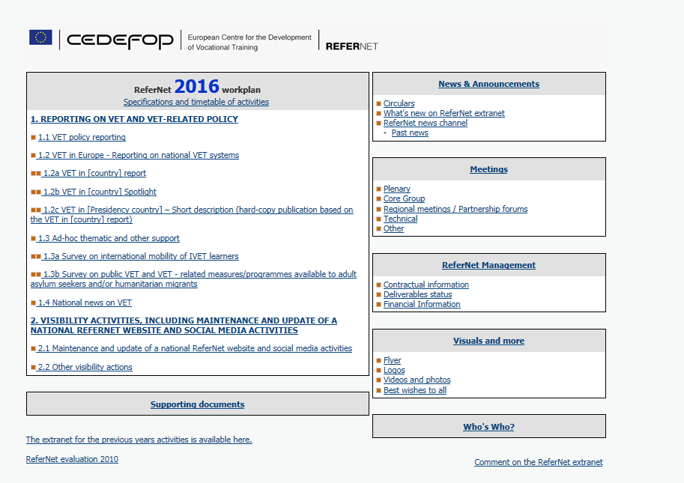
Could reporting be improved?
Key competences: Training VET teachers/trainers to help learners acquire key competences
Ministry of Education through its specialised unit offers annually training programmes and seminars to teachers/trainers who either are recently promoted to School Directors or act as mentors to learners.
Are VET teachers/trainers included in this group?
Do these training programmes include training on how to help learners acquire key competences?

Slide 19
Questions?
External evaluation 2016
Efficiency? Effectiveness?
Funding?
Commitment?
…

Slide 20
Thank you!
Enjoy your stay!
Sylvie.bousquet@cedefop.europa.eu

