Slide 1
Establishing a lifelong learning culture
Irish Context and National Initiatives
Barry Ryan
4th December 2020

Slide 2
Enabling a Lifelong Learning Culture
Lifelong Learning
Strategic Enablers
Staffing, Capabilities and Structures
- Future Staffing Framework
- Quality Cross-FET Provision
- Cross-FET Funding/Guidelines
- Professional Development
Learner and Performance Focused
- Performance Framework
- Measuring Distance Travelled
- Learner Engagement
Digital Transformation
- Learner Access and Delivery
- Data Driven
- Management Systems
Capital Infrastructure
- Consolidate Provision
- Flagship Developments

Slide 3
Skills to Advance https://www.solas.ie/programmes/skills-to-advance/
Skill to Advance was developed in response to evolving skill needs and remains central to assist those facing changes in their work due to technology advances, changing work practices and market diversification.
STA incorporate digital, socio-emotional and technical skills development to enhance employee skills and support increased productivity in Irish SMEs.
The focus of developing skills is to future proof our workforce in vulnerable occupations, businesses and sectors is centre to the core mission of the Skills to Advance Initiative. Recent events only highlight that those in vulnerable sectors run the risk of being most impacted and need to be engaged in life-long learning to reduce their vulnerabilities.

Slide 4
STA achievements for 2020
(preliminary figures as of November) are as follows:
Total STA Learners 8,264 (127 % achievement against target)
Over 1,000 training programmes delivered
Profile of employees 61% female, 66% are aged in the target group 35-65 years
Key programmes in healthcare support, management, early childcare support, business administration and ICDL, with pans to expand to the Hospitality sector, Green skills and further ICT developments.

Slide 5
E-College https://www.ecollege.ie/
eCollege is a National Online Learning service providing online courses on a continuous intake basis that facilitates a flexible learner centred approach to training delivery.
Courses are supported by online eTutors and are certified through test centres distributed around the country. (E-badging is in consideration)
eCollege courses are free of charge to participants and include all courseware, software and certification.
Typically, over 500 jobseekers per month avail of this opportunity that are referred to eCollege courses through the Dept of Social protection.
An additional 2,300 staff employed within VET and employed individuals that qualify under the STA initiative also avail of eCollege courses.

Slide 6
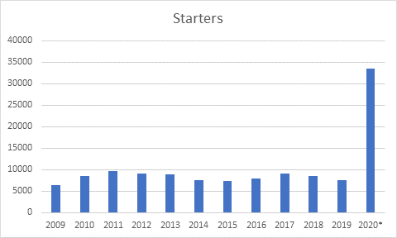
Impact of Covid-19 on E-College enrolments
As a result of the state’s response to the Covid-19 pandemic, all eCollege courses were made available to everyone in the country free of charge.
To date (November 2020) over 33,500 people have responded to this lifelong learning opportunity and commenced eCollege courses.

Slide 7
Other National Lifelong Learning initiatives
Service to Business – Each region has a Local Business support service
Regional Skills Fora – Enable employers to connect with the range of services and Research.
Skills to Compete - A SOLAS initiative aimed at reskilling and retraining those effected by Covid-19 by combining three strands of FET provision, linked to tailored advice and support.
Social Partnerships - Supporting SMEs to identity training needs and Innovation
Community Training delivered through Community Training Centres
Return to work schemes aimed at specific target groups (Youthreach/BTEI)

Slide 8
Funding Lifelong learning
Direct Investment from Department of Education
In 2020 direct investment from government* into Higher and Further Education was increased by €153m and of this €11m is dedicated to Lifelong learning initiatives.
National Training Fund
Employers are obliged by law to contribute a fixed share of payroll (1%) to a training fund. This dedicated fund supports the training of those in employment, and those seeking employment. In 2020 this fund was increased by €74m with over €35m allocated to VET.
Covid 19 Stimulus package
Under the Government's July Stimulus Package 5,000 VET places will be refocused through Skills to Compete with and additional 4,000 fulltime VET paces will be provided. The skill to Compete will continue in 2021 with plans in development for and additional 50,000 places over 2020 provision.
* https://www.education.ie/en/Publications/Corporate-Reports/Financial-Reports/Estimates/2020-budget-main-features.pdf

Slide 9
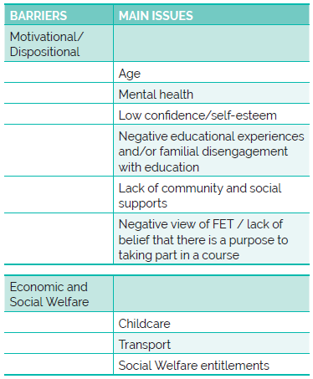
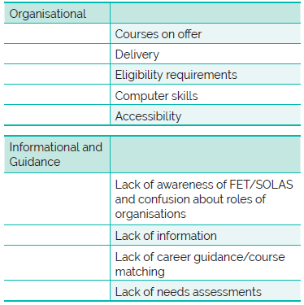
Extrinsic and Intrinsic Barriers to Participation to Lifelong
Learning

