Slide 1
Post-2020 vision and priorities for VET in Ireland
Barry Ryan
4th December 2020
Notes:
Hello everyone my name is Barry Ryan I work in the vocational and training authority in Ireland (SOLAS)
My role is in Strategy and Policy development of vocational training in Ireland.
I have a brief Overview of our Vet strategy which was published earlier this year and I draw some parallels to the Osnabrück Declaration.

Slide 2
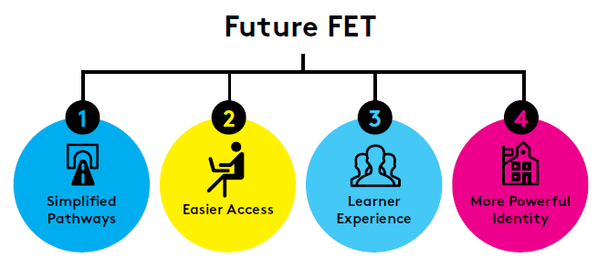
Notes:
Irelands post 2020 Vision for VET involves change.
Reform is needed to meet the needs of the future world, the changing working environment, Automation, Digital transformation and the evolving needs of economy to address climate change and modern society.
Irish Vet is focusing on 4 main areas of change in the years ahead.
Vet in Ireland must:
simplify its structure and learning pathways,
facilitate easier access,
ensure a more consistent learner experience
and build a more powerful identity within communities and potential learners.
VET in Ireland must be reinvented - rebranding is needed - It must become louder and prouder, with more and more people of all ages becoming aware of the opportunities to learn, develop and progress at local level.
There is a real opportunity to grow the VET contribution to a more collaborative and cohesive, developing tertiary education system for Ireland.

Slide 3
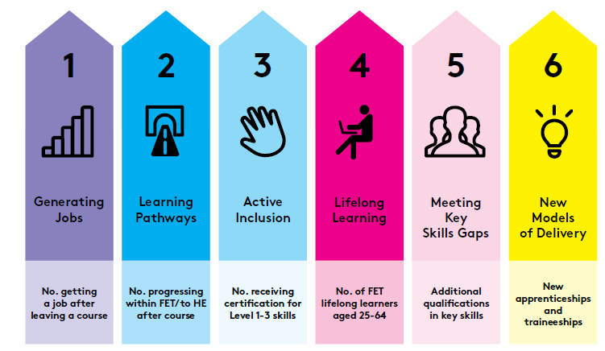
Notes:
The national FET system targets, incorporate 6 core benefits that FET should be able to offer learners:
A better chance of a job;
The opportunity to progress to other education and training;
The transversal skills that will allow them to integrate and engage effectively with society;
A means of accessing education throughout a lifetime; vocational skills that are linked to regional and national critical skills requirements;
And new models of delivery which can meet their rapidly evolving needs.
All of these measures of learner outcomes and employer perspectives are vital to understanding the impact FET provision has for learners and the wider economy.
However it is also important that we measure the wider benefits of learning from FET, and those which have impact, in particular, at an individual level for the learner.

Slide 4
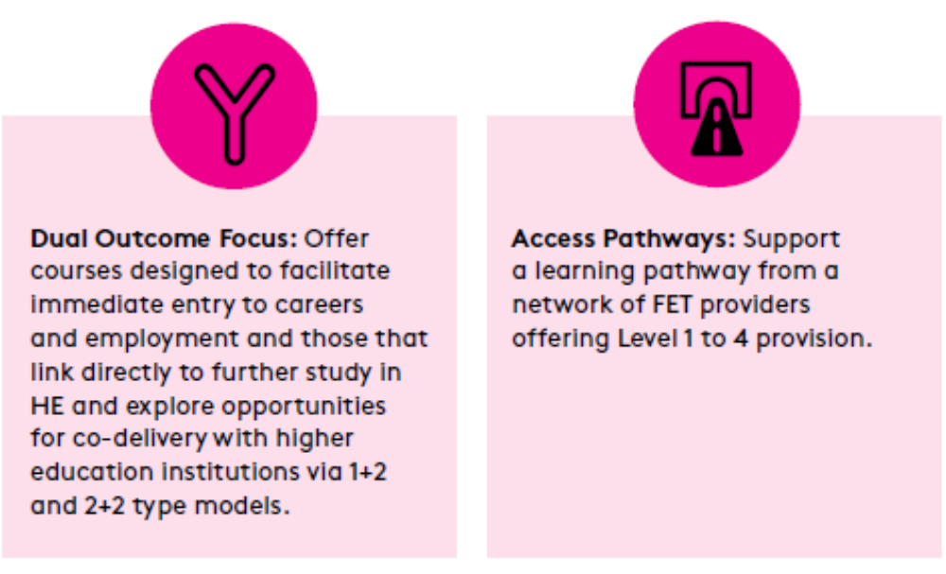
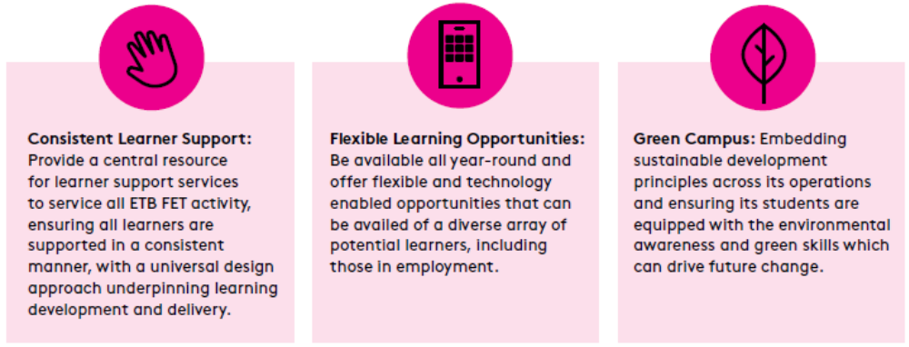
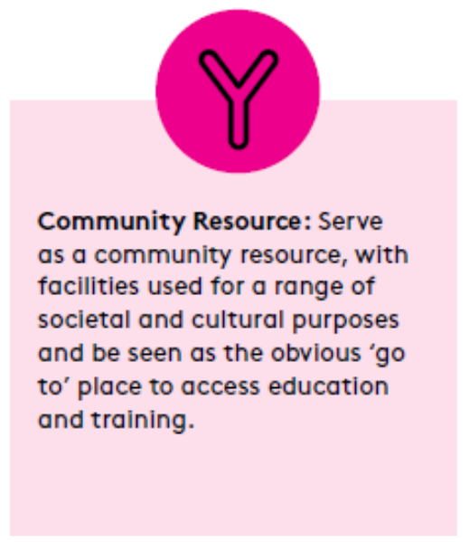
The FET College of the Future
The key to successful development in relation to skills, pathways, and inclusion of VET for the future will be the evolution of FET facilities and provision into a distinct integrated college of Further Education and Training that can serve as a beacon of community-based learning excellence which will highlight the value of further education and lifelong education in Ireland.
We believe the VET college of the future should have the following characteristics:

