Slide 1
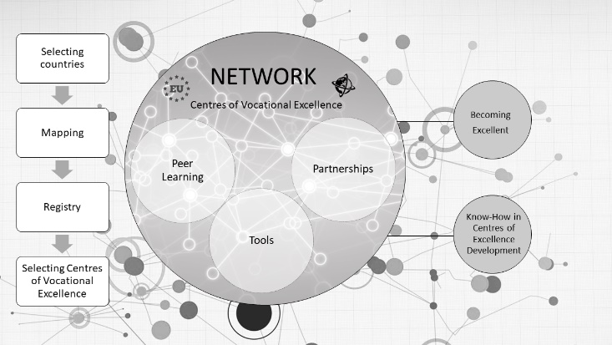

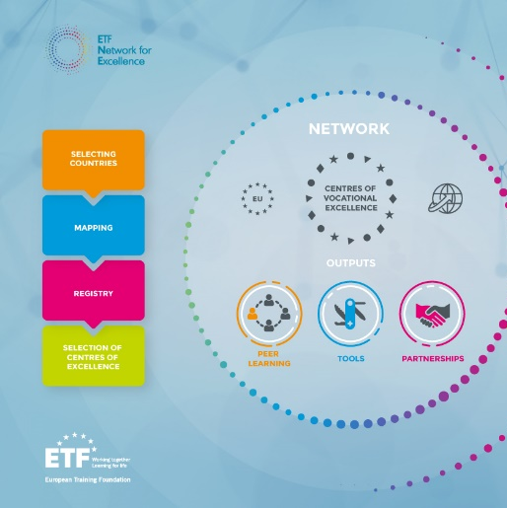

Internationalization of VET
CEDEFOP - ReferNet Meeting
2 December 2020
By Georgios Zisimos, ETF

Slide 2









ETF: an EU Agency with international perspective
- The drivers of change
Human capital a priority for EU external assistance under the new MFF 2021-27
Change of vocational education and training systems
Technological and digital change
Globalisation and connectivity
Paradigm shift towards lifelong learning
Demographic shifts
Climate change
Notes:
Over the last decade, emerging trends in technology, digitalisation,
climate change, migration and globalisation have driven immense change
in our societies and economies.
There is a consensus on the need for a paradigm shift towards lifelong
learning with more flexible pathways that combine both formal and
informal learning, hard and soft skills.

Slide 3
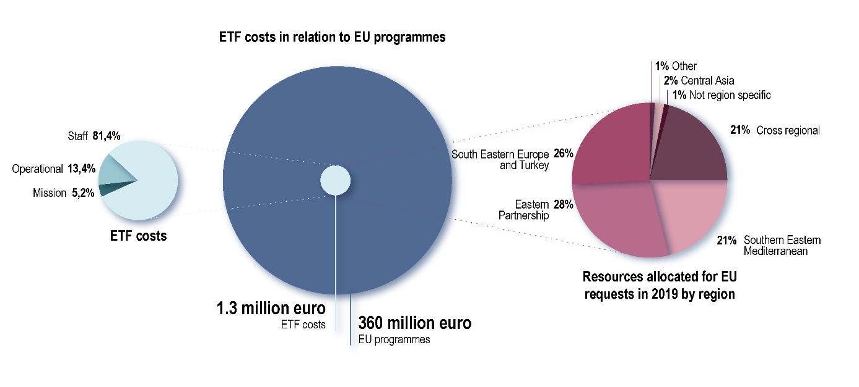
ETF working globally - Support to EU assistance
ETF expertise was used in the identification, formulation, implementation, monitoring and evaluation of European Union external programmes in skills and human capital development amounting to approximately €360 million at a cost of €1.3 million.

Slide 4

Support to the African Union / European Union programme Skills for youth employability
The Skills for Youth Employability signed in May, at the EU Delegation to the African Union.
ETF has been tasked to support output 5 of the African Union initiative, African Continental Qualifications Framework (ACQF), based on ETF’s expertise and involvement in the EQF Advisory Group.
ETF provided advice, drafted, and prepared proposals, as well as knowledge exchange and provided support to the AUC.

Slide 5



Centres of Vocational Excellence – Our initiative in numbers
More than 15 CoVEs from inside and outside EU are involved already in our Partnerships
17 partner countries have been invited to join our Network of CoVEs
More than 40 CoVEs registered since March in our Network
A self assessment tool for 8 Dimensions of Excellence is ready to be tested
Several publications have been produced
A Mapping exercise in 12 partner countries was completed in 2019

Slide 6
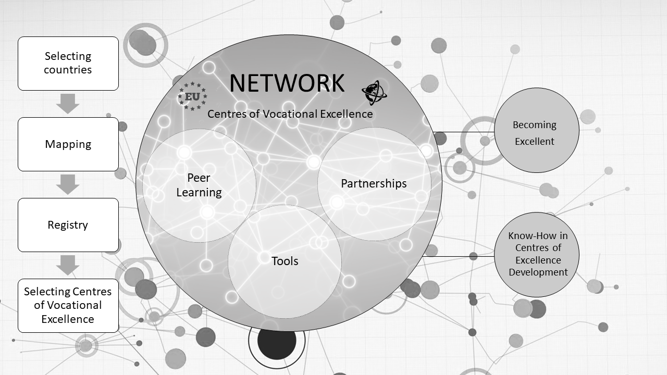

Slide 7
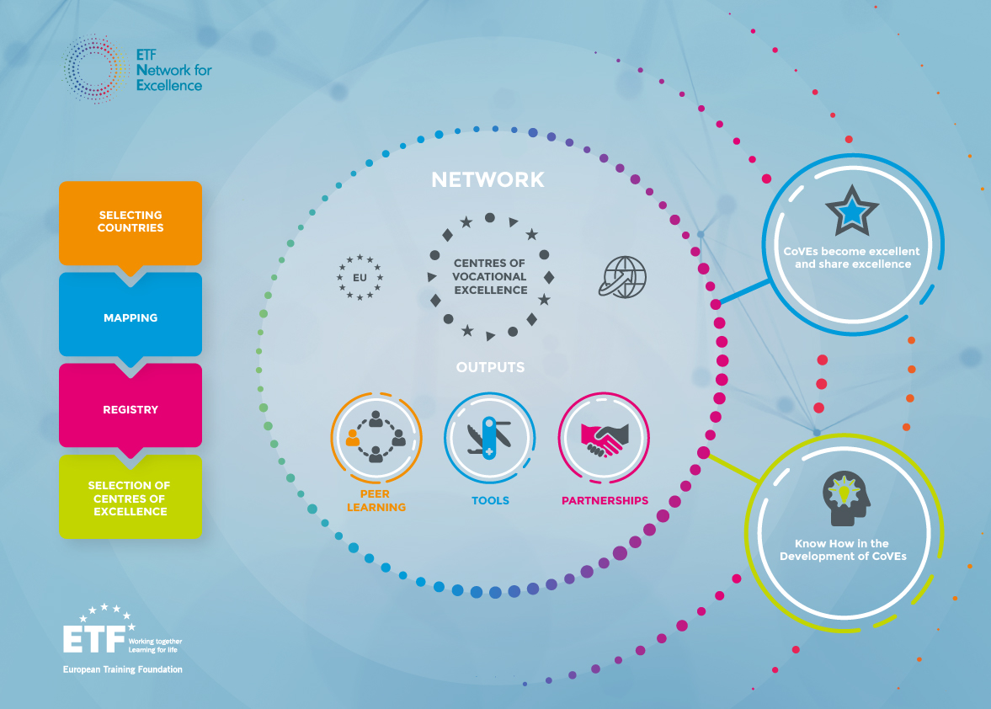
Thank you for your attention
Visit our dedicated space in:
https://openspace.etf.europa.eu

