Slide 1

Machines, robots, people and skills: are we ready for the future of work?
ReferNet informing VET developments in Europe
16th ReferNet Annual Plenary Meeting
Thessaloniki 22 November 2018
George Kostakis, Expert
Department for VET systems and institutions, CEDEFOP

Slide 2
Outputs concerned
Short descriptions
& VET in Europe country reports
Spotlights on VET
Policy reporting country chapters & synthesis reports
National news on VET
Thematic perspectives

Slide 3
Use of ReferNet information
Informed discussions in 42 high level events in 2012-17:
  DGVT & ACVT meetings e.g. reporting on European Cooperation in VET
  ET2020 WGs e.g. thematic perspectives
Contributing to work on the European semester, E&T Monitor
Distributed in 25 EU presidency events in 2012-17
3
Notes:
3

Slide 4
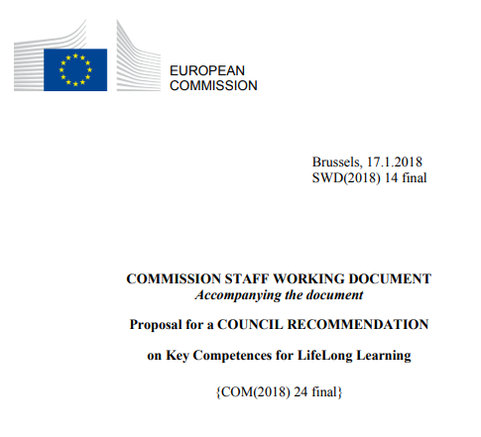
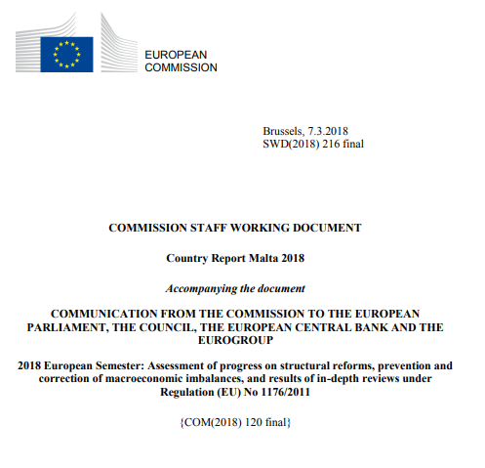




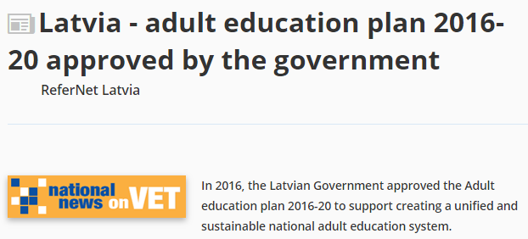

Examples of references in policy documents
4
Notes:
4

Slide 5

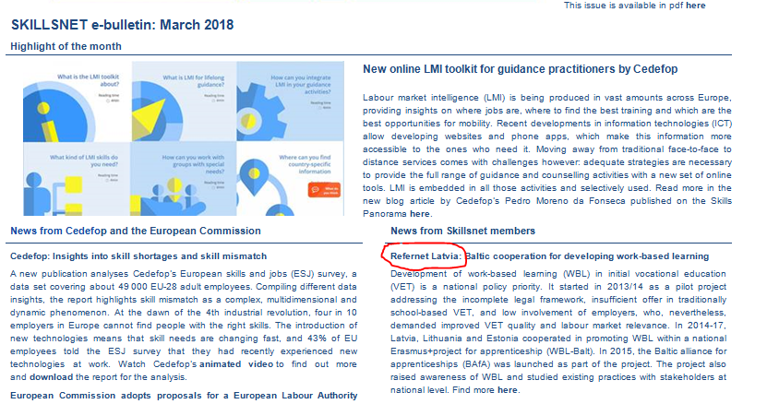

National news on VET
174 national news on VET published in 2018
  On Cedefop website
  The Skillsnet e-bulletin
  Cedefop’s magazine
  Cedefop project pages

Slide 6
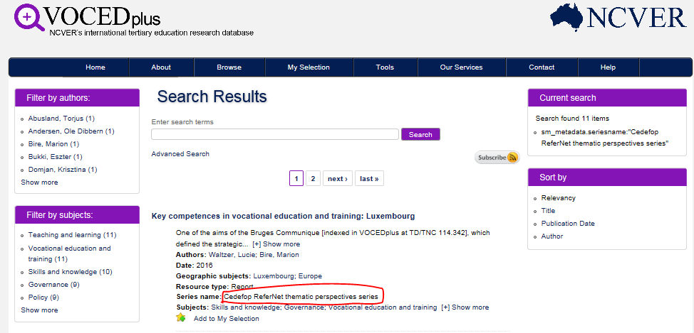
More evidence of ReferNet informing VET developments in Europe and beyond

Slide 7
ReferNet visibility survey 2014-17
Spotlights from other ReferNet partners were used to prepare for study visits funded by an EQAVET-project
We have used a number of VET in Europe country reports to gather information relating to Erasmus+ projects. Reports used included the latest country reports from Estonia, France, Greece, Ireland, Italy, Norway and Portugal.
Reports from Austria, Denmark, Finland, Germany,
Poland, Spain were used to produce a synthesis
about the apprenticeship systems in Europe

Slide 8
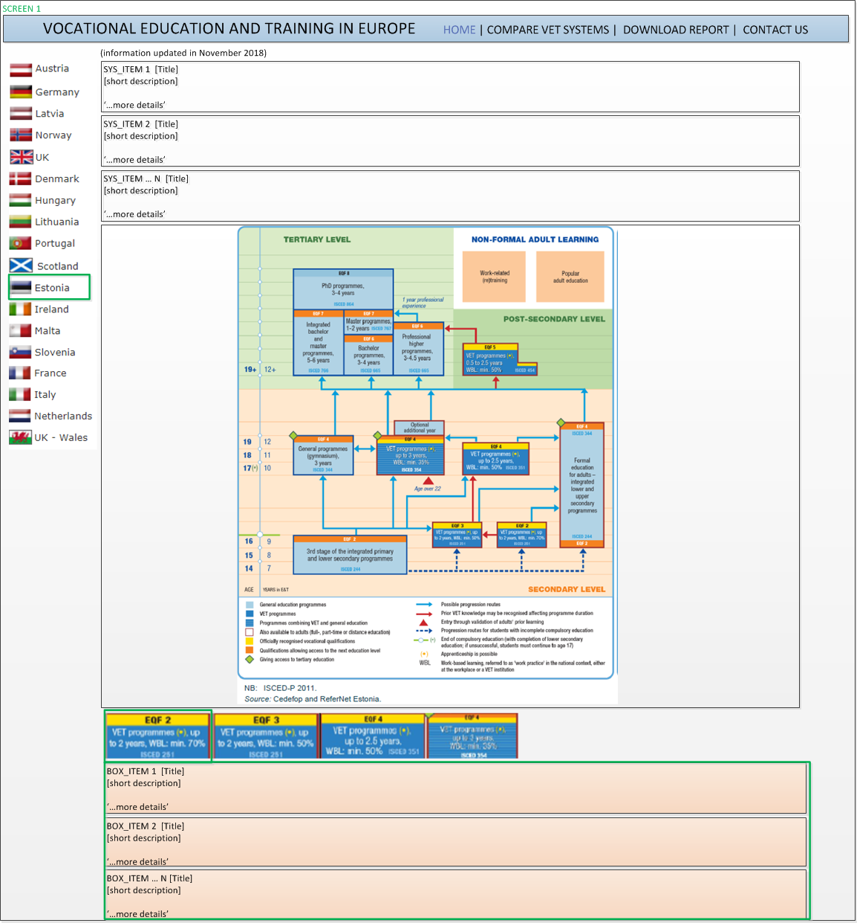

Future plans:
Better access to information
Consult a country’s VET system online
Contrast it with another system
Export relevant information

Slide 9
Thank you for your attention
www.cedefop.europa.eu
George.kostakis@cedefop.europa.eu

