Slide 1
In AMO (Ability, Motivation, Opportunity) Opportunity is key!
Frank Pot, Radboud University, TNO, EUWIN, Webinar Cedefop 27 April 2023
Results in line with previous research Cedefop and Beyond 4.0:
Learning on the job is as important as education and training.
Learning opportunities through job design and work organisation:
autonomy, problem solving, teams, organisational participation.
Behaviours of management and employees are largely a derivative of the structure of core work processes (division of labour) and the associated control structure; culture follows structure.
The recommended job design choices are the same as in EWCS and consistent with the EPSR Action Plan, encouraging governments and social partners to foster workplace innovation.

Slide 2
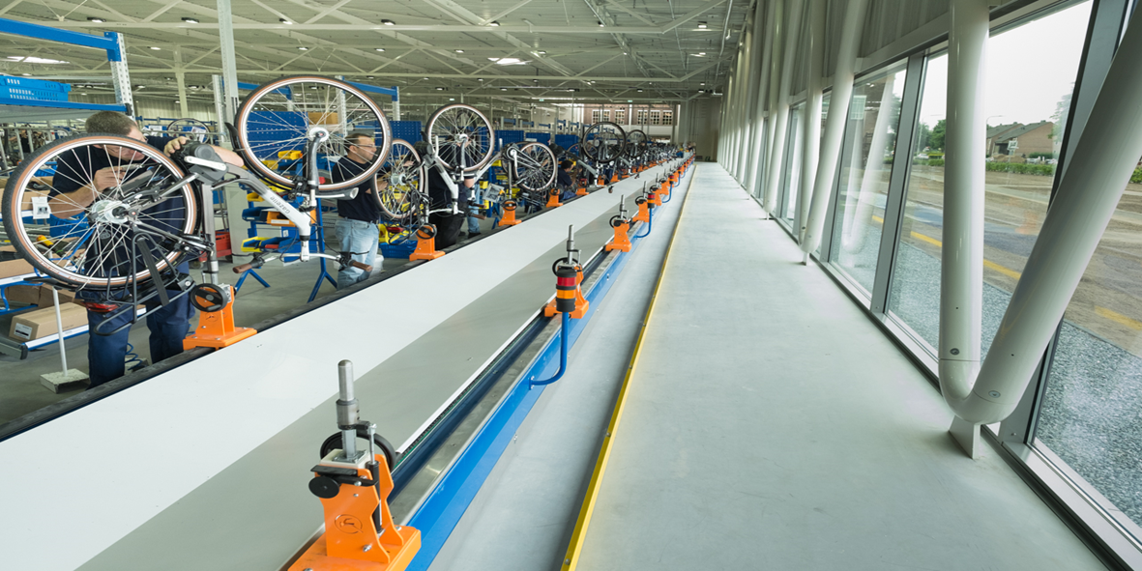
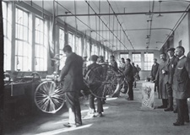
Gazelle (NL): Repetitive work, 90 sec, 2015, 1925

Slide 3
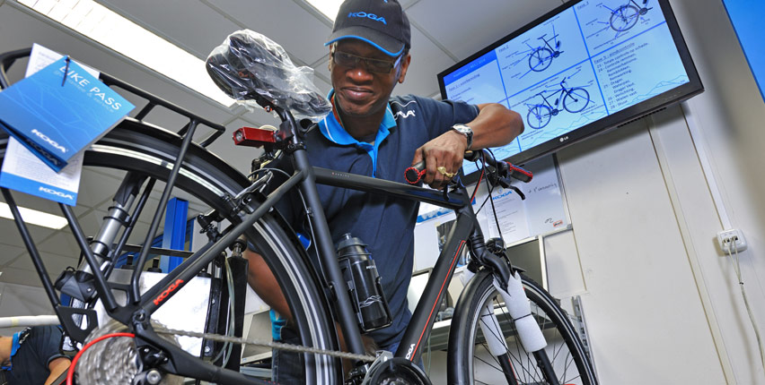
KOGA (NL): Manufacturing the whole bicycle

