Slide 1



Making accessible the ReferNet deliverables
REFERNET PLENARY MEETING
22nd November 2018
Thessaloniki
Ms. Judit Gömöri Olasz
ReferNet project coordinator Hungary

Slide 2


When we were thinking on how to make more accessible the ReferNet deliverables, first we defined the features and characteristics of the project, which helped us to shape better our dissemination and visibility activities:
it collects information on national VET policies and systems for its promoter, the Cedefop;
through its deliverables gives an insight about how the EU VET strategies are implemented on the national level;
it targets mainly VET stakeholders of EU countries;
it is a network connecting EU countries, it does not have an institutional
network within the country;
it is not connected to a specific field of VET
(eg. career orientation, dual VET, etc);
it comprises all VET fields;
it can be a VET networking platform.

Slide 3

When we planned the dissemination and visibility actions we were thinking of:
what are the specific features of NOVETAL;
what are the expectations of the Hungarian audience;
what we would like to disseminate;
why we would like to disseminate;
who can be the target group;
which impact we desire to have.

Slide 4

What are the specific features of NOVETAL?
NOVETAL, the institution involved in the ReferNet network in Hungary coordinates the functioning of the 44 VET centres. More than 386 (in academic year 2018/2019) vocational upper secondary schools fall under the responsibility of the institute; (we can reach easily students, teachers, career orientation experts, etc)
NOVETAL coordinates the national career guidance activities referring to VET, develops the draft NQR and the framework VET curricula;
NOVETAL is the appointed national reference point for ECVET and EQAVET as well, the office coordinates lots of national and international projects related to VET and AL;
This is important because we can disseminate our deliverables easier if we can link it to the activities of our Office, like EUROGUIDANCE project to the coordination of career guidance system, EQAVET to quality assurance, EPALE to adult learning. According to our experience it is crucial, if we would like to make more accessible our deliverables, to link them to a certain VET or AL field.

Slide 5
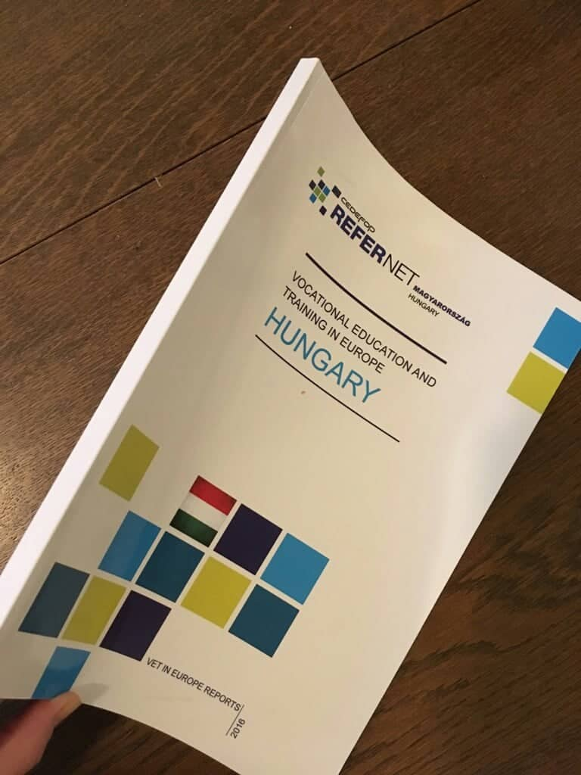

The expectations of the audience in Hungary are:
disseminating Cedefop’s researches, reports, studies and forecasting in Hungarian language;
disseminating information on EU member states’ VET systems (assistance from other countries to feasibility studies, development and implementation of new policies and projects, etc.);
making available Hungarian VET materials in English language (e.g. hard copy publication of VET deliverables, national website, newsletters, etc.);
giving a platform to the Hungarian VET stakeholders (including teachers and students) to show themselves (i.e. Cedefop Photo Award).

Slide 6
Based on the above mentioned, we have agreed that:
we would like to disseminate the ReferNet project, its deliverables and Cedefop’s activities (researches, forecasting studies, public opinion surveys);
we would like to provide information available on other EU countries’ VET system in Hungarian language, and English language materials on the domestic VET system;
the target group is: VET policy makers, experts, teachers, students and adults involved in VET programmes, economical stakeholders, social partners;
we would like to make available the Hungarian VET developments in English language, and EU VET strategies, developments, systems and forecasts in Hungarian language.

Slide 7
How can we implement this?
Newsletters:
How do we build up its content?
we translate and disseminate events organized at or by Cedefop;
we present an interesting article, research or forecasting written by Cedefop;
translation from the Spotlight, presenting in each newsletter another EU country’s VET system in Hungarian language;
we present Hungarian VET related news and events.

Slide 8
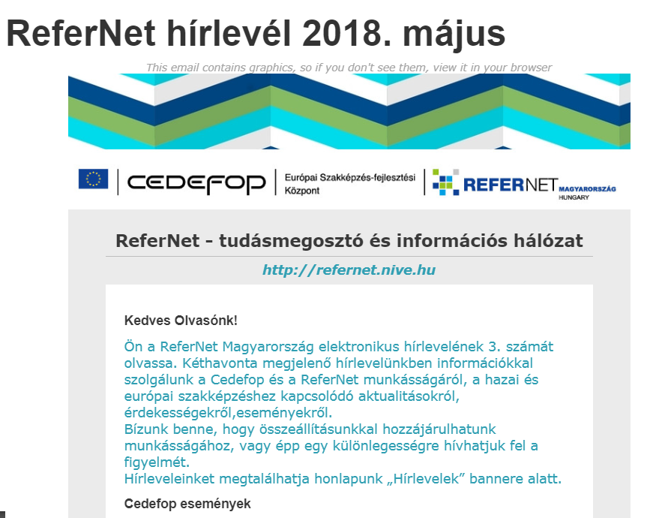
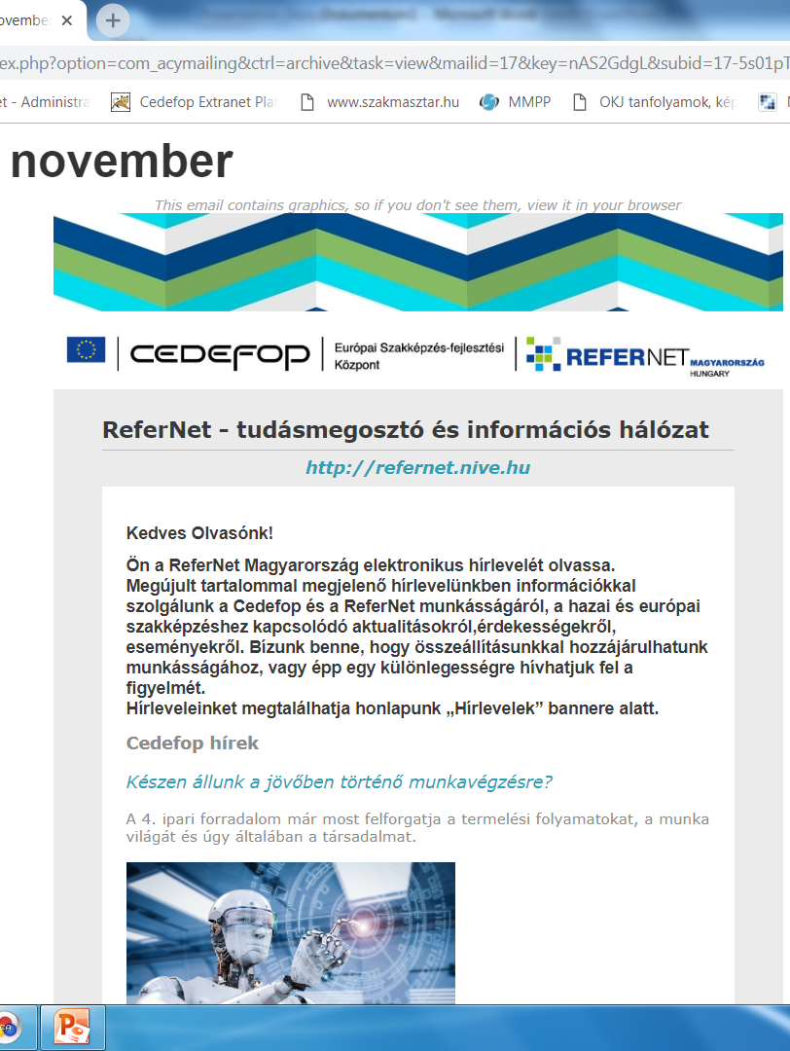
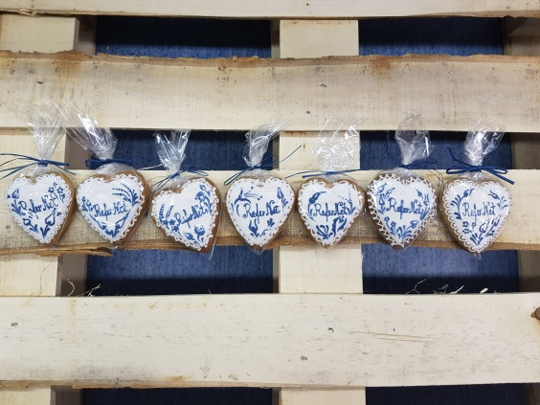
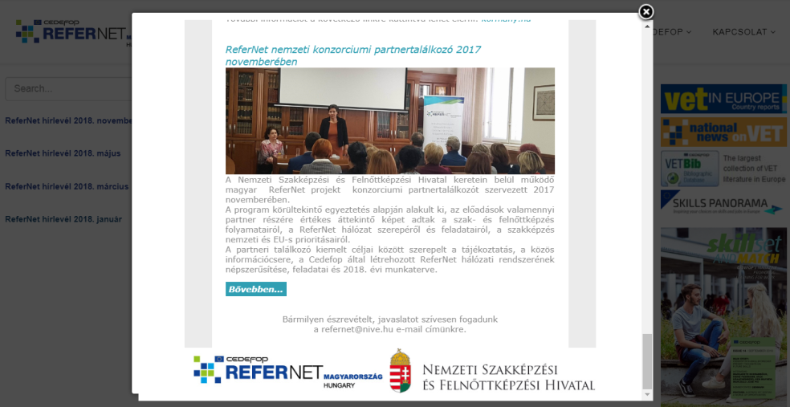

Slide 9
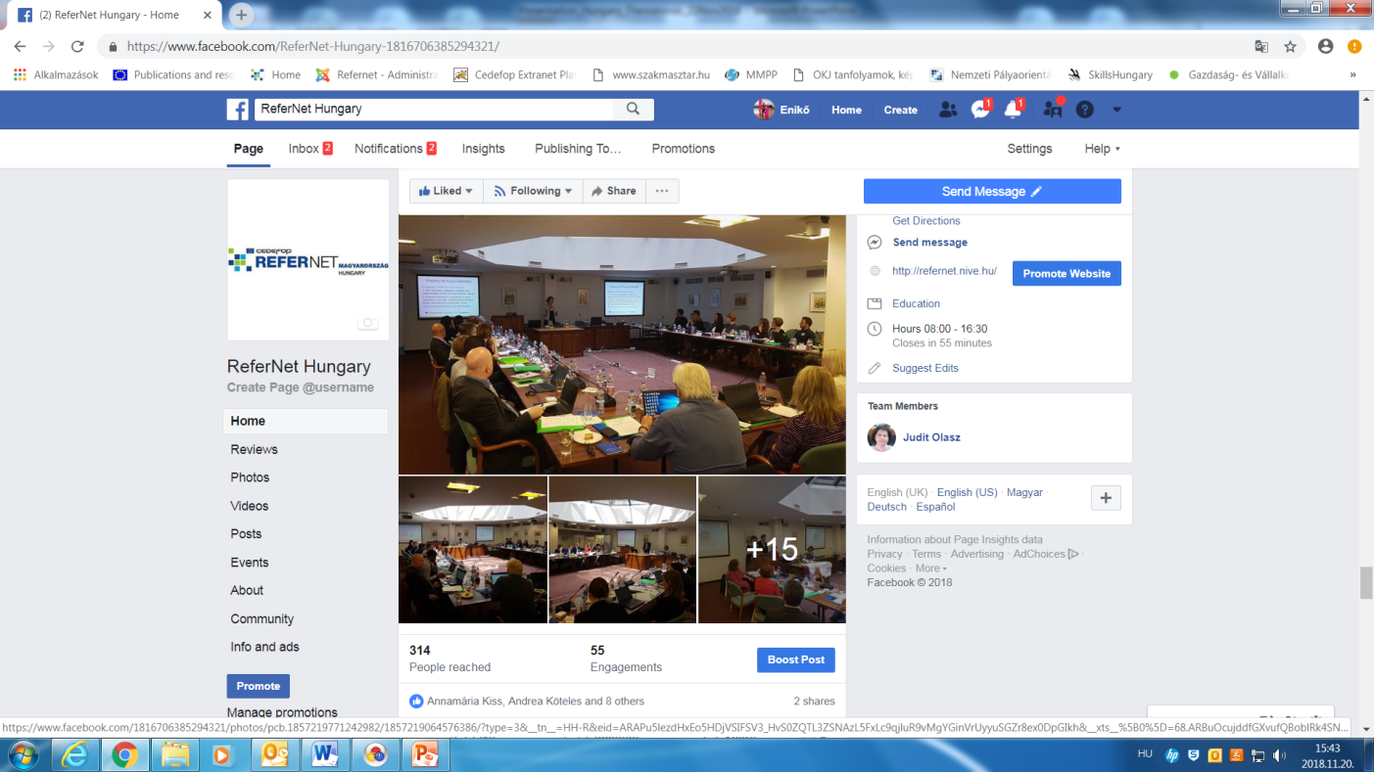
Facebook:
we try to connect to other projects, disseminating in an informal way our and their activities, It targets young people to, it was a great help in voting for the Hungarian team at the Photo Award, and disseminating the competition.

Slide 10

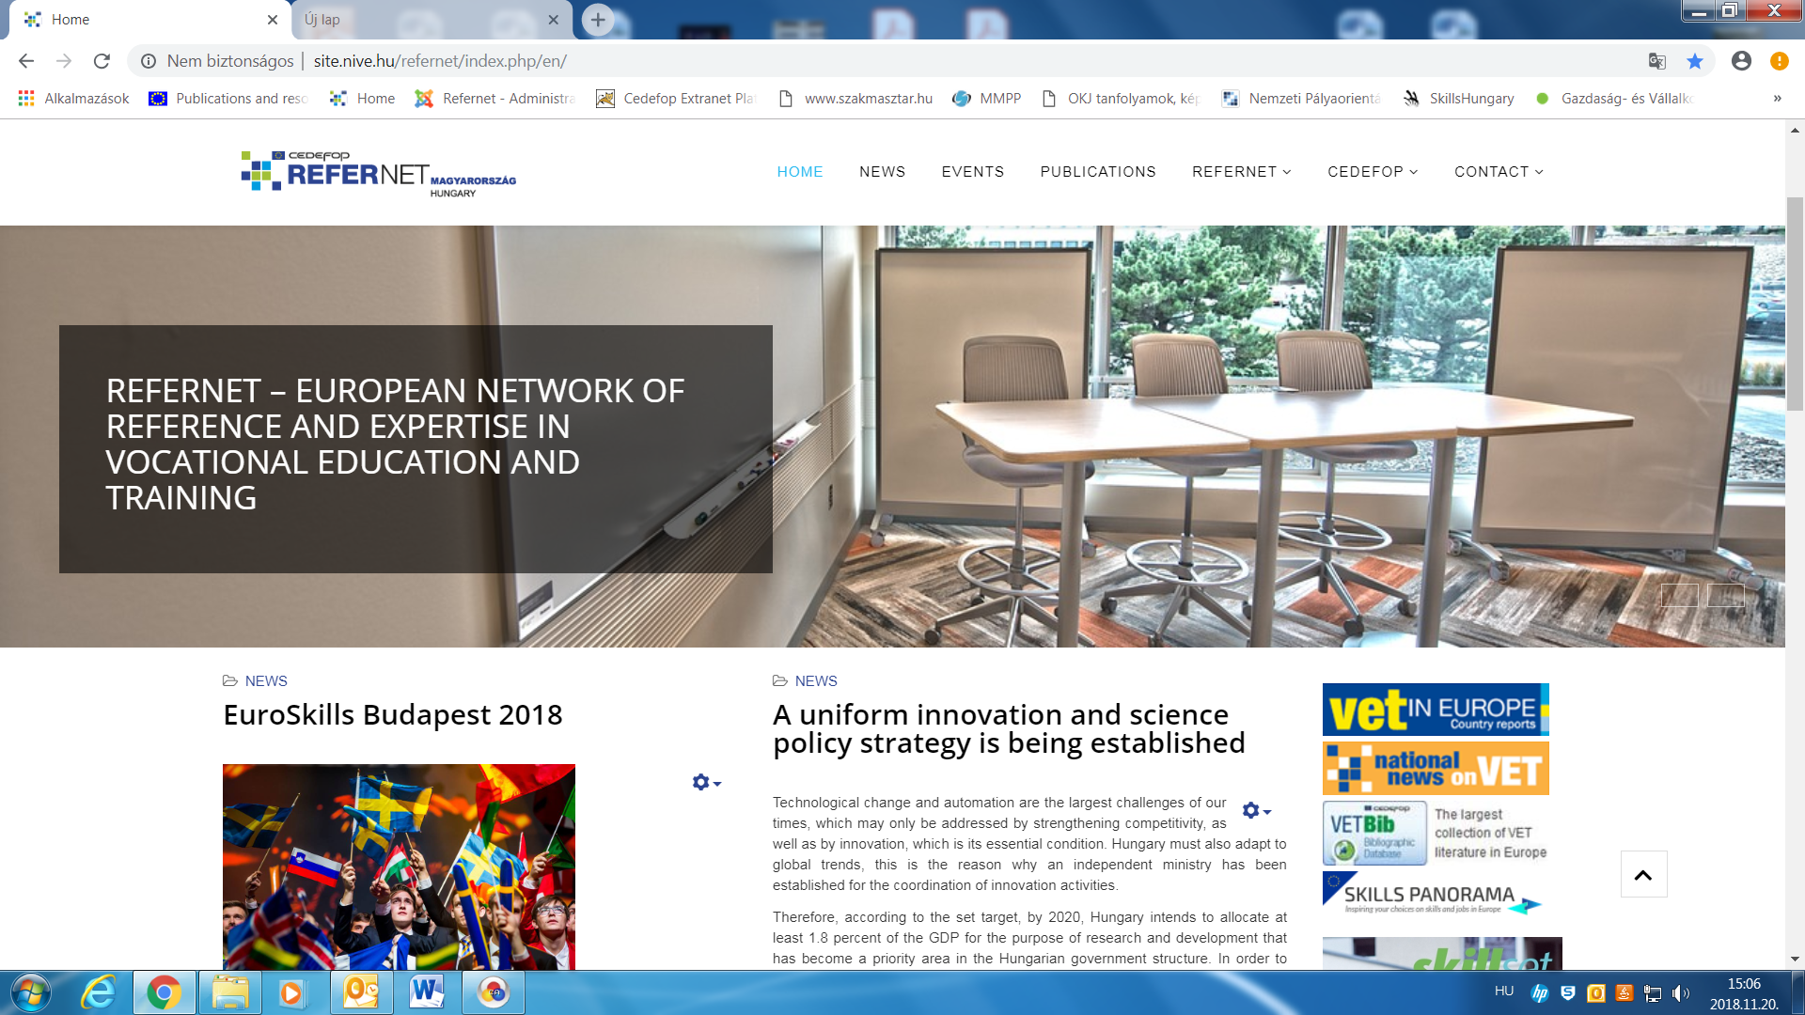

ReferNet website:
a source of Hungarian VET materials available in English language;
a source of ReferNet deliverables in Hungarian and English language;
a source of information about Cedefop’s activities, news and events;
a source of information on VET related Hungarian news and events;

Slide 11

Other channels of dissemination:
events disseminating ReferNet’s and Cedefop’s deliverables;
studies and reports citing from the ReferNet deliverables;
Euroskills Hungary 2018

Slide 12
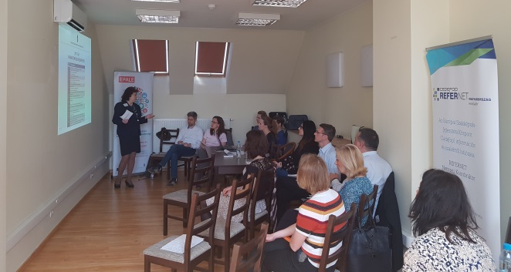
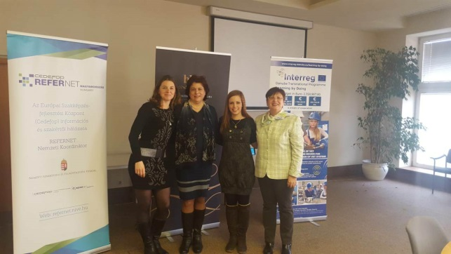
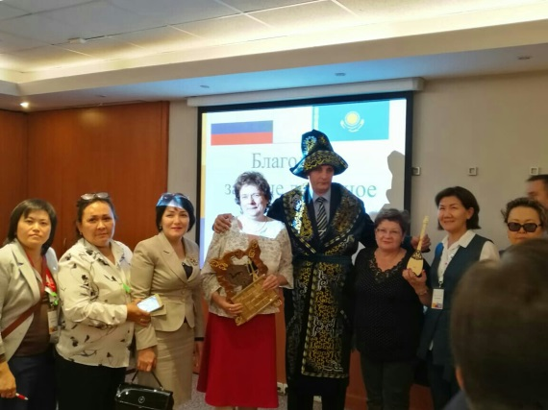
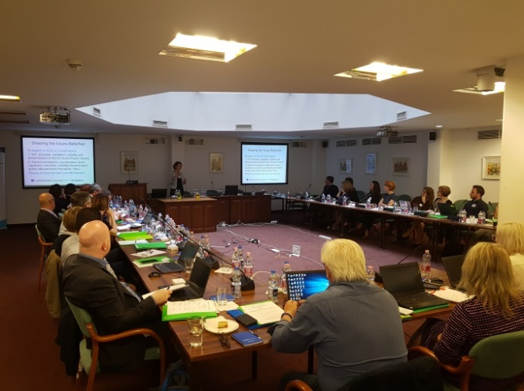
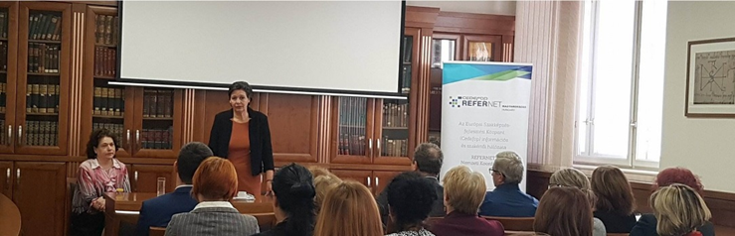
We disseminate ReferNet project on different forums:
Project networking 2018
Learning by Doing meeting 2018
EuroSkills Budapest 2018
PaFo Budapest
May 2018
Consortium meeting 2017

Slide 13
How can Cedefop help us to make our deliverables more accessible?
it provides us with its researches, reports, studies which helps us disseminating beside our deliverables VET related topics which are linked to a specific VET field and may be of interest on a national level;
connects us more to its other networks (CareersNet, SkillsNet, Network of experts on Apprenticeship);
it makes more flexible the implementation of the project;
more possibilities for the coordinators to shape the workplan;
more possibilites for students to show themselves (eg video recordings competition)
Dissemination and visibility activities needs
a lot of work, time, cooperation and devotion ☺

Slide 14
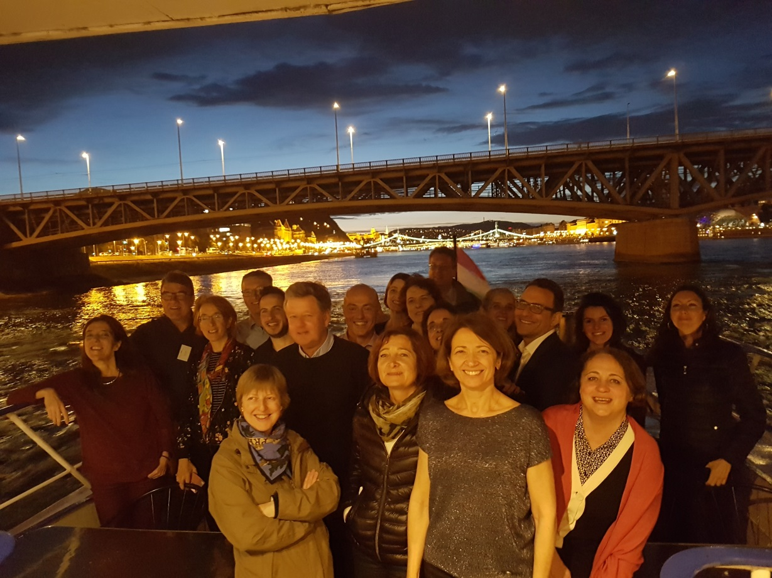
Thank you for your attention and wish you a fruitful Plenary Meeting!

