Slide 1





Image source: https://magazine.lucubrates.com/digital-transformation-in-tvet/
Enhancing digital transformation through TVET in developing countries
15 June 2023
Hiromichi Katayama, UNESCO

Slide 2
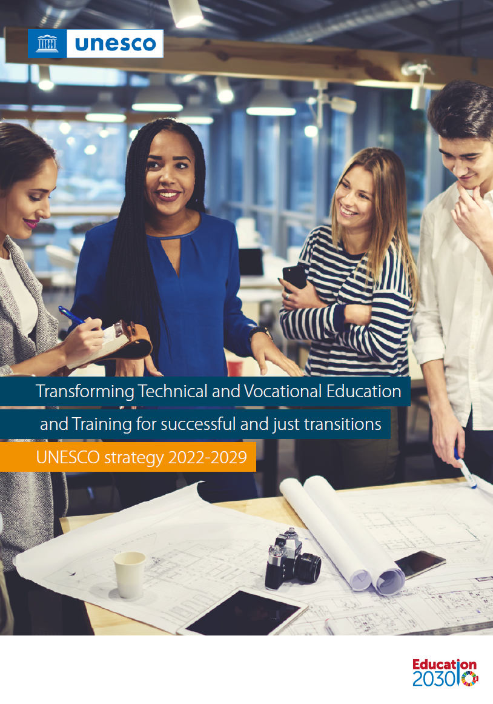

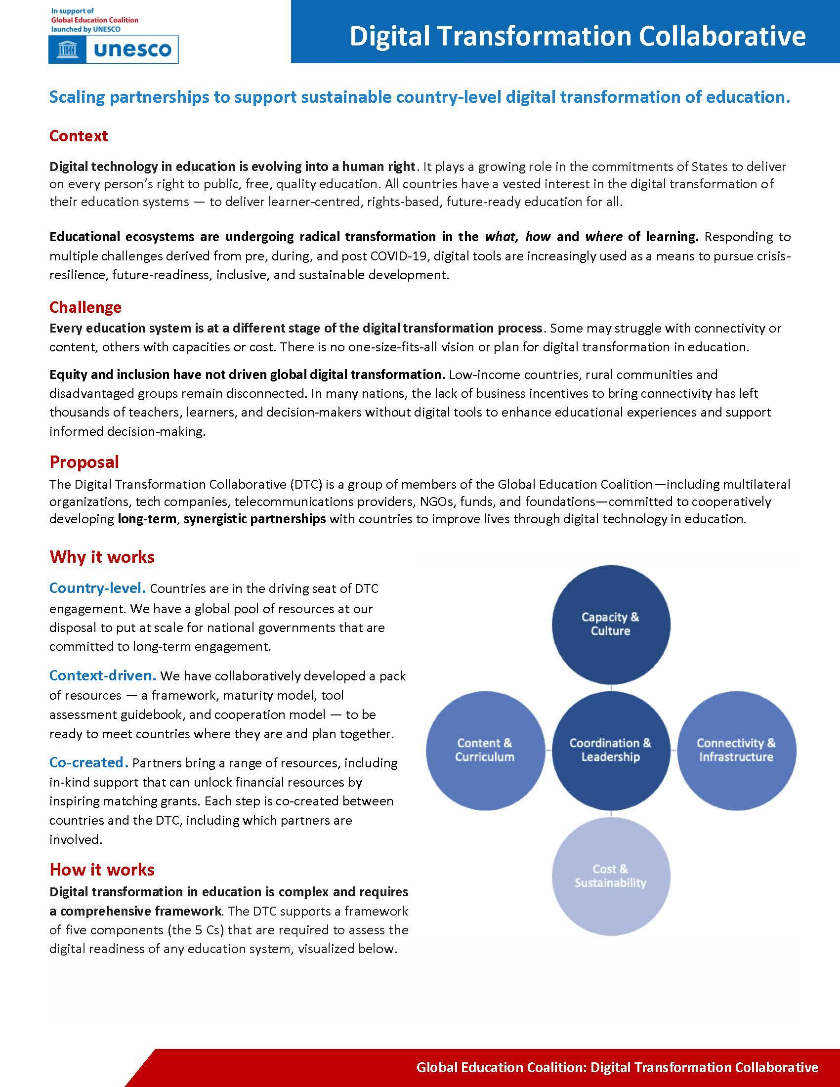
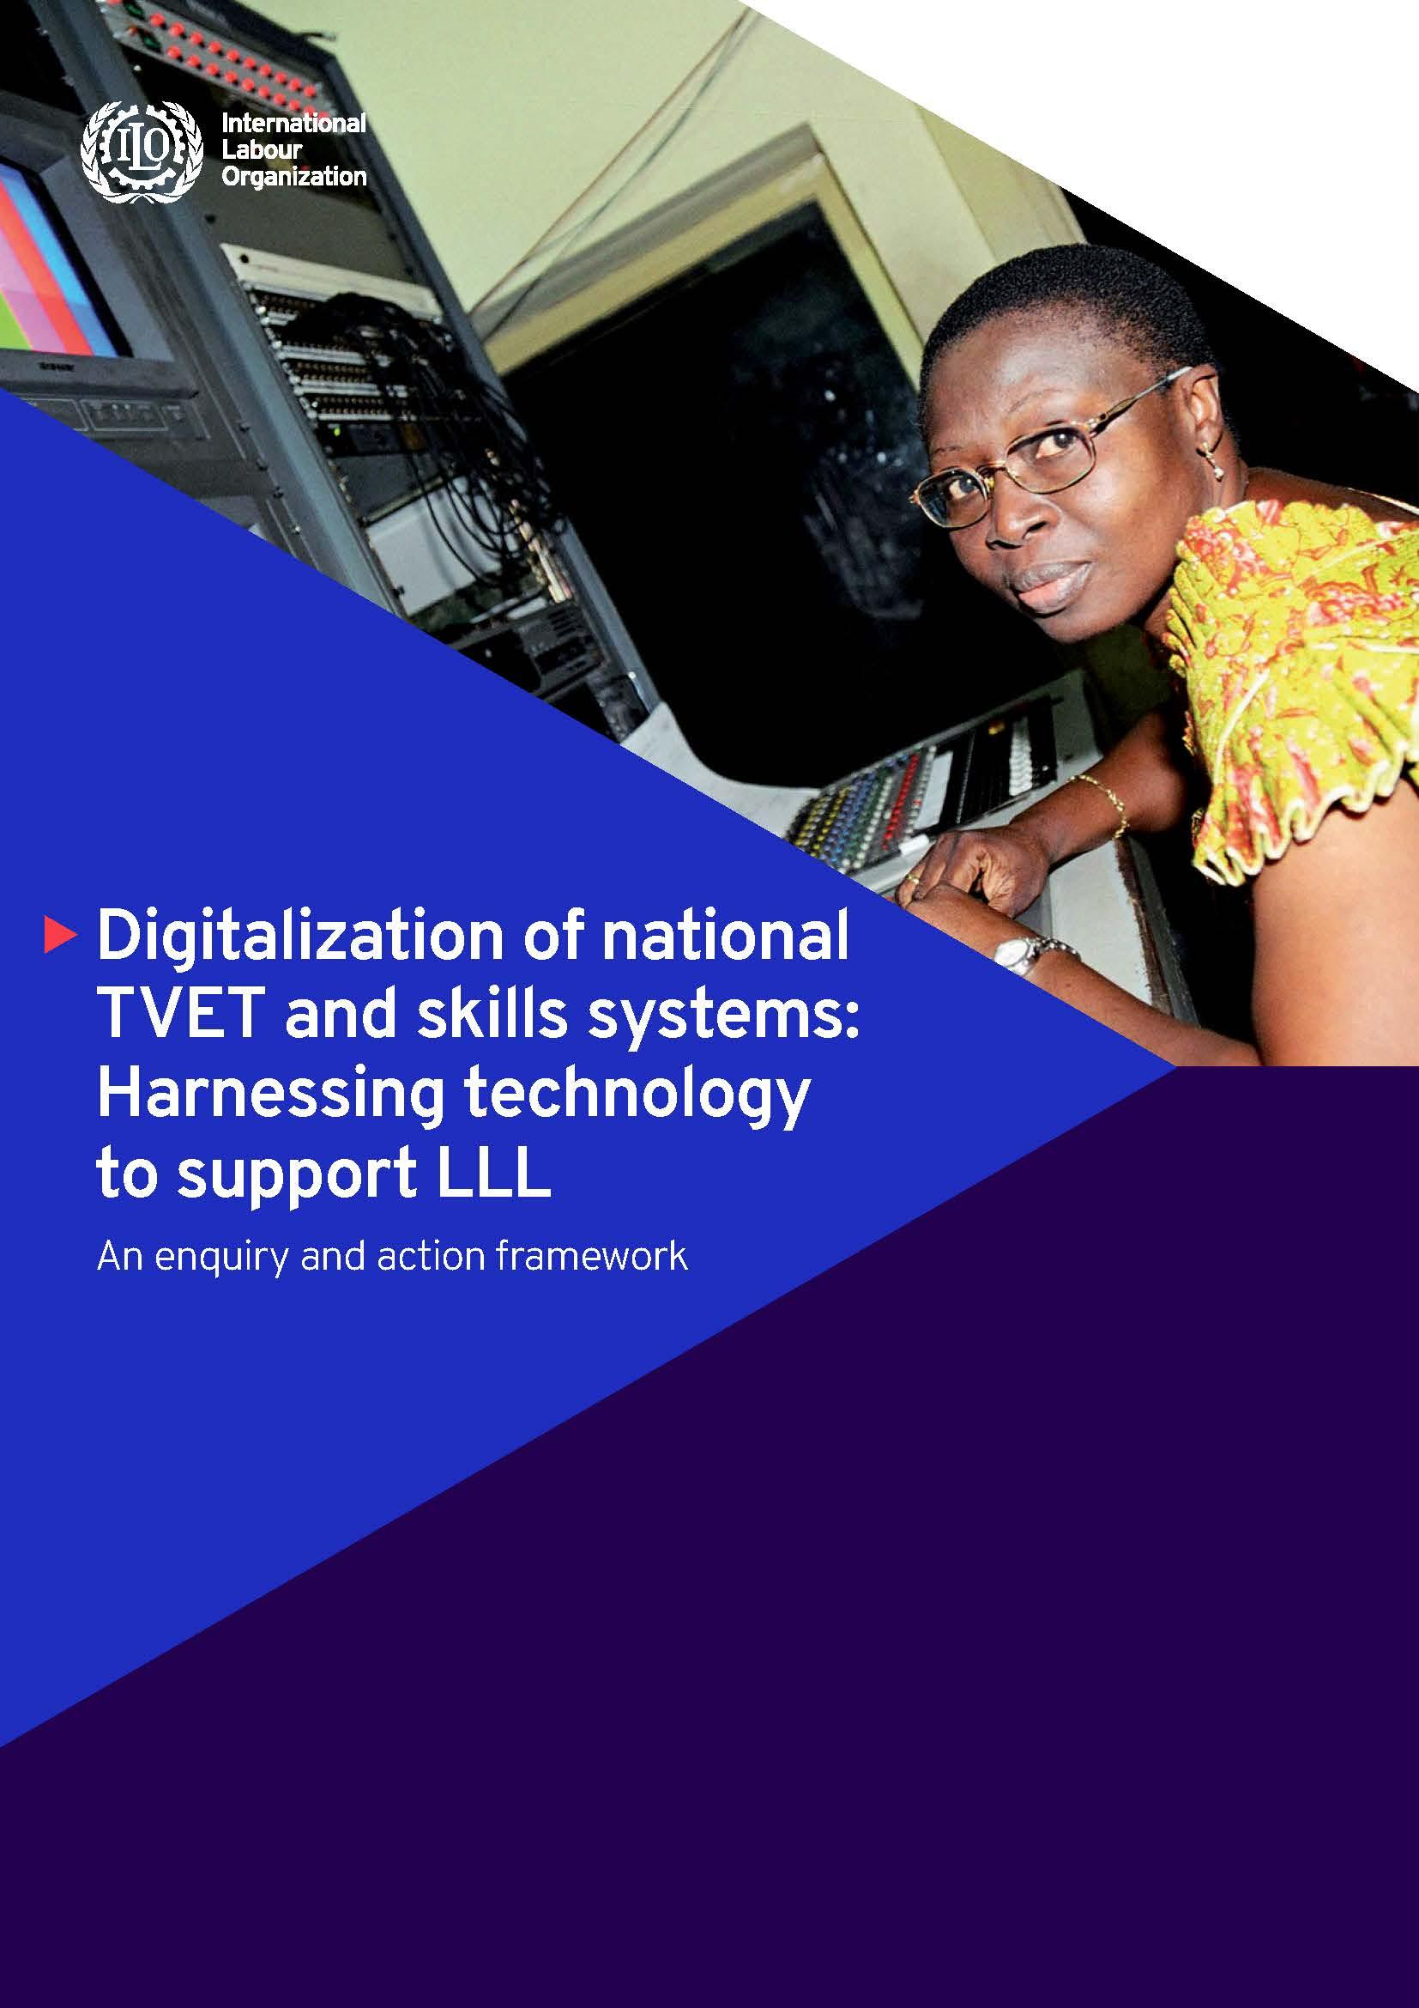
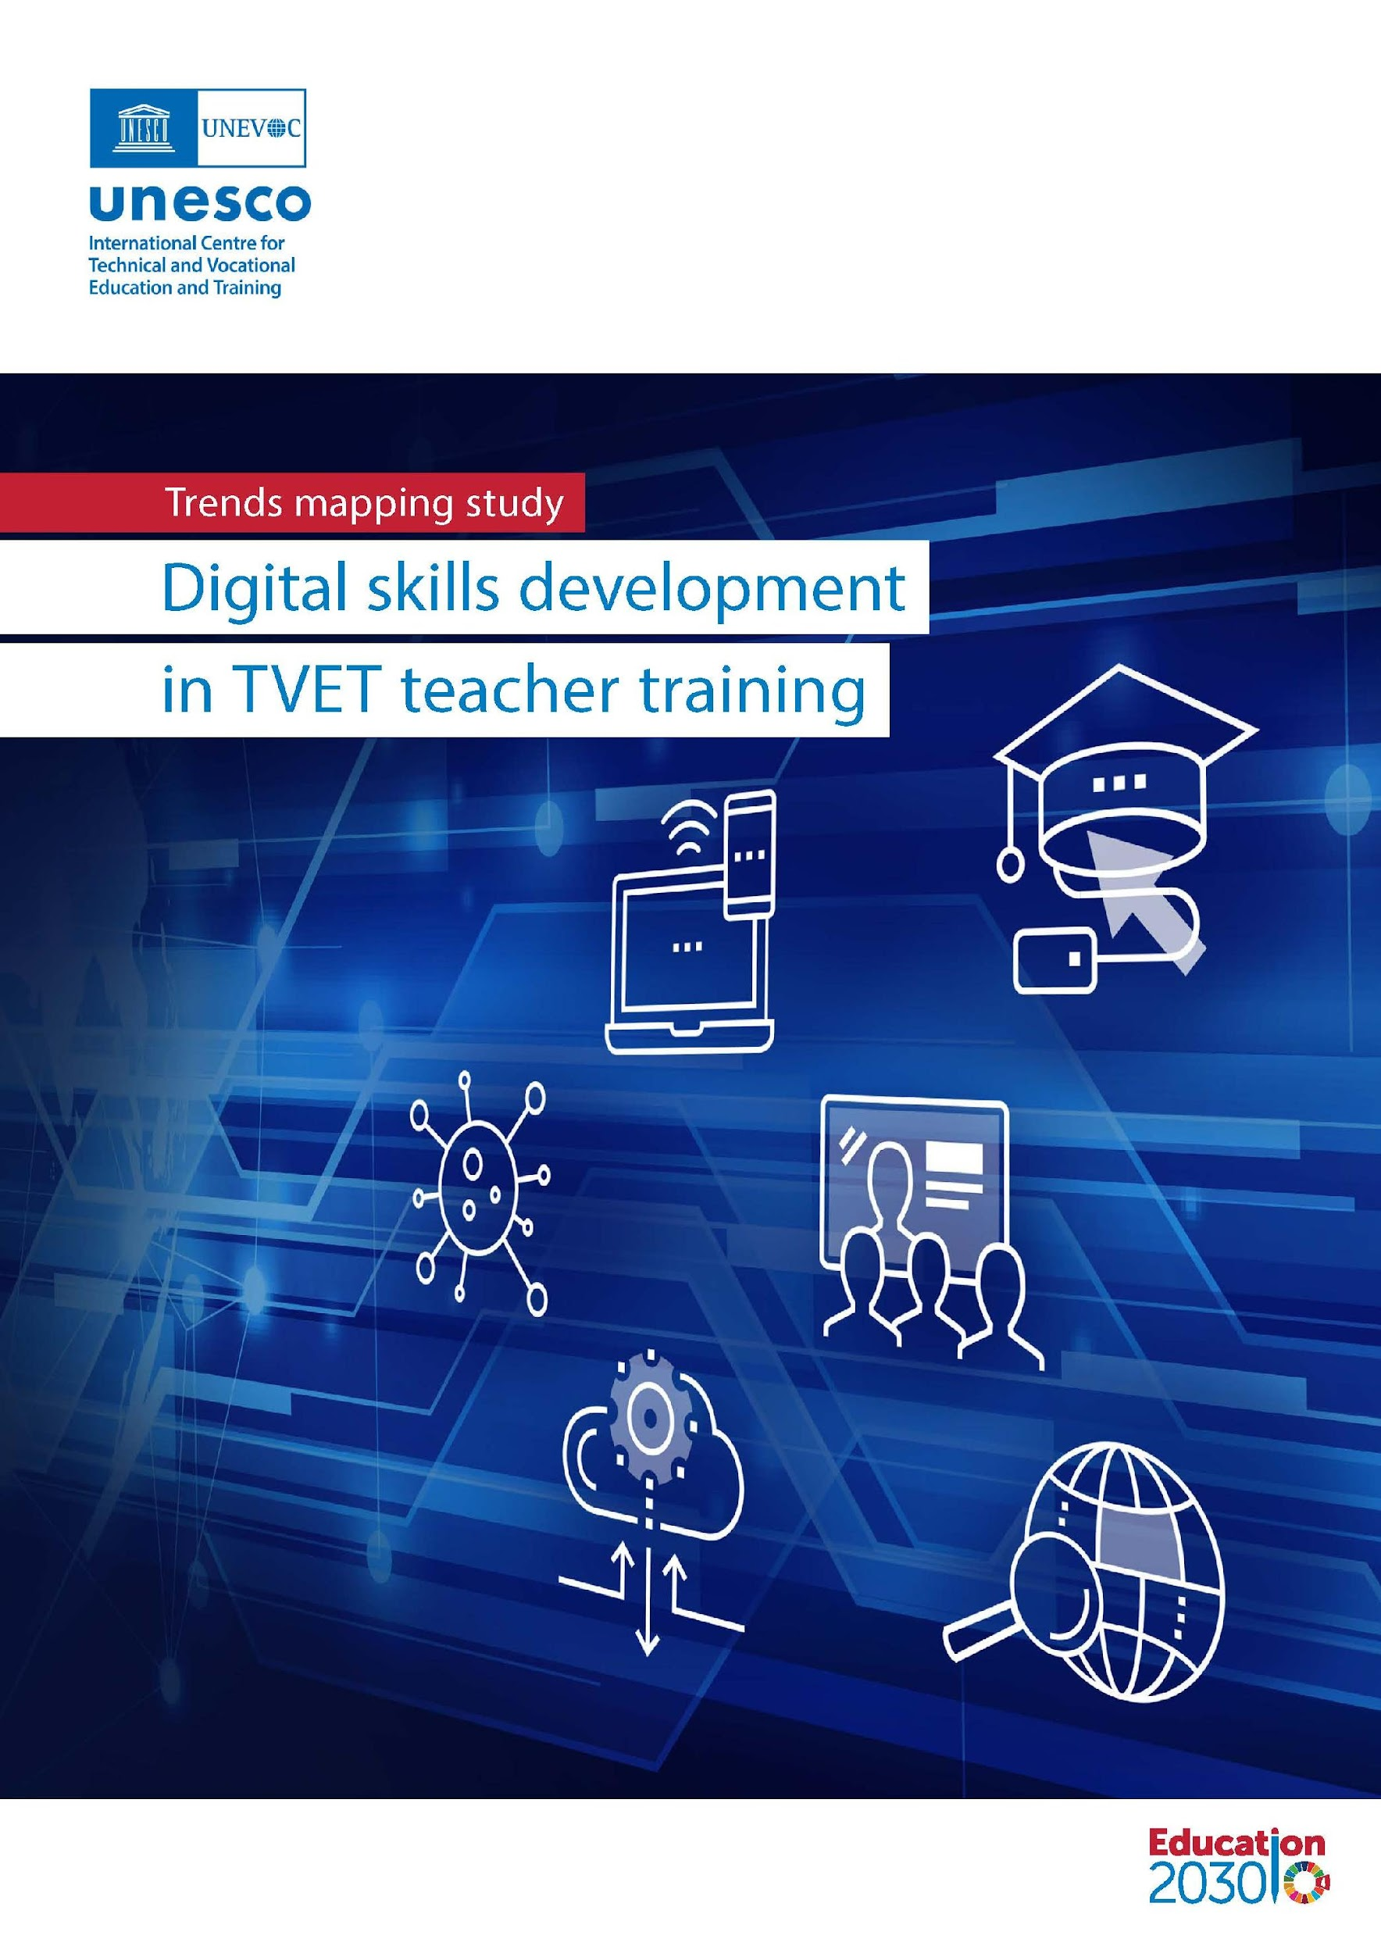


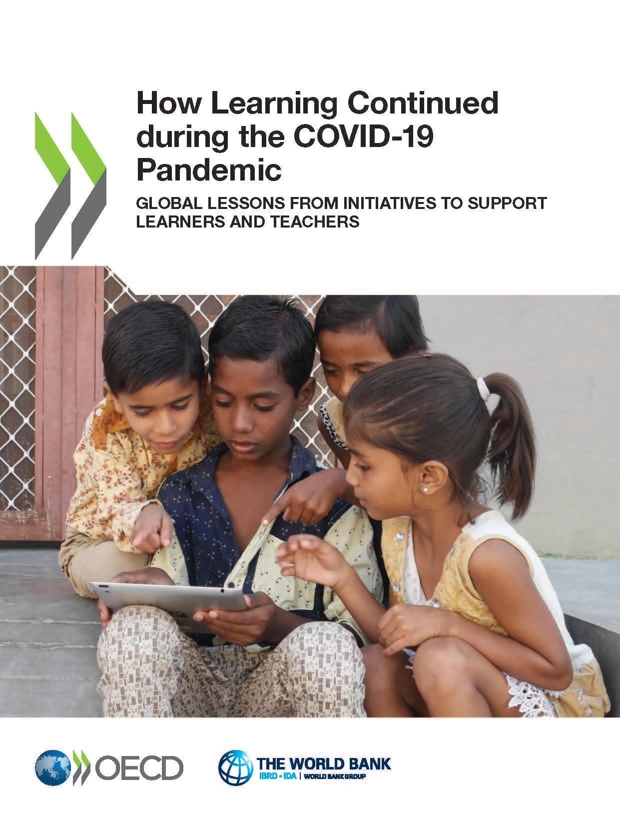

Slide 3
DX/T
Digital transformation in TVET
The planned and structured introduction of technology into institutions and national TVET systems with the goal of enhancing scope, scale, efficiency, effectiveness and ultimately, more sustainable development.

Slide 4





Image source: https://magazine.lucubrates.com/digital-transformation-in-tvet/
Overview
Case studies
Findings
Recommen-dations
Enhancing digital transformation through TVET in developing countries
15 June 2023

Slide 5




Objectives
The study aimed to explore recommendations, lessons learned, and best practices that can be used by key TVET stakeholders in LMICs to improve their systems and skills development through DX/T
STUDY OVERVIEW & METHODOLOGY
Review existing practices and trends in DX/T in LMICs
Consider how TVET stakeholders in LMICs can improve their TVET systems and skills development through DX/T, including lifelong learning opportunities
Consider how TVET practitioners introduce DX/T concepts into learning and teaching, including lessons learnt
Consider the effects of DX/T on teachers and students, including learning outcomes and entry into the world of work

Slide 6
DX/T for sustainability and resilience
DX/T for teaching and learning using technology
Digital adaptation and acceleration
DX/T for curriculum and qualifications
Digital innovation
Digitization of TVET and Skills Systems (ILO,2021e)
DX/T for technical and technological development
Digital transformation
Supporting TVET providers for a digital world (UNEVOC, 2021)
Changes to the organizational management of learning within TVET providers
Changes to teaching and learning, and delivery processes
Changes to the role of TVET providers within their education and labour market ecosystems and communities

Slide 7
Image source: https://magazine.lucubrates.com/digital-transformation-in-tvet/
Overview
Case studies
Findings
Recommen-dations
Enhancing digital transformation through TVET in developing countries
15 June 2023

Slide 8

Case Study: Brazil
Focus: The digitalization experience of SENAI in creating and providing hybrid TVET courses
DX/T for technical and technological development
Strong focus on an incremental approach, building on what exists
DX/T for curriculum and qualifications
Used existing programs to create online and hybrid courses using standardized processes - areas were prioritized based on industry and learner’s needs
DX/T for teaching and learning using technology
The primary mode of delivery is “semi face-to-face,” with 80% distance learning and 20% face-to-face
DX/T for sustainability and resilience
Implemented as a ‘culture movement’ and ‘changing people’s mindset’; followed by a deeper understanding of DX/T that involved changing the teaching and learning process itself

Slide 9

Case Study: India
Focus: The scale and use of technology-enabled solutions in India, especially in the textile and welding sectors
DX/T for technical and technological development
An aggressive partnership approach with employers and the industry; finding the right technology that is easily accessible and user-friendly
DX/T for curriculum and qualifications
Compulsory digital literacy modules of 20 - 30 hours are being inserted in the qualification packs of the curriculum, irrespective of trades across the spectrum
DX/T for teaching and learning using technology
The use of multimedia technology for interactive learning, or online learning portals are most used TVETs and building skills for service providers in India
DX/T for sustainability and resilience
Innovative solutions and policies being driven by the GoI; there is still much to do to prepare for the skills of tomorrow where a large proportion of the population are below the poverty line

Slide 10

Case Study: Jamaica
Focus: Digital integration of Jamaica’s TVET education system
DX/T for technical and technological development
Despite efforts, state access to equipment and connectivity within TVET is lacking
DX/T for curriculum and qualifications
Policy frameworks are in place with regards to the delivery of content for TVET educators; including making ICT a core subject in schools
DX/T for teaching and learning using technology
HEART was a catalyst for speeding up the DX/T of TVET, with its impact felt in the increased prevalence of the LMS; technology-centred TVET institutions that are able to be 'ahead of the curve'
DX/T for sustainability and resilience
Variety of partnerships that aid in the delivery of digital training to the general population

Slide 11

Case Study: Kenya
Focus: Kenya National Learner Record Database (KNLRD)
DX/T for technical and technological development
The KNQA has accelerated some of the digitalisation processes that were already taking place
DX/T for curriculum and qualifications
TVETs have tried to digitize the curriculum with the challenge of online assessments
DX/T for teaching and learning using technology
Reluctance from TVET teachers used to face-to-face interactions
DX/T for sustainability and resilience
Kenyan students can access information, services and learning materials regardless of their location

Slide 12

Case Study: Tunisia
Focus: Systemic level as put forward from four Ministry structures in Tunisia
DX/T for technical and technological development
A need to improve digital infrastructure for international integration of the economy, and to invest more in digital infrastructure and improve digital access in the remote inland regions
DX/T for curriculum and qualifications
Developing curriculum and renewing knowledge and skills in a range of subject and occupational areas in order to adapt to the new digital transformation changes is complex and time consuming
DX/T for teaching and learning using technology
The cohort of lecturers or instructors currently working in the Tunisia VET system is aging and there has been limited hiring of lecturers by the government over the past decade
DX/T for sustainability and resilience
High levels of unemployment among youth exacerbated by inequalities of access to work between young women and men and between youth who live in the cities and those who live in rural areas and small towns

Slide 13
Image source: https://magazine.lucubrates.com/digital-transformation-in-tvet/
Overview
Case studies
Findings
Recommen-dations
Enhancing digital transformation through TVET in developing countries
15 June 2023

Slide 14
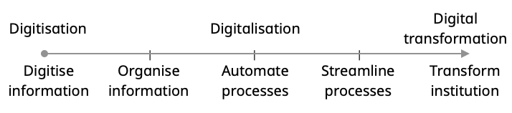

TECHNICAL & TECHNOLOGICAL

Slide 15

While hybrid formats were associated with cost savings and improved access, the impact on programmes that required practical exposure was also highlighted.
TVET systems internationally have been strongly influenced by competency-based education and training (CBET) approaches to curriculum design and assessment
CURRICULUM & QUALIFICATIONS

Slide 16

New methods of instructional delivery:
Online teaching and learning
Blended learning
Mobile learning
New tools for learning and assessment:
Learning platforms
Massive open online courses (MOOCs)
Simulations and immersive learning technologies
Virtual and augmented reality
Virtual and remote assessment
PEDAGOGY

Slide 17

Digital ecosystem platforms
groundswell of international interest in microcredentials
realising flexible learning pathways
recognition of non-formal and informal learning
New social contract for TVET
shared purposes, commitments, norms and standards
cooperation in knowledge generation and the use of evidence
financing education where it is threatened.
Skills for inclusive and peaceful societies
integrating rights-based education for global and participatory citizenship
promoting TVET institutions as places for social integration, cohesion and green citizenship
SUSTAINABILITY

Slide 18
Image source: https://magazine.lucubrates.com/digital-transformation-in-tvet/
Overview
Case studies
Findings
Recommen-dations
Enhancing digital transformation through TVET in developing countries
15 June 2023

Slide 19

DX/T for technical and technological development
DX/T for teaching and learning
build TVET trainer capacity in DX/T:
  Occupation-related digital skills
  New pedagogies
  Leveraging and integrating digital resources
follow a DX/T-by-design approach to infrastructure development
incentivise employer contributions for DX/T
RECOMMENDATIONS
DX/T for curriculum and qualifications
DX/T for sustainability and resilience
build interoperable data systems to support DX/T
redesign/expand recognition systems to both leverage and embrace DX/T
promote inclusive DX/T through policy and targeted interventions for the most marginalised
recognise that institutional culture matters, also in a DX/T context

Slide 20
DX/T - Enabling factors
Jump-starting the digital transformation
Sustainable and Resilient Systems
New and improved labour market information systems
Development of flexible credential pathways to advance and recognize citizen’s skills
Integrated Teaching and Learning
Introduction of remote/hybrid approaches and materials
Practical training for practitioners of specific technologies in use - and expectations for use
Structures of Curricula and Qualifications
Community-based training for ICT literacy
Established links to competency-based education and training
National push through policy and projects
Technical Infrastructure and Capacity in Place
Targeted public access initiatives
Public-private partnerships
  Telecoms, innovative access technologies

Slide 21
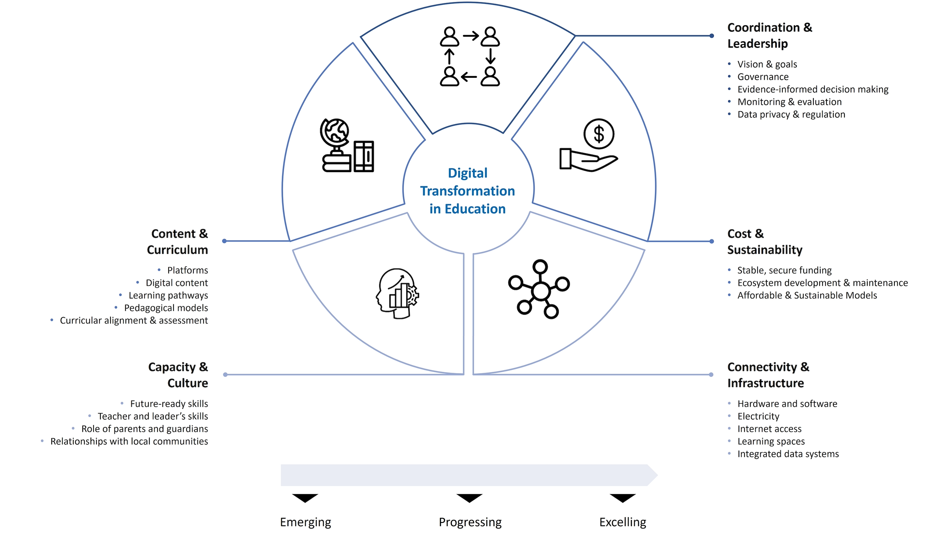

Digital Transformation Collaborative
DTC Framework
Notes:
The complex process of digital transformation requires a comprehensive framework.
​A group of around thirty DTC partners worked together to conceptually align how we understood digital transformation in education.
Leveraging our collective experience and expertise around digital transformation to produce this and also a literature review that that we conducted.
This is linked to the Transforming Education Summit, which originally had the 3C's of content capacity and connectivity which expanded a little bit in terms of the phrasing.
So we’ve added cost & sustainability is around coordination and leadership. That's the digital transformation framework needs and the plans within a country need to be anchored in a solid vision and goals.
Traditionally, over the last decades, digital transformation has always had the tendency to increase the gaps between rural and urban and between poor and rich and so forth. So the inclusive and equity angle needs to be very strong also in this.
Another of the very important components is the flag on the evidence building, the monitoring and evaluation which was highlighted.
Many times during our discussions is being very peak to just give one example. During COVID many countries didn't really have a sense of which children were learning what they were learning, how they were learning because they were monitoring systems, were not in place.
So this moves us to the next output of the DTC which is the Maturity Model.
What do the 5 Cs look like in different education systems? The DTC has begun developing a three-stage maturity model to help countries place themselves along a digital transformation in education journey.
The model uses descriptive details to pinpoint areas of digital transformation in education that are emerging, progressing, or excelling in a given context.
There is no country that can be considered fully ready for transformation in education — given the extremely rapid pace of change of technologies and growing rates of crisis. Contexts may not fall neatly into one stage but may be ‘emerging’ in one category while ‘excelling’ in another. ​
The maturity model is meant to help identify gaps where more attention or investment may be needed.
What we have seen so far in countries that sometimes there's a bit of an imbalance of focus very much in one area of digital transformation and not in others but this will help ensure also that you know this kind of guidance can help countries develop more holistic and systematic.
how can we ensure that digital transformation is not just a you know has a short term vision but also looks at the long term vision of how this can be sustainable iteratively improved and so forth. And to give another example here we found out that a lot of the learning platforms developed during COVID they no longer exist or no longer updated.
The clearly many countries there wasn't that sustainable plan in place like how to continue developing those systems beyond COVID and including for teacher emergencies and so forth.
The third one, connectivity and infrastructure, I've mentioned this is typically a very this is a very costly component and typically an area of focus
The that that also links to connectivity and infrastructure, the third killer, which is a very costly components, but it it also needs to cover things like sustainable models, how can we ensure that digital transformation is not just a you know has a short term vision but also looks at the long term vision of how this can be sustainable iteratively improved and so forth. And to give another example here we found out that a lot of the learning platforms developed during COVID they no longer exist or no longer updated.

Slide 22
Digital Transformation Collaborative
Cooperation Model
Policy Dimensions
Promote a shift from crisis management to sustained solidarity towards achieving SDG 4.
Complexity of these challenges require the mobilization of variety stakeholders.
Investment, a large amount, is needed to do this.
Solidarity remains as important now as ever.
Key Partners
Who are the partners required?
What suppliers are needed?
Which resources are acquired and by whom?
Which Activities do partners perform?
Key Activities
Which activities do our value propositions require?
Value Propositions
What value does the DTC provide countries?
Which problem are we helping to solve for a country?
Partner Relationships
What type of relationships does a country expect us to establish and maintain?
Which are already established?
Benefitting Segments
For Whom are we creating value?
Key Resources
What resources are needed to deliver on the value proposition?
Channels
What are the most appropriate forms of service delivery? (see WS2 outputs for inspiration)
The DTC Theory of Change: if the DTC co-creates long-term, sustainable partnerships with countries to leverage digital technology to improve educational access, quality, and delivery for all, then all actors – learners, teachers, education stakeholders, and DTC partners themselves — will benefit.
Key Partners
What are the costs by activity?
What is the preferred modality to pay/finance the costs?
Impact
What are the results expected from the activities?
Notes:
The DTC operates using a complex cooperation model. Inspired by a business model canvas (Fig.3), a conceptual cooperation model has been developed to encapsulate the identification of Key Partners, Key Activities, Key Resources, Cost Structure, Value Propositions, Partner Relationships, Channels, Benefitting Segments, and Impact. ​
The DTC Theory of Change demonstrates that if the DTC co-creates long-term, sustainable partnerships with countries to leverage digital technology to improve educational access, quality, and delivery for all, then all actors – learners, teachers, education stakeholders, and DTC partners themselves — will benefit.
This conceptual model will be accompanied by a compendium of tested financing models for digital transformation in education, experienced by the DTC members themselves.​
The Digital Transformation Collaborative, a group of members of the Global Education Coalition committed to co-creating sustainable, synergistic partnerships with countries to improve lives through digital technology in education. They represent international orgs, NGOs, EdTech, Telecoms, Funds, Foundations, etc.
The DTC emerged really to respond to a few things:
First, digital transformation is here and it’s here to stay, but the pace of this transformation has been globally very uneven.
Second, we must work together to steer education transformation towards equity, quality, sustainability & inclusion.
We cannot move unless we move together in a coordinated way. We need bolder partnerships to harness the power of digital learning to close educational divides, by supporting cooperative actions and investments.
A year ago, the UN’s Special Rapporteur on the Right to Education said that international community needs to consider digitalization in the right to education.
We must mobilize resources and trigger concerted efforts to leave-no-one behind
You may ask, how? How can we do this together? Well, the creation of the DTC was a natural progression of transforming years of thought leadership on how into action:
The DTC emerged from growing international momentum that we can trace – we can thread the needle from Rewired Declaration to the Special Rapporteur statement on revisiting the right to education in the digital age, to the World Telecommunications Development Conference, to the TES Pre-Summit and Summit, where the DTC first met.
The DTC has collaboratively developed a framework for digital transformation in education, which you see on the slide here.
We call it the 5 Cs, or the 5 key components to unlocking sustainable, equitable digital transformation at scale.

Slide 23





Global Skills Academy - A flagship Mission of UNESCO’s Global Education Coalition
GSA Partnership
National
National Ministry or National TVET Authority
Learners
Institutional
Local TVET Institution
UNESCO Field Offices
UNEVOC Network
TVET Centers TVET Institutions
Individual
Individual learners
Member States

Slide 24






















Global Skills Academy - Partnerships in 2023
KPMG
Youth Economic Empowerment
ICT Academy
ICT skills
Skills For All and NetAcademy
ICT, digital and technical skills
Microsoft Learn
ICT and digital skills
Pedagogical skills
Conecta Empleo
ICT, digital and soft skills
SkillsBuild
ICT and soft skills
PIX
Digital skills
Siemens Stiftung
Digital skills
Outsystems
Digital skills
Women@DIOR
Leadership skills
Generation Global
PIX
Digital skills
Coursera
Junior Achievement
Orange
Water Technology Program
Technical skills
Technovation
Think Global Sustainability
Internships
Skills Tracker
Survey for new graduates
ITU Academy
Digital skills
Skills for Jobs
Measuring Skill Demands
WHO Academy
Technical skills geared towards the health sector

Slide 25
Research Team & Contributors
JET
James Keevy, Principal Investigator
Carla Pereira, Kelly Shiohira & Lungelo Mthembu-Salter, Brazil Case Study
Carla Pereira & Tanya Kapoor, India Case Study
Kelly Shiohira & Lungelo Mthembu-Salter, Jamaica Case Study,
Patrick Molokwane & Andrew Paterson, Kenya Case Study
Andrew Paterson & Deborah Hunt, Tunisia Case Study
Alan Amory & Andrew Paterson, Literature Review
UNESCO
Hiromichi Katayama, Section of Youth, Literacy and Skills Development
Danilo Dalmon, Section of Youth, Literacy and Skills Development
THANK YOU
International Reviewers:
Frances Ferreira (Commonwealth of Learning), Alessandro Brolpito (European Training Foundation), Sarah Elson-Rogers (UNEVOC) & Roy Saurabh (UNESCO)

