Slide 1

First results of the “Dobbantó” basic competency- development programme
Reducing early school leaving, promoting inclusion and development of basic competences and soft respective transversal skills’
ReferNet Partnership Forum
26 May 2021
Judit Gömöriné Olasz
ReferNet project coordinator, HUngary

Slide 2
Bridging competence-development programmes in IVET – Legislative background
Hungary in 2019 adopted a
MEDIUM TERM POLICY STRATEGY FOR THE RENEWAL OF VOCATIONAL EDUCATION AND TRANING
AND ADULT EDUCATION
RESPONSES OF THE VET SYSTEM TO
THE CHALLENGES OF THE FOURTH INDUSTRIAL REVOLUTION
AND BASED ON THIS IN NOVEMBER 2019
ACT LXXX/2019 ON VET
A
Notes:
The Act entered into force as of the 1st of January The main goals to implement a new act was to:
Raise the awareness and atractivenes of VET
To introduce VET programmes with learning outcome approach
To promote dual training
To tackle early school leaving and introduce competence-development programmes

Slide 3
Number of students studying in IVET
According to the Hungarian Central Statistical Office – Központi Statisztikai Hivatal – KSH) the share of upper-secondary students studying a VET programme is 50.33 % in the school year 2020/2021. (out of altogether 398,300 students studying in an upper secondary programme in Hungary 200,500 students have been studying in an upper secondary VET programme.
Link: http://www.ksh.hu/docs/hun/xftp/idoszaki/oktat/oktatas2021e/index.html
Compared with the previous year in 2021 the number of students applying for upper secondary VET programmes has increased on average with 10% .

Slide 4
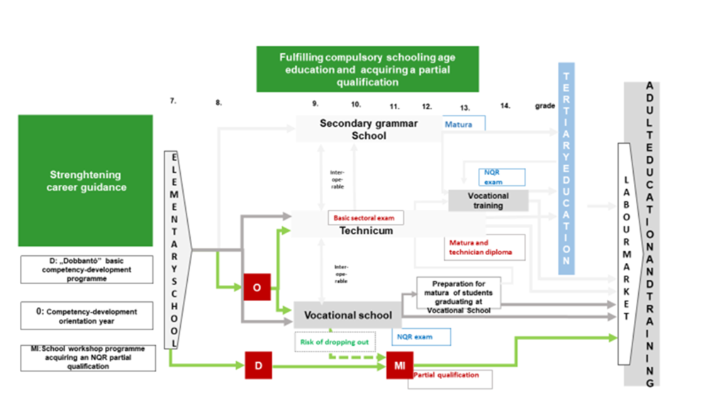
Special functions were added to the new IVET system. . These functions primarily aim at reducing the lack of competences and leaving school without a qualification.
Notes:
, The new Act emphasises flexible learning routes in IVET, with special focus on learners with disadvantaged social and economical backgrounds, learners with disabilities , SEN learners and learners at risk of dropping out or leaving the school early.
To meet their needs the legislators created new programmes for them, the
„Dobbantó” programme (Springboard class),
„Műhelyiskolai” programme (School workshop programme) and the
Orientation year.
The main goal is to integrate them in an inclusive way into the education giving them the possibility to acquire a partial qualification and a basic school leaving certificate (attesting the skills and competences required to pursue further studies in the upper secondary education). Thus they can enter successfully on the labour market becoming a valuable member of the society.

Slide 5
Reasons of introducing the new competence-devolopment programmes
An increasing part of the students (nearly 30%) arrive to upper secondary VET from the elementary school with severe lack of competences (confirmed by the results of the PISA assessment too) which do not enable them to obtain competitive knowledge. Even if these young people formally obtain the qualification at school, they are not able to develop and adapt to the changing technologies.;
Furthermore, there is, unfortunately still a significant difference in the performance of students coming from better and worse family backgrounds. The objective is to decrease this differences.
In 2019 the share of ESL in Hungary was 11.8% (men: 12.7%, women: 10.9%) which is above the EU average.
Due to the previous inflexible regulation of compulsory education, a significant proportion of young people -particularly in disadvantaged regions - leave school early to earn income from unskilled work.
The result of the ESL early warning system module
Notes:
Public Education Registration and Study Core System -NEPTUN-KRÉTA (Köznevelési Regisztrációs és Tanulmányi Alaprendszer – NEPTUN-KRÉTA) - electronic school and study administration system in Hungary
A complementary module within the NEPTUN-KRÉTA system is the ESL programme module:
is functioning as an early warning system, continuously monitoring the performance of the students based on their academic performance and on the justified and unjustified absences. If the performance of a student has started to worsen, and the number of unexcused absences has started to increase rapidly the ESL module sends an automatic message both to the student’s parents and form master. This is important, because if the problem is recognised in time, the early school leaving of students can be prevented. Based on these data informs the form masters and school management about that which students to what extent are exposed to the dangers of dropping out and leaving school early without a qualification.

Slide 6
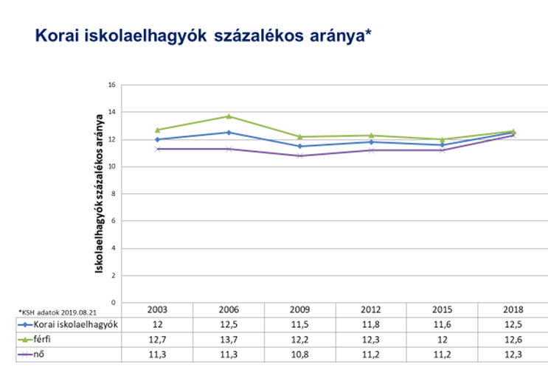
Share of early school leavers between 2003-2019
ESL 2019:
Total: 11.8%
Men: 12.7%
Women: 10.9%
Notes:
Country specific features related to ESL and dropping out rates :
ESL rates are higher in the rural areas respective there are great regional disparities.

Slide 7
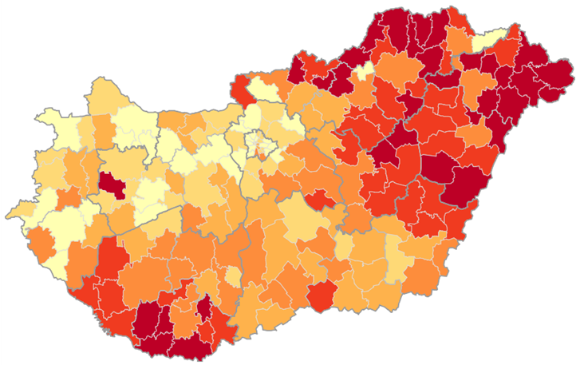
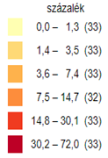
Percentage of disadvantaged upper secondary school students per districts in
the school year 2016/2017
Notes:
There is generally a significant correlation between the disadvantaged / multiply disadvantaged status and dropout rates.
According to the Act on national public education the definition of student at risk of dropping out is: a student whose average academic performance in a given school year is below average or is with at least 1.1 less than in the previous school year (we have grading system from 1 to 5 where 5 is excellent, 4 – good – 3 - average and 2 satisfactory ) and complex and systemic level pedagogical measures are needed to be taken. Dropping out is rather a process which complements early school leaving, and leaving school without a qualification, the three definitions complement each other and it is worth to eximane them together.

Slide 8
Features of the „Dobbantó” Programme (Springboard Class)
The „Dobbantó” programme was introduced in the school year 2020/2021 so now we are in a piloting period. It does not lead to a qualification but it provides basic competence development for those students who need it to reintegrate in education, or who needs competence-development.
It is for students older than 16 years and without any qualification or who have already dropped out from the school system. There is no upper age limit for entering the programme.
It does not lead to a qualification or certificate but it provides basic competence development for those students who need it to learn further in the School workshop programme.
Notes:
The „Dobbantó” programme replaces the previous VET Bridging Programme (Szakképzési Híd Program) . The need to rethink the bridging programme was that the number of dropping outs remained high, partly due to the high number of general subjects (35/week) and inflexible school year schedule. (compulsory 2 years with central teaching curricula and assessment requirements. Teachers teaching in the VET Bridging Programme (which is in a phasing out system the school year 2020/2021 being the last one when the second year VET Bridging Programme students will finish their studies), were able to choose between experience-based and frontal teaching methodologies or to mix them, there was not any recommendation in this regard.

Slide 9
Features of the Dobbantó Programme (Springboard Class)
The programme is flexible it does not bound to the school year schedule as the previous 2 years length VET Bridging programme. When the student reaches the competence level required to move forward to the „School workshop” programme (being capable to acquire a partial qualification) he/she can do it. The capability is attested by his/her mentor.
The education happens in small groups of 3-8 learners,
At the beginning of the programme an individual development plan is made for each student, and the development is being implemented along this line,
There are no school lessons, there are dedicated school activities,
Each student has a mentor.
Each students receives a scholarship

Slide 10
Features of the Műhelyiskolai („School workshop” Programme
It can be started above the age of 16
Its lenght varies between 6-24 months, depending on the performance of the student
If a student fulfill successfully this programme aquires a partial qualification and a certificate attesting lower secondary school attainment.
Beside this students can pursue further studies in upper secondary IVET, both technicums and VET Schools.
They acquire the partial qualification in a school workshop but it is preferable to acquire it in the framework of dual training at companies’ work placements.
The education and training happens in small groups of 1-5 students
In this programme as in „Dobbantó” one VET teachers focus on the individual skills development of the students. *
Teachers and instructors follow closely the students performance supporting them as mentors and telling them if they acquired the necessary skills and competences required for the final examination. This can happen within 6-24 months.
Notes:
This programme is available not only for students finishing successfully the „Dobbantó” programme but for all students who would like to acquire a partial qualification, even those who have a secondary school leaving certificate (matura examination) or finishing the lower secondary education or the orientation year. In case if they have already acqured the certificate attesting lower secondary educational attainment (or in other words 8 grades of the elementary school) they receive a cetificate attesting a partial qualification.
Unlike in the „Dobbantó” programme in this programme there are common learning outcome standards assessing the students ability to perform the final examination in order to obtain a partial qualification.

Slide 11
Features of the orientation year
It is a competency-developing year which is addressed for those young people who are uncertain in their career choice or who finished the lower secondary education with lack of competences. It was introduced from the school year 2018/2019 as an experimeental programme lead by the Piarist Outlook Career Guidance and Labor Market Development, Methodological Center (link: https://www.kilato.piarista.hu/english/ )
Its aim is that based on the assessment of the student’s individual competences to provide them personalized development, which enables them to deepen their self knowledge, skills and competences. Beside this it gives students career orientation and guidance, and the possibility to get acquainted in practical circumstances with the occupations which can be acquired in the framework of vocational education.
The condition for the student to enter upper secondary IVET programmes is to possess those basic competences which are needed to successfully finish a VET programme and obtain a vocational occupation.
The education happens in small groups of 6-15 students
There are 30 lessons/week (general education subjects, career guidance, competence development, mentoring activities)
The education is based on an individual development plan
Each student has his/her own mentor
There are JOB SHADOWING activities (on site company visits, orientation)
Finishing successfully the orientation year students can continue their studies without any further entry examination in upper secondary VET.
It is practice oriented.
Each student recives a scholarship.
Notes:
In the school year 2020/2021 in 20 upper secondary VET institutions 264 students learn in an orientation year. For the next school year 42 VET institutions affiliated to 27 VET Centres plan to start an orientation year.

Slide 12
Common Features of the programmes
Experience-based learning,
Team work,
Project based tasks,
Individual mentoring for each student
Developmental assessment,
There is no grade retention (grade repetition),
Co-operative and not frontal teaching methods (strengthening attachment bound and building trust)
Teachers and learners perform together project-based tasks, team building trainings, thus creating a good community.
In the new „Dobbantó” programme the teachers approach is of key importance, they have to use innovative teaching methodologies, like
personal development,
project tasks,
co-operative learning methods,
lesson studies
Notes:
The goals of using these teaching methodolgies are:
Development of basic competences,
Reintegration into education, and labour market
Development of skills and competences necessary for the aquirement of a partial qualification.

Slide 13
Recommendations for IVET institutions running these type of programmes:
Creation of a pedagogical team based on:
the attitude and commitment of teachers (for example: empathy)
involvement of special education teachers, developmental teachers, psychologists, social workers, etc.
teacher training programmes to become mentors
a sharepoint collaboration system
Creating family like physical learning environment:
separate learning room for each group
warm and friendly learning environment (carpets, tables set in a circle, ICT tools, a little kitchen, if possible offering breakfast for children, etc.)
Notes:
The programmes are coordinated by two agencies of the Ministry for Innovation and Technology. These institutions (National Office for VET and AL and IKK Innovative Training Support Center Plc) organise continuously workshops bringing together the VET teacher involved in the programmes giving them the possibility to share their experiences. It is in course the preparation of a Methodology Manual determining outcome and mentoring competences respective creating a sharepoint system for sharing good practices.

Slide 14
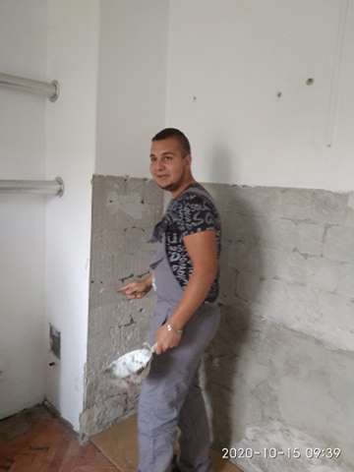
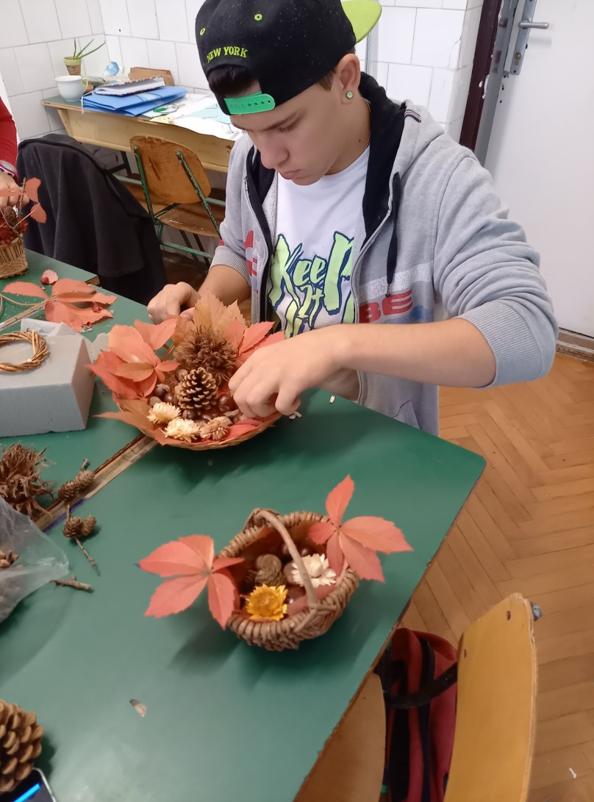
PREPARING DECORATIONS AND PAINTING THE CLASSROOM WALL
Notes:
First results based on the interview with Magori Beáta deputy school director and head mentor of the Siófoki SZC Mathiász János Technikum és Gimnázium („Mathiász János” Technicum and Secondary Grammar School belonging to the VET Centre of Siófok town)

Slide 15
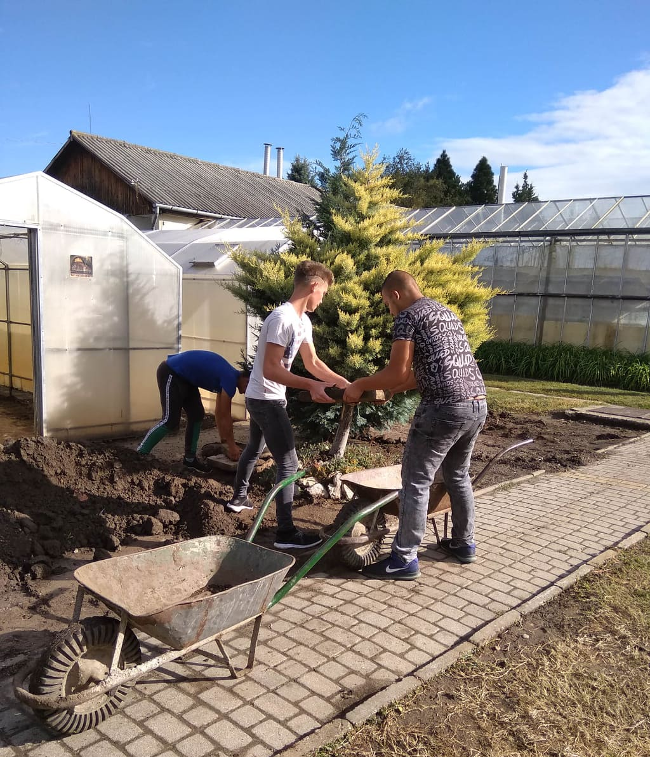
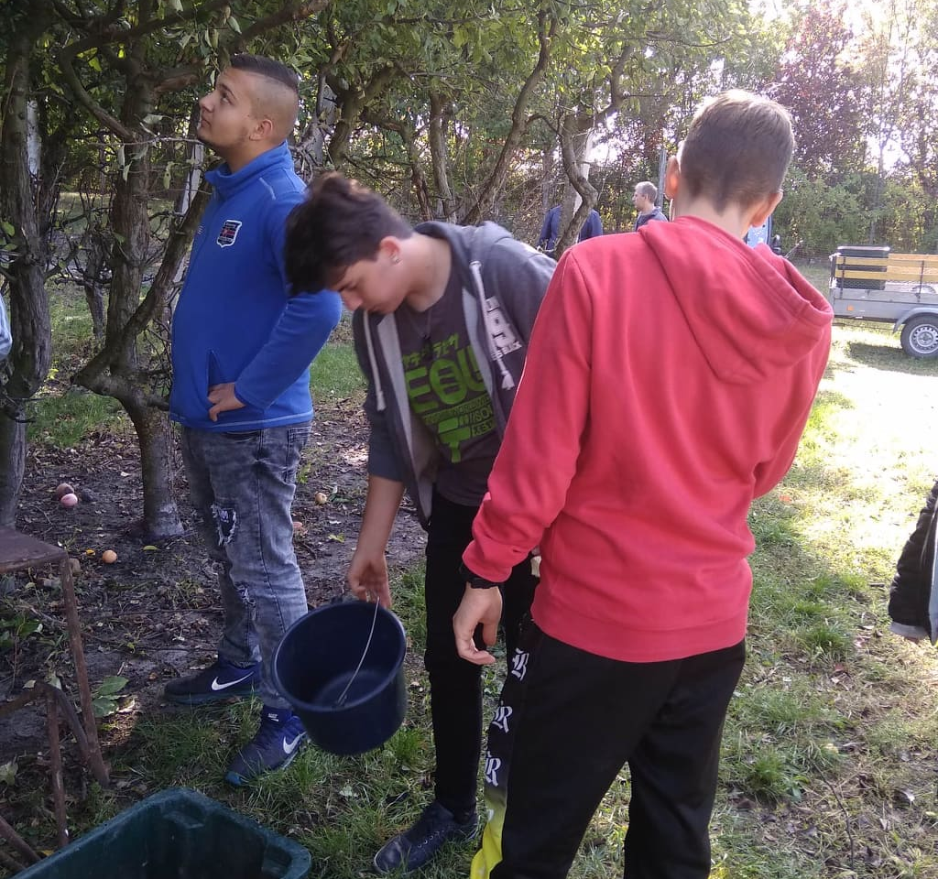
WORKING IN THE SCHOOL FARM
Notes:
Shifting from face to face to distance learning (between 11 November 2020 - 10 May 2021) was a challenge for them because there were families even without a mobile phone. Teachers personally went to each student and give them the tasks and teaching material based on paper, and they collect the homeworks also in this way. At first families were a little embarrassed because of their living conditions, but as time has passed they were grateful for the care they received. Personal care means a lot and in this way teachers achieved that in this school non of their students was left behind and non of them was dropping out during the distance learning imposed by the COVID-19 pandemic. This result was not achieved in the VET Bridiging Programme.

Slide 16
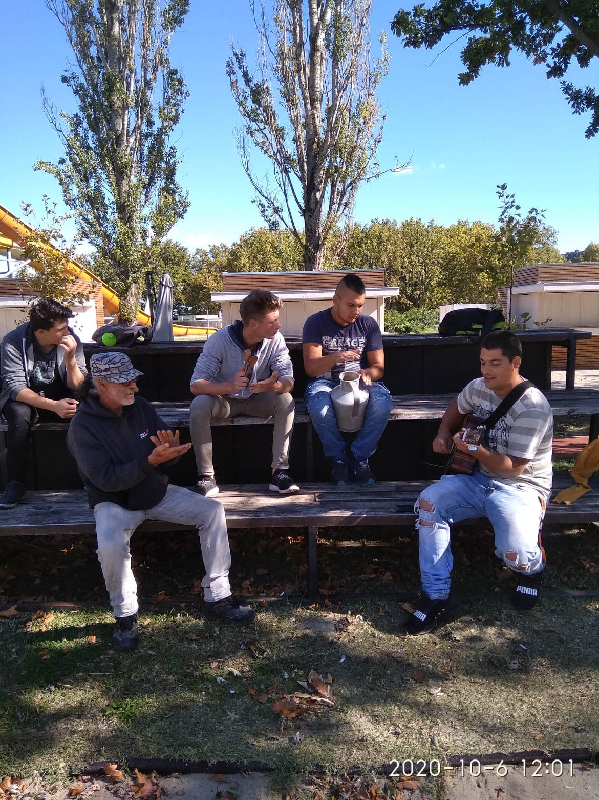
PLAYING MUSICAL INSTRUMENTS
AND SINGING TOGETHER
Notes:
Good practices worked out in the Siófoki SZC Mathiász János Technikum és Gimnázium:
The experiences during the pandemic show that even for students with good capabilities is a challenge to shift to online learning. They need special attention and care in order not to leave the programme. Students involved in these programmes generaly have a poor social background, one third of them do not have mobile phone, there are families whithout mobile phone. To tackle this issue the teachers in the school worked out an action plan.

Slide 17
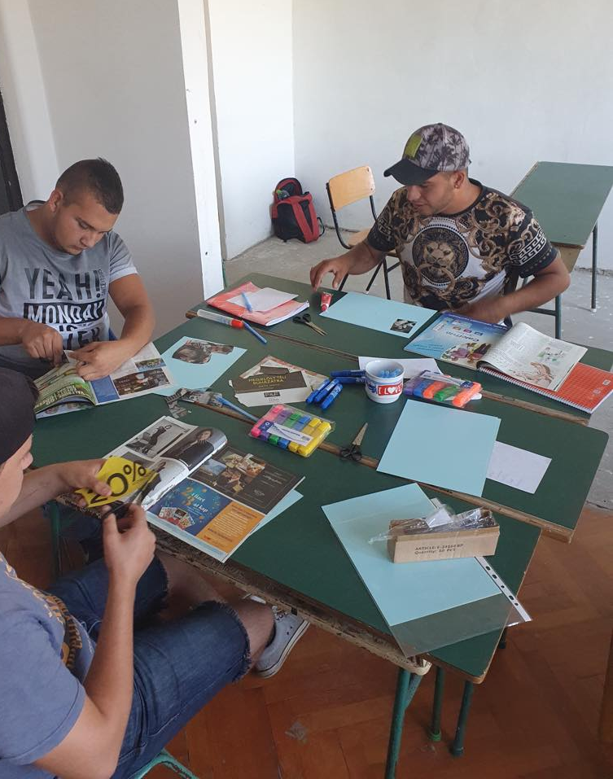
DEFINING GOALS:
Jigsaw method
(Co-operative learning)
Link: https://mek.oszk.hu/15600/15627/15627.pdf
Notes:
Students were given mainly practice oriented task emphasising the sense of achivement and developing their basic competences. The school has its own garden maintained in non-pandemic time by the students, so vegetables and fruits growing there were given for students too. Students even made cookies from this fruits. Thus teachers were able to link teaching materials related to healthy foods and alimentation, seasons, plants. The possibility of own experiences gives students a flow sense.

Slide 18
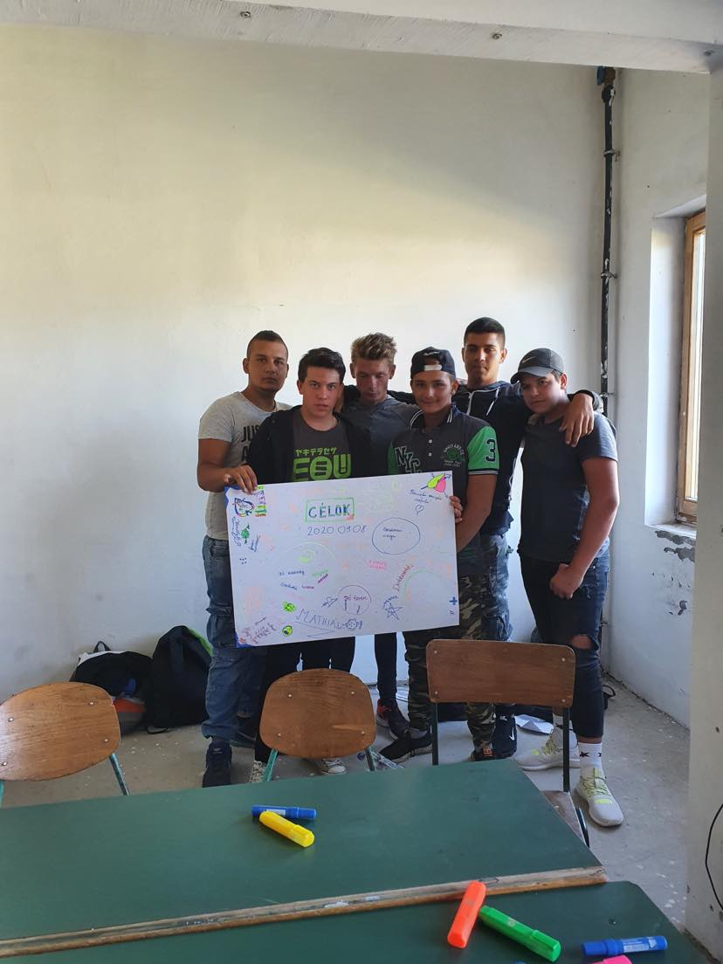
THANK YOU FOR YOUR ATTENTION!
Email: olasz.judit@ikk.hu
judit.olasz.gomorine@itm.gov.hu

