Slide 1
Cedefop
2018 European skills index
Ilias Livanos, Expert
Department for skills and the labour market
Notes:
Good morning ladies and gentlemen. It is my pleasure to introduce the European skills index to you – I would like to thank you all very much for your presence here today.
My name is Ilias Livanos, I am a Cedefop expert. I currently lead the work on the Index. However, this project is a team effort. There is a strong research team behind it, and a team of national experts whom we have been consulting with for its development. At the same time we had the pleasure to have the Join Research Centre on board from the beginning, as well as world leading experts in the field of composite indicators.

Slide 2

Skills at the forefront of EU agenda
European Pillar of Social Rights
The New Skills Agenda
How do we measure the effectiveness of a skills system?
01
02
03
03
04
Notes:
The area of skills is growing in importance at the level of European policy.
A number of key principles of the European Pillar of Social rights are built around a well functioning and inclusive labour market where education, training, and life-long learning are at a centre stage.
At the same time the New Skills Agenda lists a set of actions aimed at improving the skills system through better formation, more visibility of skills, and more informed career choices.
However, a question that remains is how do we measure how EU skills systems performance, how can these be made more effective?
To fill this gap, Cedefop has developed the European Skills Index.

Slide 3
What is the ESI and what does it do?
    01
A composite indicator
    02
Skills development, activation and matching
    03
Measures the relative performance of EU skills systems
    04
Identifies areas for improvement
    05
    05
Aids cross-country analysis and policy learning
Notes:
Let me start by outlining a few key points about the European skills index.
First of all, it is a composite indicator. Just like the GDP or OECD’s Better Life Index. The rationale, as with any composite indicator, is to reduce a large number of indicators from different dimensions into a single measurement. Indeed, a skills system provides a useful platform for such an endeavour if we consider that it has multiple facets. Although there is no single universal definition of skills systems, or skills, we have identified three distinct areas of a skills system: skills development, activation and matching. I will elaborate on these later in the presentation.
The purpose of the index is to measure and monitor over time the relative performance of EU skills systems. At the same time, areas for improvement can be identified while it also allows for cross-country analysis and policy learning.
Having said that, as with any composite indicator, the European skills index is not built to drive simplistic policy messages. Using it requires further investigation that needs to be coupled with local knowledge of how a skill systems has been built. As such, it is an empirical exercise, so an element of judgement is required.

Slide 4



Defining a skills system
Skills
activation
Skills development
Skills
matching
Notes:
Traditionally, when we think about a skills system, we tend to focus on the education and training available. However, a skills system is more than that. It is also about how smooth the transition to the world of work is, how inclusive the labour market is, and to what extent the skills are utilised at work. We have built this index to capture all these different aspects.
Our work on the index started by identifying three pillars. These pillars represent three distinct areas of a skills system: delivery of skills, activation in the labour market, and matching. These pillars resemble the elements of any system: inputs – processes – outputs.
Inputs are captured by skills development which includes both formal and informal education and training in compulsory and post-compulsory education, including lifelong learning and vocational education. This pillar is related to the education and training systems.
The processes are captured by the skills activation. This pillar examines the extent to which a smooth transition from education to work is achieved. For instance, how fast do graduates find a job? How many people decide to join the labour market? Thus, this pillar relates to the institutional framework and the mechanisms set in place.
The third pillar, the outcomes of the system, reveals the interplay between demand and supply as it examines how well the skills developed and activated, are then matched at work. Do for example, individuals find a job that is equivalent to their education, skills, and expectations?
There is no single owner of a skills system. One can say that the education system is responsible for the skills development, the institutional framework for the skills activation, while for skills matching it would be both employers and employees. The point here being that this index can be useful for multiple users.
All in all, these three pillars measure how well a skills system is functioning.

Slide 5

Building a composite indicator
OECD-JRC handbook on constructing
composite
indicators
10 steps to
a successful
indicator
  Theoretical framework
  Data selection
  Normalisation
  Weighting and aggregation
  Sensitivity analysis
JRC
statistical
audit
Notes:
Building a composite indicator involves a complex methodological procedure.
For the European skills index, we followed the recommendations set out in the JRC-OECD handbook on constructing composite indicators.
In particular, 10 steps were undertaken with regard to various technical choices ranging from theoretical framework to data selection, the normalisation process and the aggregation methods to the sensitivity analysis.
It is worth noting that building a composite indicator is an iterative process, as the choices made at any step may require revision of all previous steps. This means that all steps remain under continuous revision until the very end of the process.
Once our index had been constructed we submitted it to the Joint Research Centre for statistical audit. The purpose of this was to ensure the statistical robustness of the index – that enables policy-makers using it to reach more accurate and meaningful conclusions.

Slide 6
JRC statistical audit
The European skills index 2018 meets international quality standards for statistical soundness … The ESI framework is well-constructed. One of the greatest strengths is the amount of original research into the multiple facets of skills systems in the EU Member States.
Notes:
This is an extract from the JRC audit report:
‘The European skills index 2018 meets international quality standards for statistical soundness. The ESI framework is well-constructed. One of the greatest strengths is the amount of original research into the multiple facets of skills systems in the EU Member States.’
This outcome, of course, makes us at Cedefop very happy and proud.
The JRC audit report is available on our web page.

Slide 7
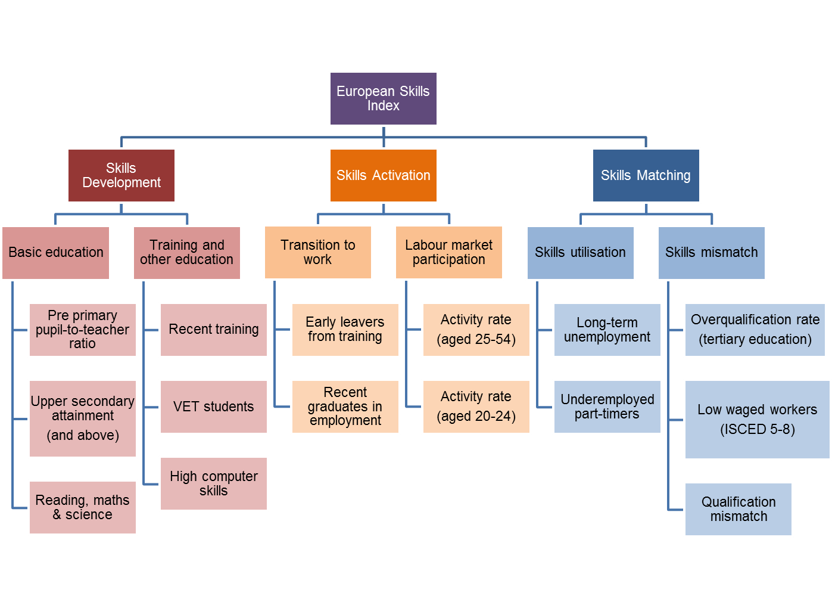
ESI structure
Notes:
This slide shows the final structure of the ESI.
As you can see, we have achieved a balanced structure of the index. Here are the three pillars. Each pillar includes two sub-pillars, and each sub-pillar 2 to 3 indicators.
A question that might arise is how we ended up with this structure. First of all, we started from a theoretical framework to define what skills systems are. For that purpose, we tried to include as many policy-relevant indicators that matched the theoretical framework as we could. At the same time, the choice of indicators focused on measuring outcomes rather than intentions. For instance, we did not include measures whose impact on a skills system is ambiguous. For example, high share expenditure on education could signify either a very good development pillar or a very inefficient pillar.
Now it is worth noting, that we experimented with a much larger number of indicators from different sources, but we were restricted to the data sets available across all Member States. We also experimented with different structures, but this final one ensures that each indicator contributes to the sub-pillar it is allocated to, the sub-pillar contributes to the pillar and the pillar contributes to the overall index. Our weighting method also ensures that an equal contribution is achieved so no indicator, pillar or sub-pillar dominates the index.
The detailed description of the indicators (that is the data they came from, their definitions) as well the rationale for inclusion can be found in our technical report.

Slide 8
ESI scores
ESI scores show how far along a Member State is in relation to an ideal performance.
A score of 65 suggests that the Member State has reached 65% of the ideal performance, allowing for 35% room for improvement.
Notes:
This is the last slide before we get into the results. It is very important, as it explains how to read the results.
The index measures countries’ ‘distance to the ideal’ performance. This ideal performance is chosen as the highest value by any country over a period of 7 years. The scores are calculated by country at indicator level and then the score is averaged at the various layers, and finally the index score is formed.
The ideal performance score is scaled to 100 and the scores of all countries are compared to that.
What this practically means is that a score of 65 suggests that the country has reached 65% of the ideal performance, allowing for 35% room for improvement. So if a country scores a 100% this means that it has achieved the best score over a period of 7 years. Overall, it helps to remember that the higher the score, the better the performance.
Full details about our methodology and all our considerations can be found in our technical report.
I think that is enough background information, so let’s have a look at the results.

Slide 9
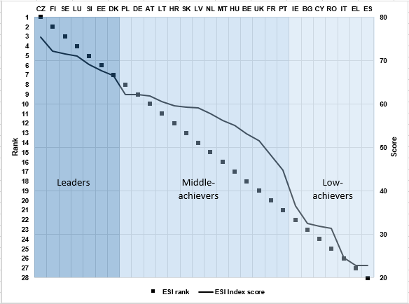
2018 ESI results
Notes:
A necessary evil of constructing a composite indicator is that country scores are presented side by side. This graph shows how countries rank based on their scores. So we start from the best performer on top to the one with the lowest score at the bottom.
What we see here is that there are three groups of performers. The first group comprises seven countries, from the Czech Republic to Denmark, scoring above 67, characterised by the prevalence of top 10 scores in the three pillars. Countries of northern Europe have a strong presence in this group. The second group comprises 14 countries, from Poland to Portugal, characterised by relatively unbalanced profiles, meaning that they may score high in one pillar and lower in the others and so on. The third group comprises seven countries, scoring below 36, characterised by relatively poor performances across all pillars.
One of the biggest challenges when producing rankings is to ensure they are robust with respect to the modelling choices made. In other words, to ensure that the modelling choices do not affect the order of the countries. In our case, a series of robustness checks were conducted and only two countries, the NL and MT were sensitive to them. Both these countries are in the middle of the ranking, so they do not affect the top or bottom ranks. The challenge, however, is getting correct rankings for the majority of the countries and this has been achieved with the European skills index. So if you are wondering why the NL scores in the middle, then you are probably right as the score would have been different if another approach had been adopted. On the other hand, if you are surprised that the Czech Republic scores so high, then we can assure you that this result is correct and indeed the Czech Republic has good scores in most indicators included in the index.
What we have talked about here concerns the overall performance of a skills system. In order to start understanding differences, one has to investigate how the scores differentiate by pillar.

Slide 10
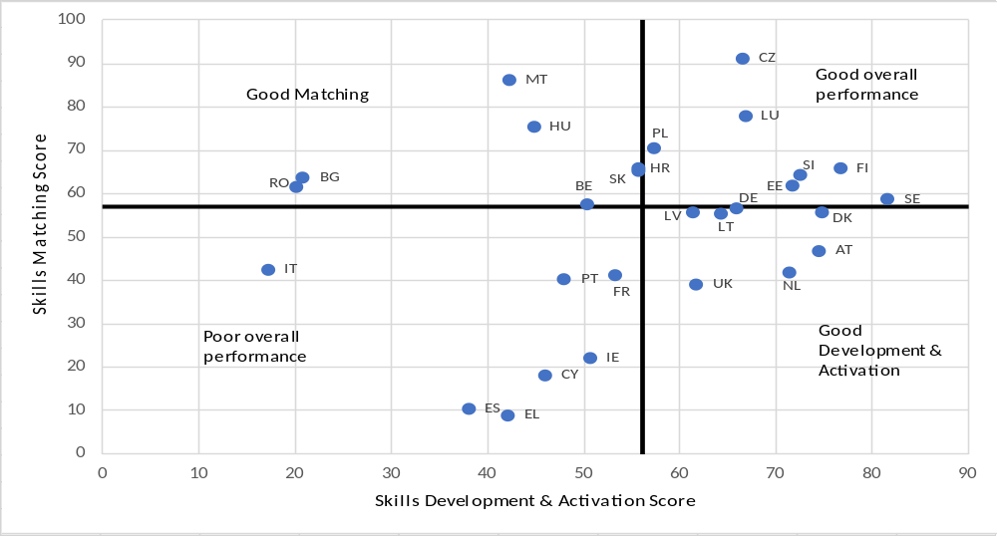
2018 ESI results
Low skills equilibrium
Role models
Hotchpotch
Bottlenecks
Notes:
This next graph breaks the index into two dimensions. The horizontal dimension puts together the pillars of skills development and activation. These two pillars were found to have a good linear relationship with each other (possibly because these pillars capture the performance of policy measures targeting the supply of skills). The vertical dimension shows skills matching, (which is an outcome of the interplay of demand and supply of skills). The crossing lines show the median scores.
First of all, this figure shows a diffuse scattering of points suggesting that these are two distinct aspects of the skills systems, each of which deserves attention from policy-makers.
Looking at the comparisons of scores across the two dimensions (e.g. skills formation and skills matching) enables some initial observations to be made. In particular, four groups can be identified. The first group consists of member states that show good performance in both dimensions (e.g. Sweden and Finland). Such countries can be considered as “role models” of overall skills systems and where good practices can be sought for. The second group, is comprised by countries where skills are efficiently developed and activated but poorly matched (e.g. Netherlands and the UK). The skills systems of these countries are characterised by certain “bottlenecks” as sufficient policies in developing and activating skills are narrowed down at the interaction between demand and supply. Specific policies targeting reducing skills mismatch would be necessary in these cases. A third group, is that of countries where matching is high but development and activation scores low (e.g. Romania and Bulgaria). On the one hand, these systems are rewarded by efficient labour market matching and can possibly be used as good cases of matching practices, on the other hand, however, given the low scores in skills formation can provide a signal of “low skills equilibrium”. In other words, a situation where efficient matching is an outcome of poor demand for high skills. Finally, the fourth group is that of countries where scores are low in both dimensions (e.g. Cyprus and Portugal). This can be described as a “hotchpotch” situation where better co-ordination is needed towards both skills formation and skills matching.
At the same time, some policy lessons can emerge by looking at these quadrants. In the top right we have countries scoring higher than average in both dimensions. Therefore, good practices of skills systems should be sought in the top right corner. In the bottom right corner are countries that score high in development and activation but lag behind in skills matching. For instance, if the UK wants to improve its skills system, it needs to focus on its skills matching aspect. Similarly, the top left corner shows countries that score high in matching but can do a better job in skills development and activation. In the bottom left quadrant we have countries scoring low in both dimensions.
Finally, we may want to look at countries showing similar scores in one or the other dimension in order to look for policy lessons. For instance, in this first group we have countries with similar skills development and activation but very different matching. Let’s take Hungary and Greece. Hungary could perhaps inspire Greece with regard to matching policies. In particular, Hungary’s scores can be looked at and then the policies behind them can be analysed to discover what it takes to get there. In the next two groups, we have countries with very similar skills matching but different levels of skills formation. In Group 2, effective policies on skills development & activation in Finland, Slovenia and Estonia may be helpful for gauging [αυτό διαβάζεται ‘γκέιτζινγκ’ – sorry αν το ήξερες] how policies can be shaped in Bulgaria and Romania. In Group 3, Austria and the Netherlands may be used as good examples for ‘what works’ policies on advancing skills development & activation in Italy.
The current version of the ESI is suggesting priority areas for policy focus. However, skills systems are complex entities and building a country’s skills system is a dynamic process that takes time. How well skills systems perform depends on their capacity to respond to a variety of external factors which affect the demand for skills in the labour market both currently and in the future.

Slide 11
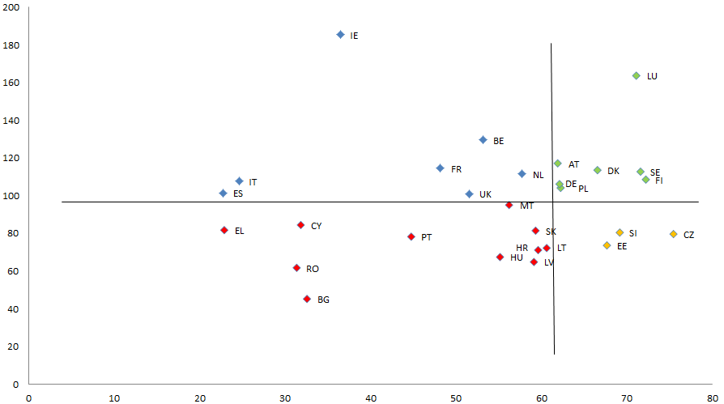
Skills Systems vs Labour Productivity
Notes:
An interesting area for investigation is the factors affecting a good overall skills system performance. What measures is a good skills system linked to?
For instance, the purpose of initial vocational education and training is to provide young people with skills and competences to access and maintain their position in the labour market. Therefore, Member States investing more resources in IVET should, other things being equal, produce better skill outcomes. Indeed, there is a positive relationship between the index scores and IVET expenditure (as a percentage of GDP); Member States with higher IVET expenditure also have higher ESI scores.
This graph also helps us understand the position of a country relative to others (concerning spending on initial vocational education and training).
High-return countries (a green dot): those with an average-to-high ESI score and relatively lower expenditure on IVET, e.g. Estonia, Luxembourg;
Low-return countries (a yellow dot): those with an average-to-high ESI score and relatively high IVET expenditure, e.g. Slovakia and Sweden;
Low-spending countries (a red dot): those with a lower-than-average ESI score and lower-than-average IVET expenditure, e.g. Romania and Spain;
High-spending countries (an orange dot): those with the highest IVET expenditure but where the skills system performs similarly to other countries, e.g. Belgium and Finland.
Moreover, countries with similar scores in one dimension or the other can be looked at, so further investigation is possible. Why does Spain spend the same as Hungary but the outcome is so different? Similarly, why does Slovakia spend much more than Latvia for the same outcome?
This is of course, not to say, that the ESI also provides the answers but it provides the platform for further investigation to start.

Slide 12
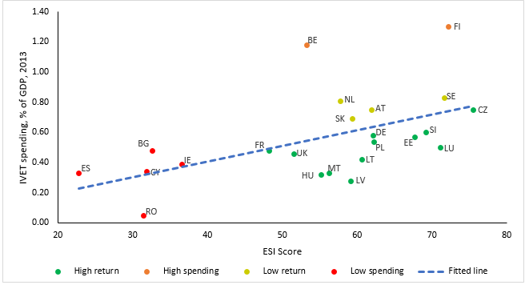
IVET spending: a key to success?
Notes:
An interesting area for investigation is the factors affecting a good overall skills system performance. What measures is a good skills system linked to?
For instance, the purpose of initial vocational education and training is to provide young people with skills and competences to access and maintain their position in the labour market. Therefore, Member States investing more resources in IVET should, other things being equal, produce better skill outcomes. Indeed, there is a positive relationship between the index scores and IVET expenditure (as a percentage of GDP); Member States with higher IVET expenditure also have higher ESI scores.
This graph also helps us understand the position of a country relative to others (concerning spending on initial vocational education and training).
High-return countries (a green dot): those with an average-to-high ESI score and relatively lower expenditure on IVET, e.g. Estonia, Luxembourg;
Low-return countries (a yellow dot): those with an average-to-high ESI score and relatively high IVET expenditure, e.g. Slovakia and Sweden;
Low-spending countries (a red dot): those with a lower-than-average ESI score and lower-than-average IVET expenditure, e.g. Romania and Spain;
High-spending countries (an orange dot): those with the highest IVET expenditure but where the skills system performs similarly to other countries, e.g. Belgium and Finland.
Moreover, countries with similar scores in one dimension or the other can be looked at, so further investigation is possible. Why does Spain spend the same as Hungary but the outcome is so different? Similarly, why does Slovakia spend much more than Latvia for the same outcome?
This is of course, not to say, that the ESI also provides the answers but it provides the platform for further investigation to start.

Slide 13
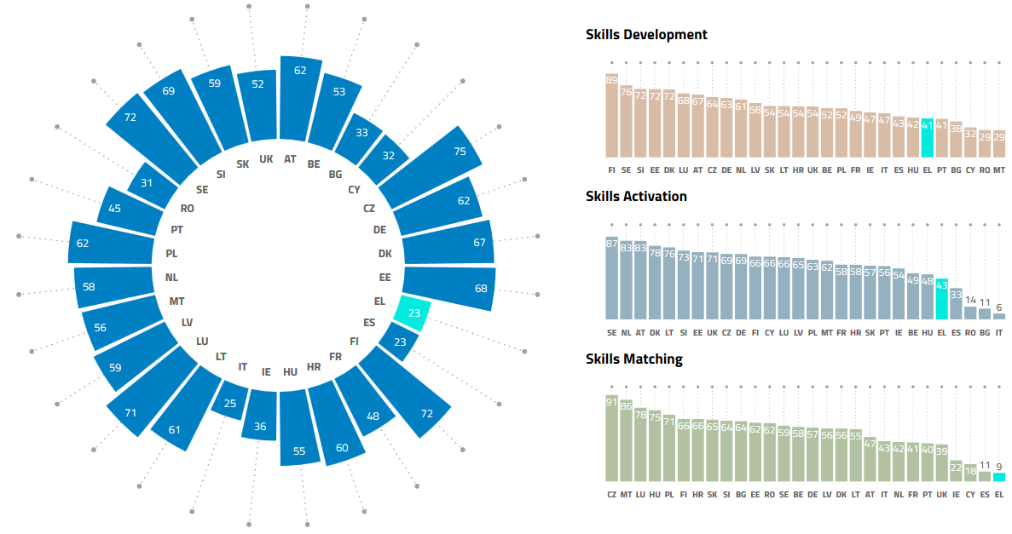
2018 ESI results: Greece
Notes:
Let us now have a look at how the index is displayed and how it can be used for such an investigation. This is a snapshot from the Skills Panorama portal, where the ESI is currently available. In the coming period the index will also be available on Cedefop’s web page. You can find details on the Skills Panorama in the flyer provided in your folders.
The wheel shows the results in alphabetical order. The bars on the right show the scores in the three pillars. The shaded part in the graphs below shows how far (in %) a country has scored in comparison to the ideal, while the dotted line shows the remaining distance to cover until the best performance is reached.
Users will find that the display is interactive, allowing them to choose a country or pillar of interest.
By hovering your mouse over a country, the respective results are highlighted, as I have done here for Greece, which is my country and the country Cedefop is based in.

Slide 14
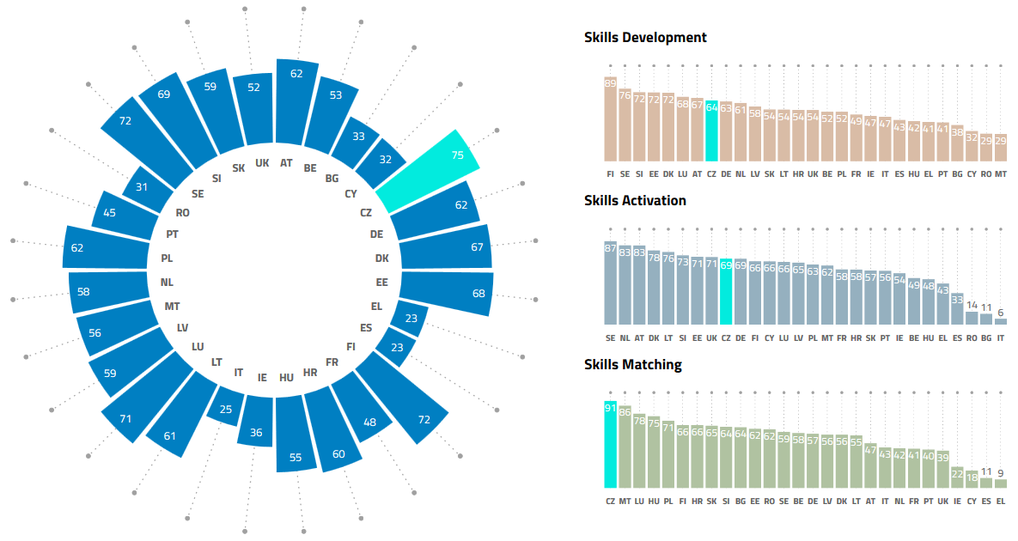
2018 ESI results: Czech Republic
Notes:
A first observation to make is that no country has an ideal skills system performance.
The second observation is that skills matching is the pillar with the larger distance to cover – we can see this from the lower scores in the bar chart here.
The Czech Republic has the best score, but it still has a significant distance to the best achievable value, which is 100. In particular, in the skills development and activation pillars there is still considerable room for improvement for the Czech Republic. In contrast, the Czech Republic is a very good example of good practice in skills matching.

Slide 15
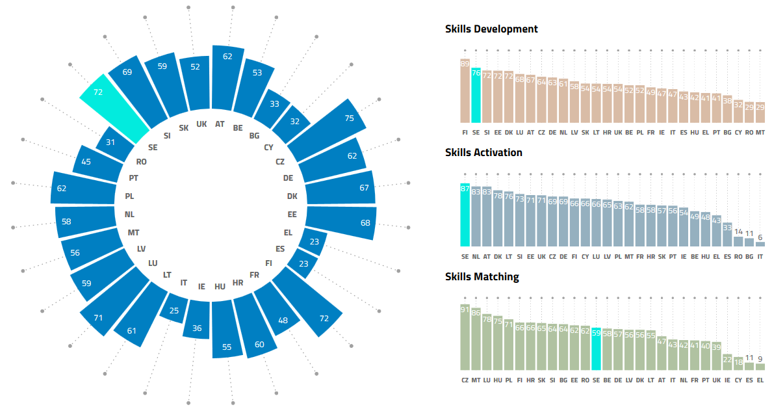
2018 ESI results: Sweden
Notes:
Let us say that we want to investigate the skills system of Sweden, which is one of the leaders. As we can see, Sweden has the best score in skills activation, the second best in skills development, but an average score in skills matching.
So it is worth investigating what lies beneath skills matching in Sweden, and this is possible with the ESI.

Slide 16
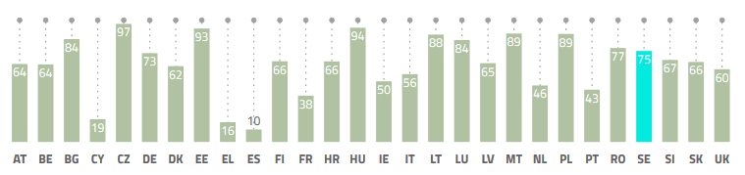
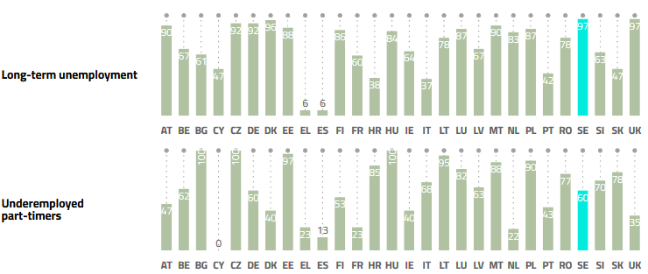
Skills utilisation
Notes:
These are the results under the first sub-pillar of skills matching called ‘skills underutilisation’. The first observation to make is that Sweden has a very good score of skills in the sense of long-term unemployment. What is also relatively good is the score of underemployed part-timers, which are people who have accepted a part-time job even though they were looking for a full-time one. These two signify that jobs are both readily available in the labour market and, to a lesser extent, these jobs represent workers’ preferences in terms of type of contract (part-time or full-time).
In contrast, the case of the UK is quite different , where even though jobs exist, they are very often of a different format to the ones people are looking for.

Slide 17
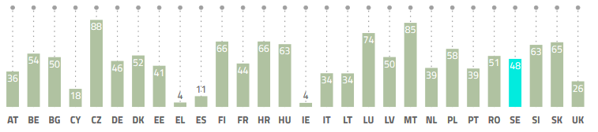
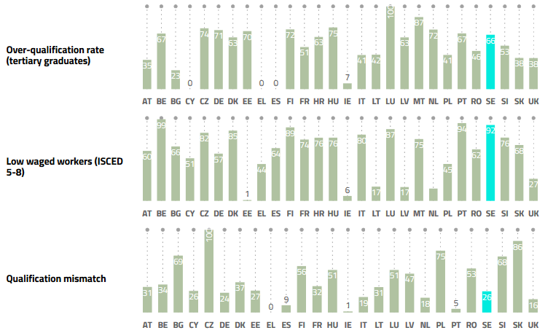
Skills mismatch
Notes:
Moving on to the skills mismatch pillar and looking at the indicators there, we can see that Sweden’s biggest problem is the very high levels of qualification mismatch. That means that in Sweden there is a high share of workers with an educational attainment that is higher or lower than that required for their job. Typically, this is translated as a mismatch between people’s education and actual work. We know from the literature that qualification mismatch can be linked to low job satisfaction, decreasing productivity and other negative outcomes.
So in order for Sweden to improve the overall score, this is the area that it needs to focus on. The Czech Republic, which has the best score, could constitute a useful case study for this purpose. In contrast, the UK has low scores in all indicators in the matching pillar, suggesting that all these areas need to be looked at.

Slide 18

Keep pulling the thread . . .
FES Athens analysis on Greece results
Problematic areas were identified and explained
Policy actions were proposed
Notes:
So the main message is that the ESI is a tool that helps initiate the process of investigating to discover which the problematic areas of a skills system are, and how these can be improved.
In other words, as the title suggests we need to keep pulling the thread, and in order to do so, local knowledge and expertise is needed.
A very good example of that is the Athens Friedrich Ebert Foundation, where a working group comprised of senior stakeholders analysed the results for Greece to ‘flesh out’ the indicator scores [alternatively you can say ‘to identify from the indicator scores what’s happening on the ground’] and propose measures for improvement. I should point out that this was an independent initiative where Cedefop was invited to present the results of the index.
Let me share with you a couple of examples of this analysis.

Slide 19
Compulsory education
Pre-primary
pupil-to-teacher ratio
64
Reading, maths & science scores (aged 15)
22
Abstract nature of curricula
Limited use of technology
Lack of autonomy
Share of population aged 15-64 with at least upper secondary education
50
Embrace critical thinking
Practical applications of knowledge
Frequent teacher assessment
Notes:
To start with, looking at the index it was evident that, even though Greece has an average performance regarding compulsory education, it is scores in reading, maths and science that are most problematic, driving this pillar down. Such scores come from PISA indicators, which are in fact key monitoring indicators regarding the performance of an education system.
The working group noticed that the abstract nature of the curricula, the limited use of technology and lack autonomy of teachers and schools are the primary reasons behind the poor performance.
A number of measures were proposed. Reshaping curricula embracing critical thinking, practical applications of knowledge and new technologies, focus on higher-quality study material, together with increased teacher autonomy and frequent assessment, were proposed as essential areas for policy intervention.

Slide 20
Transition to work
Early leavers from training
76
Gains of education deeply rooted
Weak link between universities
and employment
Lack of labour market intelligence
Inefficient apprenticeship/internship schemes
Recent graduates
in employment
0
Better career guidance
Build labour market information systems
Link education programmes to labour market needs
Tax incentives for hiring new graduates
Notes:
In contrast, Greece has a considerably high score of people not leaving education and training early. This shows that the concept of the gains of education is deeply rooted and supported by family and the education system; thus a modernisation of some aspects of the education system will yield benefits.
At the same time, it has the worst performance regarding participation of recent graduates in employment. The reasons behind this according to the working group include:
Weak link between universities and the employers
Lack of work experience
Low apprenticeships
No information system of labour market prospects
Low mobility
High reservation wage
No new hirings
Measures suggested by the working group included:
Better link of curricula and education programmes to the needs of the labour market
Modernization of apprenticeships and traineeships
Better career guidance
Offer tax reliefs for new graduates
Modernisation of career offices
This exercise shows the potential of the index and how it can be used for policy learning. We really hope it will prove to be a useful tool in the hands of a variety of users, and of course Cedefop is happy to provide any support necessary.

Slide 21

Ilias.LIVANOS@cedefop.europa.eu
#EuropeanSkillsIndex
Notes:
That concludes my presentation on the European skills index.
Allow me to say that apart from the BN you have in your folders, we are currently preparing a main results report that we aim to publish by the end of this year. As mentioned earlier, the index is currently available in the Skills Panorama portal, and it will soon be available on Cedefop’ s website.
This looks like a good time to stop, so I would like to thank you very much for your attention and I would invite you to come and talk to me if you require further details.

Slide 22
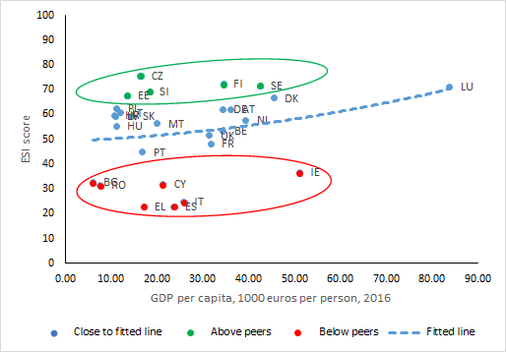
ESI vs GDP

