Slide 1
Making skills intelligence actionable
Stelina Chatzichristou & Jiri Branka
Experts, Cedefop
Cedefop virtual get-together: Roadmapping the skills revolution
11 March 2024

Slide 2


Cedefop looks
into labour markets’ changing skill needs and the development of vocational education and training policies across the EU Member States
With its research and policy analyses, it supports the European Commission in designing and promoting EU VET policy

Slide 3


Let’s get to know each other!
I am a:
ⓘ Start presenting to display the poll results on this slide.

Slide 4

Skills intelligence what is it and how can it support you?
identifying key trends and demands in the labour market
assessing, anticipating and forecasting skills needs
addressing skills gaps and mismatches
adapting provision of education and training
providing educational and career guidance and counselling.
skills intelligence
foundations
Data and surveys, statistics, qualitative information
Analysis, synthesis, interpretation
Actionable information, reflection on HR and policy implications
Dissemination, communication, user interaction + action
Skills intelligence the outcome of an expert-driven process of identifying, analysing, synthesising and presenting quantitative and/or qualitative information on skills and labour market
skills intelligence value added
https://www.cedefop.europa.eu/en/tools/skills-intelligence

Slide 5
Cedefop blends insights to develop skills intelligence
Sectoral skill foresights
Qualitative research and analysis
Cedefop networks and expert groups
EU Skills forecast
Online job ads analysis (OVATE)
VET and skills surveys
Long-term trends
Future skills demand and supply
Understanding megatrends
Matching skills and jobs
Skill demand, utilisation and learning
Skills (mis)matches/tensions
Immediate skills needs
Demand for occupations
Emerging skills trends
Cedefop Skills Intelligence https://www.cedefop.europa.eu/en/tools/skills-intelligence
Notes:
How to develop skills intelligence for ET, LM policy makers? No single data source (e.g. a survey), method or approach gives all the answers. Data (quantitative and qualitative) is the foundation of skills intelligence, but we often find we need to combine different sources of information to get the full picture. Cedefop’s approach to developing skills intelligence therefore is to blend (or mix) insights that are coming from different data sources and analysis approaches.
In the yellow shapes you see the skills intelligence foundations (sources, methods) Cedefop is using such as forecasts, surveys and online information; I will explain more about some of those resources later.
The blue dots shows the three perspectives in our skills intelligence work: a Long-term and future oriented perspective, the skills matching perspective and the perspective of skills that are currently in demand or emerging.
We look into the future using skills forecasts (quantitative) and foresight (qualitative or mixed qualitative/quantitative). Our focus is often on understanding megatrends – important development that shape our economies and societies such as digitalisation, greening economies, population ageing and their impact on the labour market and skills.
We use surveys on VET, work, skills and learning to analyse labour market and skills bottlenecks and imbalances, The job market is a market that is constantly evolving and as a result there are imbalances: shortages in occupations (IT, medical professionals) and skills gaps among workers. Another type of imbalance is people in jobs that do not use their full potential. This happens when for example a university graduate cannot find a job at his level and therefore settles for a low level job (e.g. selling electronics in retail store). Not a big problem if it is a few months to earn some money while learning. But being ‘overskilled’ (as we call it) for long leads to less job satisfaction, and worse – people that do not use their skills for a long time, forget them, making it difficult to find a matching job as time goes by.
Since a few years we are exploiting online job ads (the ones you find on monster, indeed, infojobs in spain) to reflect on skills at a much more detailed level and on what skills trends are trending now or emerging. Apart from job title, such ads contain descriptions of what jobs are about and what skills they require. We collect millions of online job ads from all EU countries and the UK and analyse them using big data techniques. I will show some of the most recent analysis we do with such data later.

Slide 6
I use skills intelligence in my work:
ⓘ Start presenting to display the poll results on this slide.

Slide 7
I mostly use skills intelligence in my work to support/shape:
ⓘ Start presenting to display the poll results on this slide.

Slide 8

The five challenges of skills intelligence
Detailed
Timely
Affordable
Representative
Skills!
Practical applications of skills intelligence is limited by levels of aggregation
Resources to conduct in required scale and frequency
Reliable methodology, data robustness & gaps, comparability
Surveying and measuring skills is extremely difficult
Relevant, “finger on the pulse”

Slide 9

Skills intelligence principles
Thematic, occupation and sector focus
Single EU-wide methodology
Visual storytelling
Update friendly

Slide 10


Below
the surface of skills intelligence
Visualisations
Dashboards
Publications
Presentations
User testing
Product design
Data validation
Quality control
Data management
Data collection
Design and prototyping
Methodology work
Ideas and research questions
Image by Mote Oo Education from Pixabay
10

Slide 11

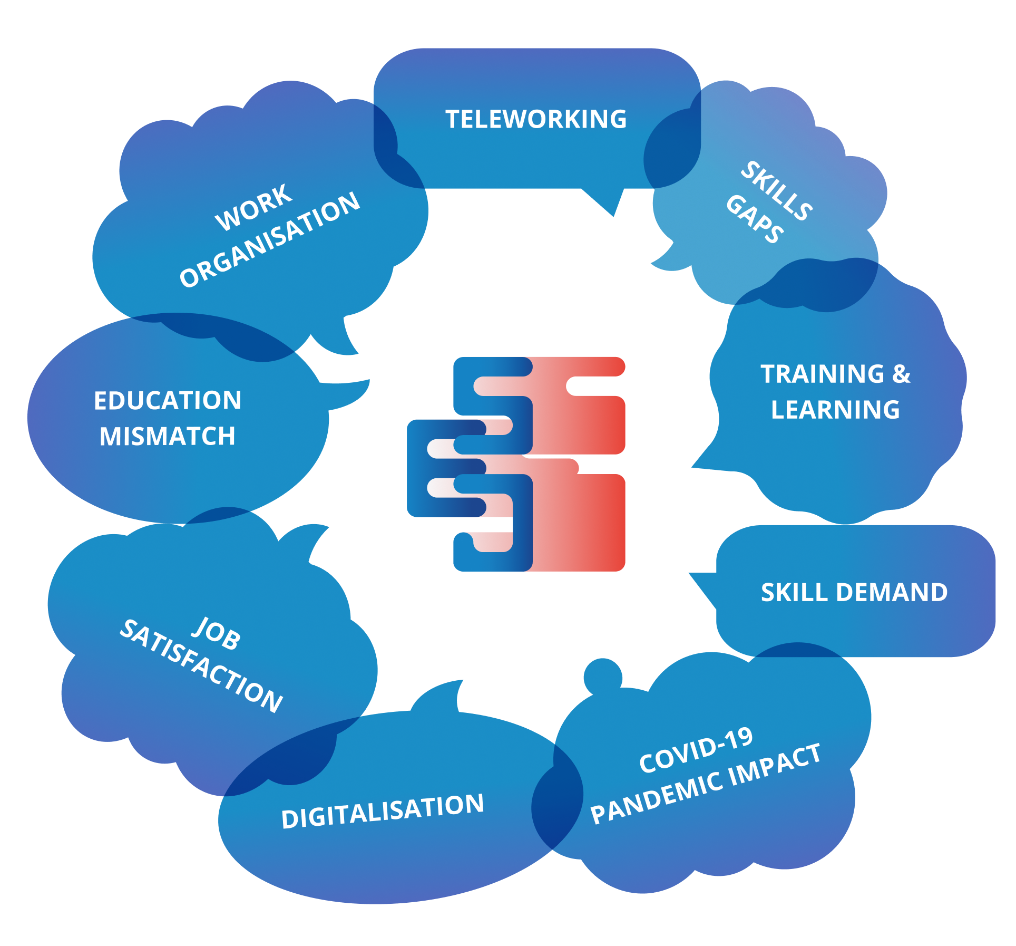




Let’s go online
Skills forecast
Skills OVATE
European skills and jobs survey
Matching skills database
European skills index
Skills intelligence tool

Slide 12
I am mostly interested in:
ⓘ Start presenting to display the poll results on this slide.

Slide 13

Skills intelligence powers effective VET
Short-term (sprint)
Recalibrating VET
Targeted CVET: Adjust training to learners’ needs (e.g., short-training modules; microcredentials)
Work-based learning/apprenticeships
Shaping circular economy citizenship
Technical and digital skills; but also empathy
“Green” skills anticipation
Accompany change
Long-term (marathon)
Trigger change

Slide 14
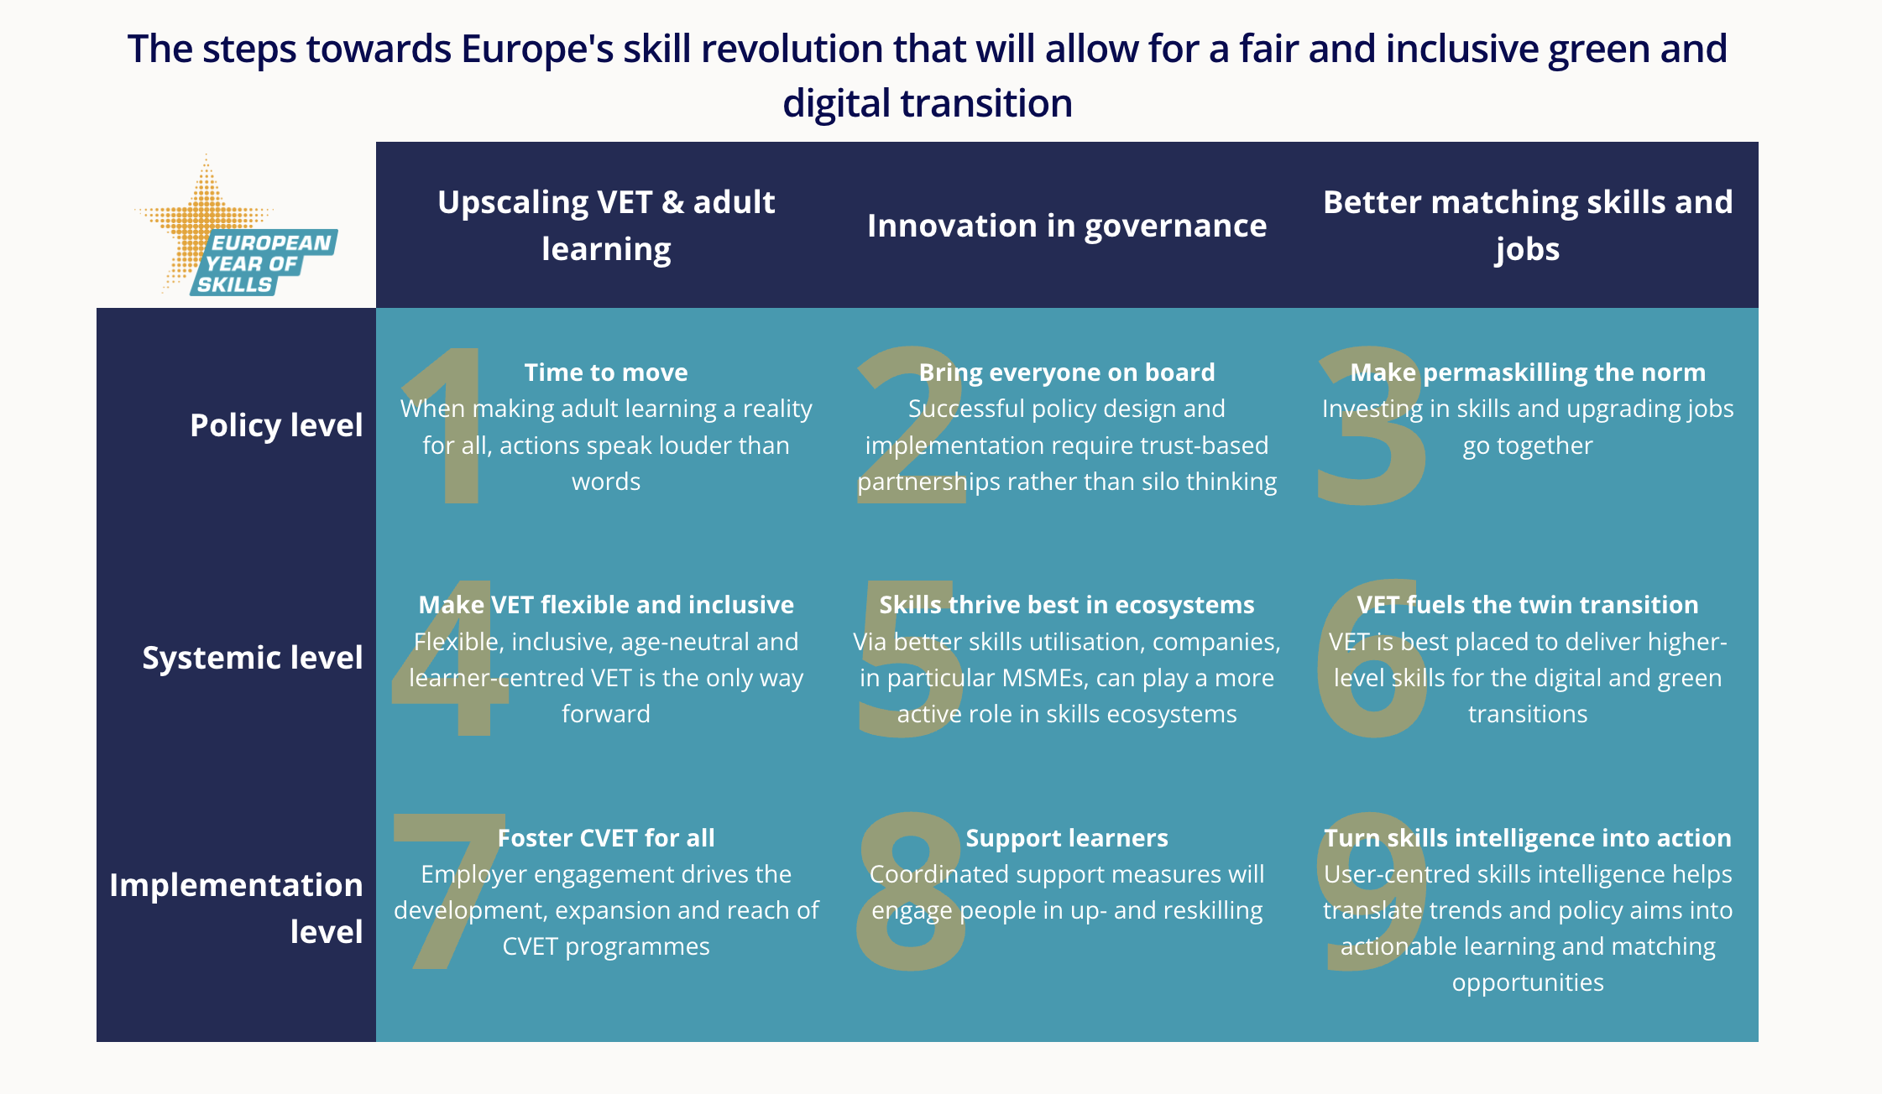
Cedefop’s approach and work on EYS

Slide 15

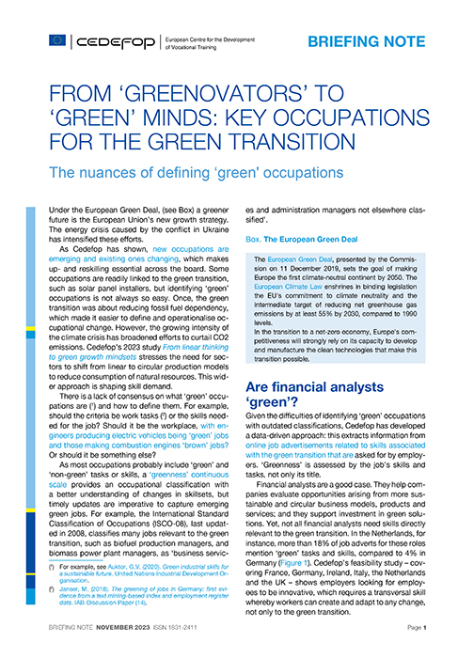







Recent Cedefop skills intelligence publications
From ‘greenovators’ to ‘green’ minds: key occupations for the green transition | Going digital means skilling for digital | Handling change with care | The feasibility of using OJAs in analysing unmet demand
Skills in Transition: The way to 2035
From linear thinking to green growth mindsets | Growing green | Too good to waste | Cities in transition

Slide 16


Slide 17
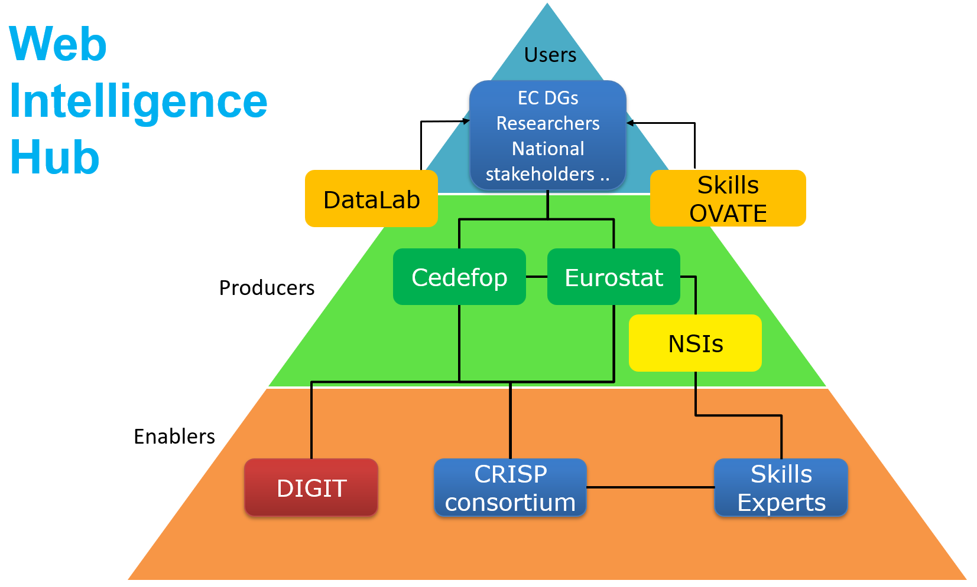

Using big data to see emerging labour market trends
Online job ads (500M+)
In 28 countries
From 419 sources and 146,993 sites
In 29 languages
Collected jointly with Eurostat
Feasibility
Production
Trend mapping
https://www.cedefop.europa.eu/en/tools/skills-online-vacancies
Notes:
Future LM trends via forecast and foresight What about the present (today and tomorrow)?
That is where another skills intelligence tool comes in. Cedefop skillsOVATE is a system that collects and analyses hundreds of millions of online job advertisements from all EU countries plus the UK. Those online job advertisements contain information on what employers are asking for when they recruit new staff (Joint venture with Eurostat)
Relatively new approach with many opportunities – more detail (actual skills instead of skills proxies such as occupation or qualification level we use in forecasts), more contextualised info, faster, analysis of trends over time (compared to e.g. a skills survey)
At the same time it is also a very different data source – Challenges:
there is much less control over data generation (compared to e.g. a survey).
OJAs are not generated for research purposes.
Representativeness – some jobs not or very rarely advertised online (e.g. waiters, but also some higher level jobs where informal recruitment is a main recruitment channel.
Skills in OJA are not complete job descriptions or job profiles. Some skills are implicitly assumed, others may be overstated.
Seperating valuable information from noise – need for highly complex data collection and production system (see the triangle) AND woman/man in the loop
What is important for you: information accessible via Skills OVATE platform + datalab access to classified data for researchers. Let me show what type of analysis is actually possible with skillsOVATE.

Slide 18
Future shortage indicator by sector (EU average)
Notes:
I will give you a sneak preview for the findings for sectors. As there are many sectors here, I’ll Focus on three findings
Mining and quarrying – EGD implementation/green transition – not much shortages
Human health, social care, services – significant shortages because these sectors have many jobs where personal skills play a big role. They require a particular profile and cannot be simply carried out by someone who is more educated. Also in these sectors the workforce is quite aged, and we see strong replacement needs in the future.
ICT – now a sector which faces big shortages, but likely to change in the coming years. Mainly because supply is expanding and will suffice and because the current workforce is relatively young (meaning less replacement demand than other sectors).

Slide 19
The labour market up to 2035
megatrends make jobs rapidly more skills intensive
Millions
Jobs by skill level
Job openings in 2021-35
+ 3%
+32%
-7%
-29%
Millions
Source: Cedefop skills 2021-35 forecast
19
Notes:
Cedefop new skills forecast (to be out very soon) clearly shows that THE labour market megatrend is accelerating skills upgrading. So, up to 2035: the broad outlook is more jobs (employment) and more skills intensive jobs.
our analysis strongly suggests that it is very likely that already before 2035 there will be more high skilled jobs (requiring academic or High-level VET) than medium skilled jobs. ​
Skills upgrading is very visible in job openings: out of every 100 job openings up to 2035, 57 will be for people with a higher qualification; 41 for people with a medium level qualification only 2 for people with a lower qualification. ​
But - and this is very important, these forecasts are not an image of what happens by itself. We incorporate the EU policy framework and its targets (e.g. EGD). The trends the forecasts show will not materialise unless we invest in Europe’s people by giving them the skills they need, address skills shortages (already putting a brake on progress in some the IT, energy, and care sectors) and make our economies more green and digital.

Slide 20










Just digital transition via
up and reskilling people
Learning potential in digital activities (% adult workers)
Basic
Medium
Higher
Manage or merge databases | 81%
IT systems, hard/software | 87%
Programme or code | 92%
Use specialised software | 50%
Prepare presentations | 60%
Advanced spreadsheets | 74%
Browsing, e-mail, social media | 20%
Write or edit text | 28%
Use spreadsheets | 38%
Source: Cedefop 2nd European Skills and Jobs Survey (2021)
Notes:
How can we ensure a just digital transition? Our survey evidence first of all tells us that it is a matter of making use of learning potential. We see that we can achieve a lot by investing in basic and medium level skills.
1 in every 5 EU+ adult workers could benefit from additional training in the most basic of digital skills - navigating the web.​
Between 30-40% of the EU+ workforce can be further trained in fundamental word processing and use of spreadsheets.
Between 70-90% is trainable for more advanced digital skills, such as database management and computer programming. So many people are potentially trainable for such skills. That is not to say many jobs demand them.​ [CLICK]
But it is not only about supplying more skills. Our skills and jobs survey also shows a side of mismatch that tends to be less emphasised: knowledge and skills underutilisation at work. ​No matter what someone’s skill level is, there are substantial untapped opportunities to expand skills utilisation at work. In other words. We also need to upgrade jobs by designing jobs in smarter ways, by improving work organisation and by giving more people opportunities to use and expand their skills. ​

Slide 21
The green transition is a skills revolution
European Green Deal skill forecast scenario
About 2.5 million additional jobs by 2030
Employment benefits in most sectors, some negatively affected (e.g., coal mining)
Indirect employment benefits mainly for service-based sectors (e.g. ICT, real estate)
Cedefop (2021) The green employment and skills transformation
Online job advertisements by ‘greenness’
(averages for Q1 2020 - Q4 2022)
Up-/reskilling for all workers:
Targeted policy for ‘key’ and ‘thyroid’ occupations
VET for workers’ transitions in ‘brown’ sectors (e.g. conventional electricity)
IVET to prepare future workers for green(er) jobs
Many types of jobs will drive green transition:
Frontline green jobs Greentech specialists
Green management Digital specialists
Green minds
Cedefop foresights: cities, waste management , agri-food, circular economy

Slide 22

Green jobs in the future of work
and VET’s role in accelerating transition
Frontline green jobs
Green management
Construction professional
Repair specialist
Energy professional
Material extraction/recycling/reuse expert
Material and process engineers
Circular product designers
Transport and mobility specialist
Environmental protection specialist
‘Μarketing’
green jobs/careers
Green/smart city manager
Logistics manager
(Strategic) waste manager
Waste valorisation professional
Renewable energy managers
Trusted skills
intelligence
Green
apprenticeship
Strong feedback
loops for agile VET
Digital specialists
Green transition accelerators
Microcredentials
ICT professional
Data scientists and data analysts
E-commerce specialists
GPS experts (precision agriculture)
Waste sorting optimisation professional
Greentech specialists
Systems
thinking
Networks
Industrial problem analysts
Industrial symbiosis facilitators
Hydrogen specialists
Urban space specialist
Energy expert
Circular economy plant designer
Agronomists
Empowered
local players
Green hearts and minds
HR specialists
Consumer behaviour specialists
Sustainability trainers
Waste management trainer
Citizen engagement specialist
Source: Cedefop green skills foresights in cities, waste management , agri-food and circular economy
Source: Cedefop green skills foresights in cities, waste management , agri-food and circular economy
22

Slide 23

Small but indispensable:
“thyroid” occupations are green transition enablers
Highly and medium-skilled
Tasks change rapidly (emerging “greentech”)
Inventing, designing, conceptualising green transition solutions:
  Engineers, process designers, scientists/R&D
and implementing it:
Managers, lawyers, renewable energy technicians, communication specialists
Source: Cedefop Green Observatory
Notes:
Moreover, achieving the green transition highly depends on the development and implementation of “green” technologies. The occupations mainly responsible for the development and design of such technologies (and of the relevant infrastructure necessary for the implementation of these technologies), such as scientists, R&D researchers, specialised engineers and associate professionals supporting these occupations etc. may account only for a small share of green jobs and/or be expected to have small changes in their employment shares. Nonetheless, they are critical for the achievement of the green transition. Cedefop has described such jobs (usually in R&D or engineering), as “thyroid” (Cedefop, 2022a).
“Thyroid” occupations may be highly skilled (e.g. engineer working on alternative fuels), while skill sets in some of them may yet to be defined (due to being relevant to emerging technologies, such as hydrogen). Middle-skilled occupations with more technical profiles, concerning technicians, such as offshore renewable energy plant operators and biogas technicians, are equally critical.

Slide 24

Skill sets driving the green transition
Strategic skills
Production skills
Marketing / communication skills
Systems thinking, empathy
Enabling skills: digital and data analysis skills & product and process design skills
Source: Cedefop green skills foresights in cities, waste management , agri-food and circular economy
Notes:
Strategic skills: management and entrepreneurial skills establishing a sustainability vision or mindset;
❖ Enabling skills: digital and data analysis skills to collect, combine and process information to deliver sustainable solutions effectively and efficiently. Product and process design skills, playing a major role in waste reduction, are also needed;
❖ Production skills: e.g., for workers installing sensors, food production line workers, soil and water management professionals, and waste processing and recycling workers;
❖ Marketing / communication skills: needed to communicate to consumers or the wider population to merits of reducing waste, upscaling recycling, and repairing goods

Slide 25

Cedefop reaches out in the European Year of Skills
Main events
Skills, Skills, Skills – 20/9
At the European Parliament with the European Commission, Eurofound, ETF, ELA and EU-OSHA
Mind the gaps – Skills and learning in a changing world of work - 12/10
Cedefop flagship event in Brussels
Contact Cedefop for more information
EYS virtual get-togethers (90min) 2023/24
EU blueprints in the spotlight – sectoral skills strategies: 26/9
Valuing all skills - The European approach to validation 3/10
Matching skills to quality jobs - From evidence to action
Tackling the digital divide in the EU and beyond (with ETF)
What does going green mean for skills? (Green Observatory)
Info on Cedefop webportal
& social media

Slide 26
Slido question 1: Let’s get to know each other!
I am a:
VET provider
Career guidance counsellor/trainer/researcher
Researcher
Policy-maker
Social partner (e.g., employer/employee organisation)
Sectoral/occupational association

Slide 27
Slido question 1
I use skills intelligence in my work:
Daily
Once per week
Once per month
Never

Slide 28
Slido question
I mostly use skills intelligence in my work to support/shape:
decisions at national level
decisions at regional/city level
policy making
individuals (e.g. job seekers)
VET programmes/curricula

Slide 29
I am mostly interested in:
ⓘ Start presenting to display the poll results on this slide.

Slide 30


Skills intelligence challenges
Affordable
Detailed
Representative
Timely
Skills!
Employment (household) surveys
Skills surveys
Skills forecasts
Online job advertisements

Slide 31
Cedefop’s Skills intelligence
Surveys
(ESJS, ECS)
Skills forecast
Online job advertisements
European skills index
Labour market indicators (LFS, SILC …)
Publications
Online tools
Data
Occupations
(blended) Skills intelligence
Sectors
Countries
Digitalisation
Green transition
Societal changes
Job market trends

Slide 32
Slido question
I am mostly interested in….: (multiple choices possible)
Indicators
Thematic dashboards
Sectoral skills intelligence
Occupational skills intelligence
Country-level skills intelligence
Data insights/short analysis

