Slide 1



Cedefop
VET toolkit for tackling early leaving
ReferNet 2021 Partnership Forum
26 May 2021
Irene Psifidou, Expert
Coordinator of VET for youth team
Department for Learning and Employability

Slide 2



Why tackling early leaving from E&T matters?
Early leaving from education and training is still a pressing issue in Europe
Early leavers are at greater risk of becoming NEETs and socially excluded
1/10 young people do not qualify in upper secondary education
Extended school closures due to Covid-19 may lead to higher rates of dropping out
Notes:
Early leaving from education and training is a pressing issue in Europe, with considerable costs for individuals and society. Early leavers are at greater risk of becoming NEETs (young people not in education, employment or training) and socially excluded. Despite successes in bringing down the numbers of people who exit with, at most, a lower secondary education, early leaving still affects one in 10 young adults in the EU; in some areas the figure is much higher.
Urgent need to evaluate the impact on learners at risk and on increasing drop out and early leaving rates

Slide 3




Cedefop work
Cedefop Country reports
1st European study on the role of VET for tackling early leaving (Vol I, II)
Policy learning Fora and international workshops
www.cedefop.europa.eu/TEL-toolkit

Slide 4




VET toolkit for tackling early leaving
Who is it for?
Designed for policy makers and VET practitioners to support young people at risk and early leavers
Used by ministries, VET schools, enterprises, guidance centres, public employment services,
social services and youth organisations
Notes:
We started systematic research work in 2013 with a view to providing policy-makers and learning providers with practical support; we launched the VET toolkit for tackling early leaving in May 2017. This was the first online toolkit of its kind developed by Cedefop. It is designed for young people at risk of becoming early leavers, to help them remain in, and qualify from, upper secondary education. It also aims to help early leavers reintegrate into education or training. An updated edition was launched last year, with enriched resources to support policy design, implementation and evaluation in tackling early leaving. Many people are finding the toolkit useful: in ministries, VET schools, companies, guidance centres, public employment services, social services and youth organisations.

Slide 5




What is innovative about the toolkit?
1st online resource of its kind
Evidence-based
supported by comparative research and analytical work
Highly interactive
using the online tools, you get instant results
Plethora of resources
Good practices; Quick wins; Intervention approaches; Protective factors; Tools; Data and Statistics; Publications; etc.
Notes:
The toolkit has many innovative aspects. An important element is its evidence base: all its resources are based on comparative research and analytical work. This allowed us to build the most common profiles of learners at risk, enabling practitioners to detect early the signs of disengagement. Having a detailed picture of early leavers empowers policy-makers to monitor and better understand their conditions and needs, and to intervene successfully. Users can find tailored approaches to different profiles for prevention and timely intervention. The tool is highly interactive: users can upload good practices or methods; and they can fill in reflection tools and evaluation plans to get instant results on the strengths and weaknesses of their policies and practices. They can develop action plans for a comprehensive strategy to tackle early leaving; and they can search across 250+ resources (including relevant data, publications, Erasmus+ projects, quick wins, evidence-based good practices and tools used across Europe) using several search variables to get custom-made results.

Slide 6


Four years on from its launch…
260+ resources from 33 European countries
Presented in more than 60 events
More than 70 ambassadors from 21 countries
Notes:
There have already been thousands of toolkit users, and feedback on its usefulness has been very positive. In March 2020, the toolkit had over 53 600 users and had generated over 132 000 page views. We have organised more than 50 events across Europe to present its capabilities and have worked with national and regional stakeholders to use the toolkit to address early leaving from all types of VET. I think the main reason for its success is its high relevance and user-friendliness; this is a result of Cedefop’s participatory approach to its design and development, involving policy-makers and VET providers across Europe. This was also the aim in creating an online community of practice, the so-called ambassadors tackling early leaving from VET. Today, more than 70 ambassadors from 21 countries actively contribute to the toolkit’s development and wide dissemination.

Slide 7






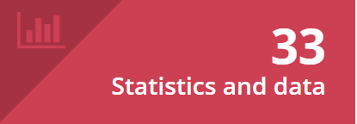


Notes:
identify and monitor early leavers and learners at risk of leaving education early;
intervene to retain them in, or bring them back to education or training;
evaluate related measures undertaken within a country, region or institution.

Slide 8
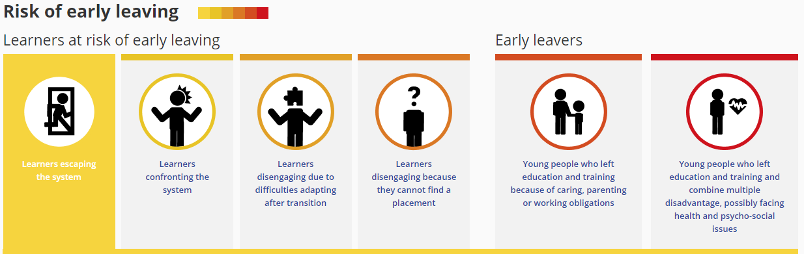
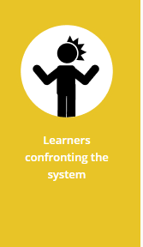
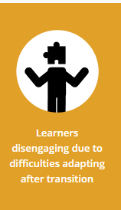
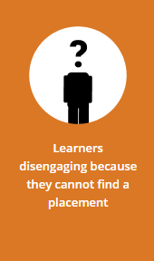
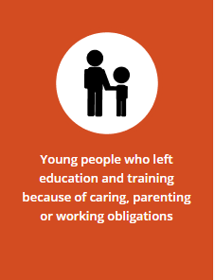
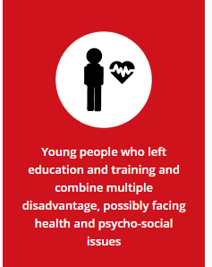
Identify

Slide 9
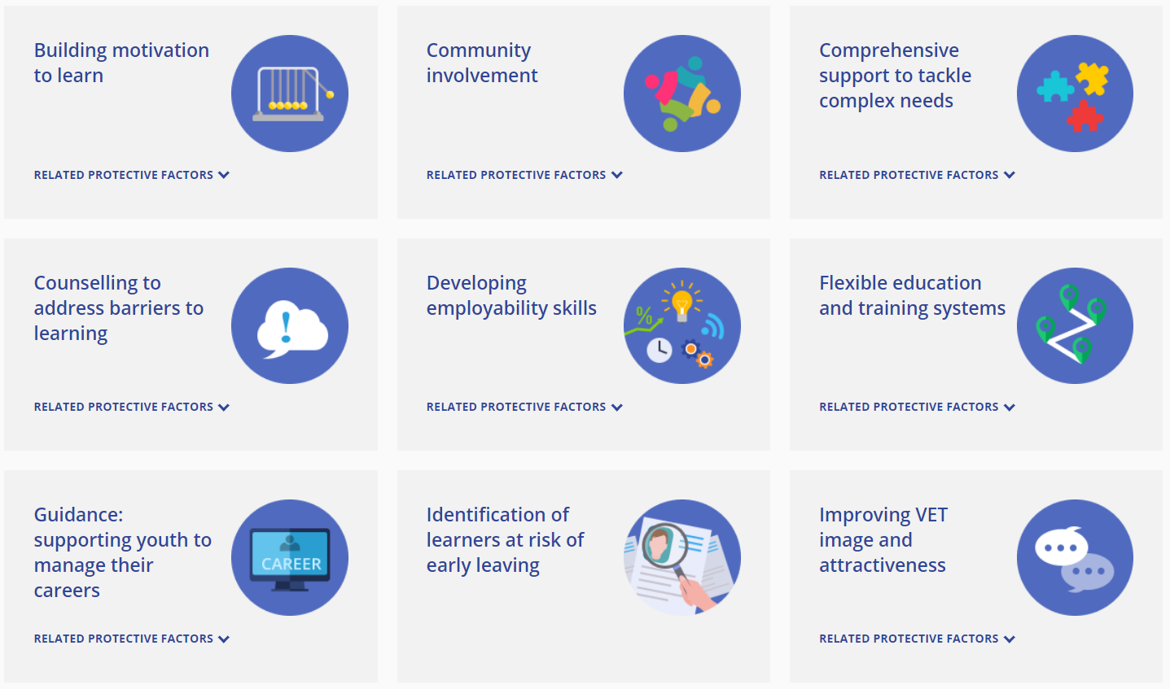
Intervene

Slide 10
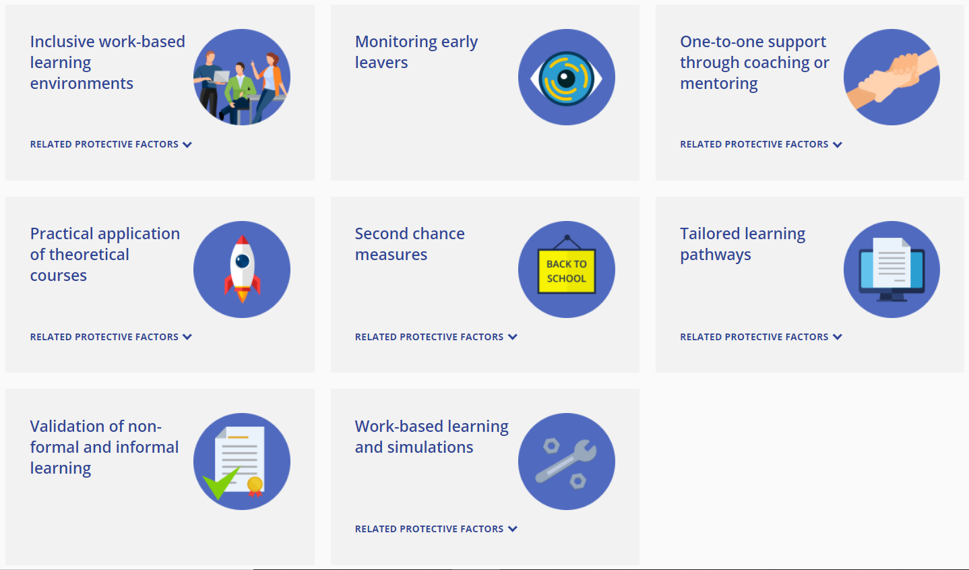
Intervene
Forthcoming:
VET teachers and
trainers

Slide 11
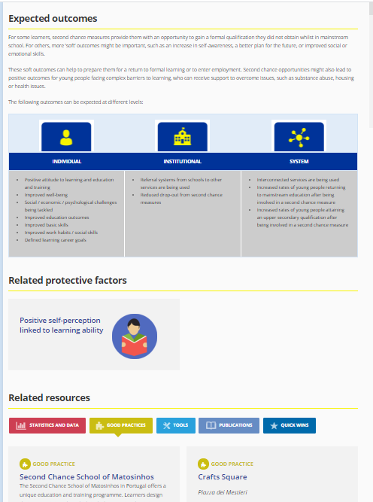
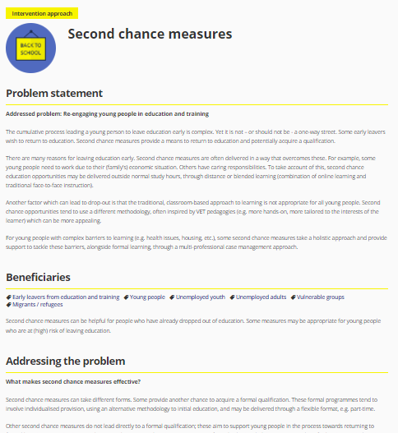
Intervene

Slide 12

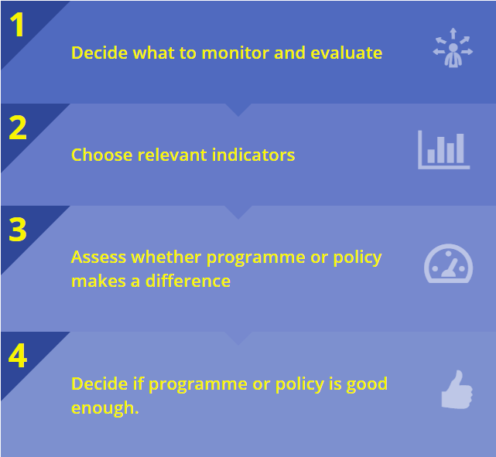
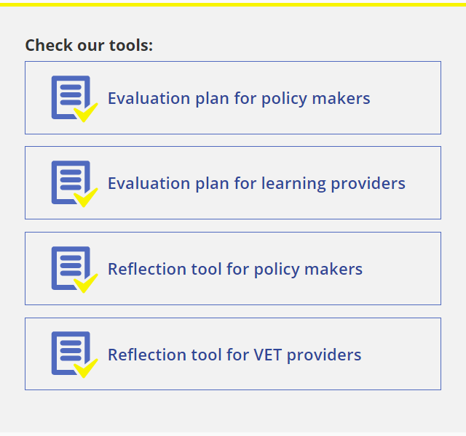
Evaluate

Slide 13
How to get involved with the VET toolkit
www.cedefop.europa.eu/TEL-toolkit
Share good practices drawn from your new thematic articles on VET T&T
  Contact the team
Contribute to developing a new intervention approach
Discover our self-reflection tools
Spread the call for ambassadors in your country

Slide 14
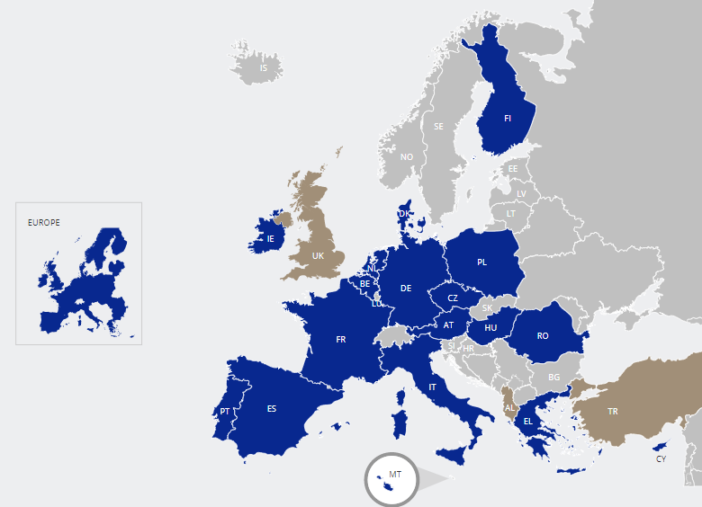

Cedefop’s network of
Ambassadors tackling early leaving from VET
Established in 2017 to support Cedefop’s
to maintain and disseminate it
to enrich its
resources
to contribute to
online discussions,
web seminars and
related events
Policy makers,
learning providers, experts and
other key stakeholders involved in tackling early leaving from VET at national, regional or local level in Europe
Open to
individuals
from all EU
Member
States, EEA
and candidate countries
* For candidate countries Cedefop collaborates with the European Training Foundation

Slide 15
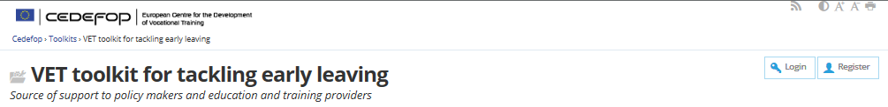
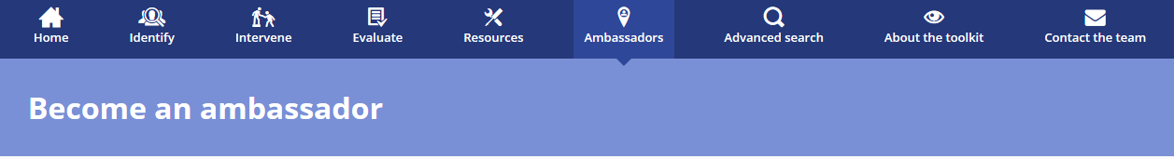
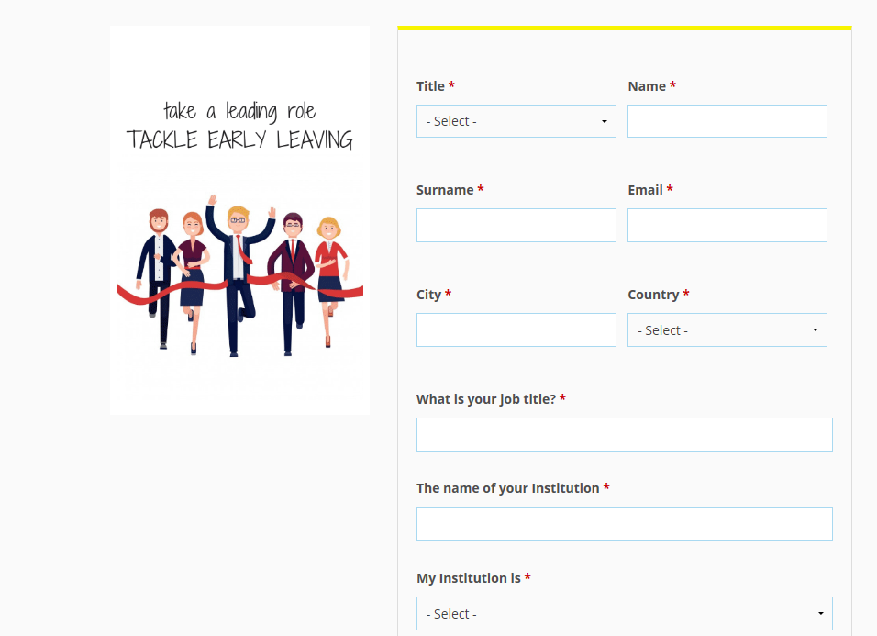
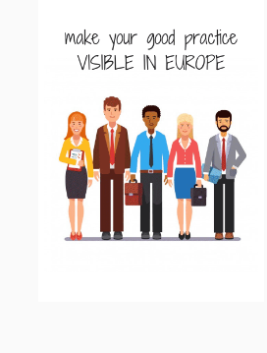
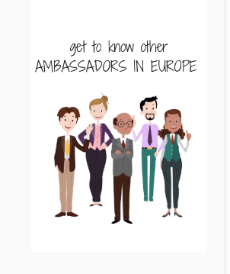
Visit us at:
www.cedefop.europa.eu/TEL-toolkit

Slide 16
What benefits you gain
Disseminate widely your country’s or institution’s good practices across Europe and beyond.
Acquire new knowledge of good practices in other countries by using the Toolkit’s resources.
Disseminate your research work and relevant publications
Have access to interactive tools that can support your work
Expand your network and get in touch with ambassadors

Slide 17


#Earlyleaving
#VETtoolkit
#ELET

