Slide 1


Apprenticeships in the Digital Era
The Erasmus+ project DigiGo and the work-based development of digital skills for apprentices and company mentors
Joint Cedefop/OECD symposium (June 15-16, 2023)
Katerina Maniadaki and Natassa Kazantzidou
IDEC S. A.
This project has been funded with the support of the Erasmus+ Programme of the European Union. This communication reflects the views only of the authors, and neither the European Commission nor the Education, Audiovisual and Culture Executive Agency can be held responsible for any use which may be made of the information contained therein.

Slide 2
Industry 4.0
Covid-19 implications - hybrid models of work
Erasmus+ 2020 call for proposal “Digital education readiness”
“DigiGo: Apprenticeships in the Digital Era” was approved
Context

Slide 3







The DigiGo project in a nutshell
June 2021 - May 2023
​Objectives
To enhance the digital competences of company trainers and mentors​
To support to VET teachers/trainers and company trainers and mentors, to develop apprenticeship programmes (traditional and virtual) with the aim to cultivate the digital competences of students​
To train company trainers and mentors
To raise awareness of VET teachers and trainers, on the possibility to use apprenticeships for the development of digital skills of VET students​
To engage companies in providing apprenticeships that will develop the digital skills of students.​
Results
Methodology for designing apprenticeships based on the DigComp Framework
E-learning Programme: Apprenticeships in the digital era​
Apprenticeships in the digital era: Success stories​

Slide 4

Definitions
Digital apprenticeships
Digital apprenticeships cover a a variety of digital skills, such as cyber security, IT skills, big data etc.
Virtual apprenticeships
New mode of implementing apprenticeships through remote working
Digitalisation of apprenticeships
Acquiring digital skills across apprenticeships in different sectors/specialties

Slide 5

Methodological approach

Slide 6
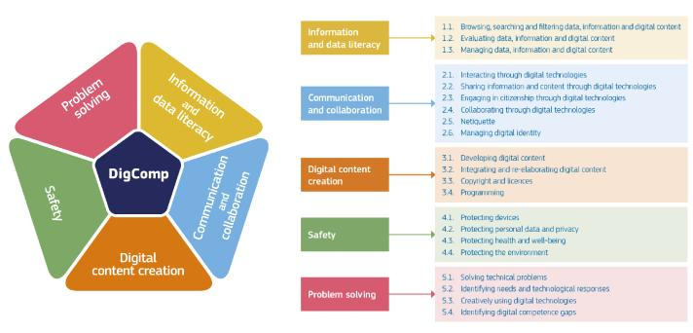
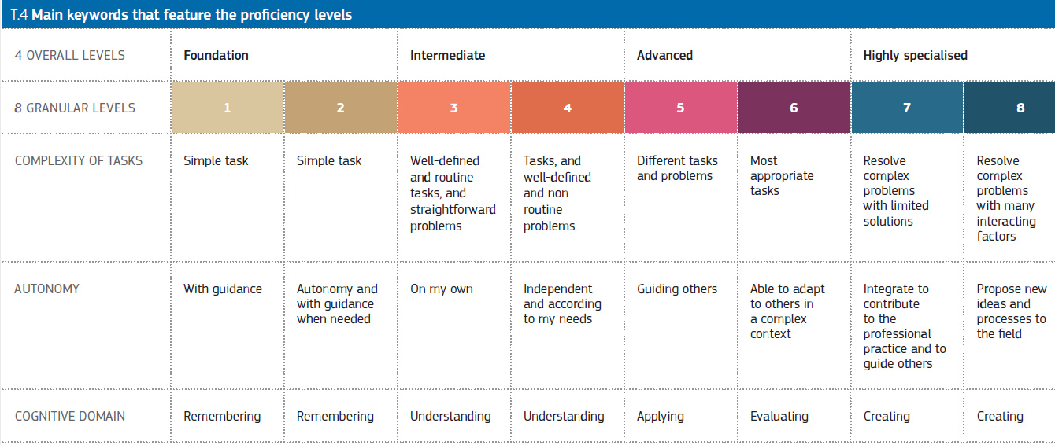
The Digital Competence Framework (DigComp)
Common European understanding of what digital competences are and help in the development of digital skills policies.
5 areas and 21 competences
4 overall and 8 granular levels
Knowledge, skills, and attitudes.
Tool that will improve the digital competences in VET education.

Slide 7
The DigiGo methodology
Preparation
VET - company partnerships
Identify companies
Follow up with the involved parties
Follow up
Apprenticeship
Planning
Explain the digital tools that the apprentices will use
Identify bodies and partnerships
Secure Funding
Self assessment
Share values
Design curriculum
Identify the level of “digital readiness”
Decide specifications of the apprenticeship
Make sure you have the best tools
Look at the latest opportunities for tools
Follow up on the digital tools
Use digitalisation to follow up on the apprenticeship
Make clear who is responsible for the development of the students
Based on the DigComp Framework
Supports digitalisation of apprenticeships
Five steps methodology
Consisted of guidelines, instructions, practical examples and templates

Slide 8
Piloting the DigiGo methodology
15 apprentices in total
(at least 2 apprentices per partner)
Duration of the apprenticeship: 2 months – 2 years
Duration of the pilot: 2 months
Different fields of studies:
Beauty, massage and well-being technician
Programming and game development
Marketing
European studies
Business Administration
Scope:
Some apprenticeships focused on all the areas of the DigComp Framework, while some others focused on specific areas only.

Slide 9
Evaluation of the DigiGo methodology
Quality improvement process
The company trainers/mentors followed the Quality improvement process which involved the Quality improvement Tool.
The tool consisted of indicators that evaluated the quality of the apprenticeship training thus offering tips for further improvement.
Evaluation from apprentices
Ex-ante and post apprenticeship questionnaires
Self-assessment of competences against the DigComp Framework.
01 Commitment
The company implements the terms of commitment
02 Beginning of the training
A specific orientation programme is prepared for the learners' arrival in the company
03 Training
The company works with all parties involved in the learning process
The company helps the learner acquire the competences and knowledge required professionally and it takes time to train them
04 Commitments and end of the apprenticeship

Slide 10
Results of the pilots
From the Quality improvement tool (trainers/mentors’ side):
The objectives set have been attained
The trainers were designated according to the methodology
The apprentices received information about the apprenticeship’s learning outcomes, and they were supported
The methodology was applied consistently

Slide 11
Results of the pilots
Competences acquired (apprentices’ side):
Information and data literacy
Search and navigate data and information through digital environments
Communication and collaboration
Use a variety of digital tools for collaboration and communication
Digital content creation
Solve digital problems through a variety of digital means
Problem solving
Safety
Customize digital environments according to their personal needs
Select ways to protect themselves and others from dangers in digital environments
Adapt the communication strategies according to the cultural and generational diversity aspects of each audience
Protect the devices from malware content
Apply the rules of copyright and licenses of digital content
Evaluate the credibility and reliability of online sources and store them for retrieval
Differentiate technical problems when operating devices and using digital environments

Slide 12
Reflections
During the pilots, the DigiGo methodology managed to support the development of digital skills, following the DigComp framework.
Suggestions – recommendations
Update of the curricula/apprenticeship programmes
Training of companies’ trainers/mentors
Continuous feedback from companies/trainers/mentors and apprentices
Adequate duration of apprenticeships
Adequate equipment and tools in companies
Close the gap between the VET institutions and the companies

Slide 13
Thank you for your attention
For more information visit:
https://digi-go.eu/
Katerina Maniadaki, k.maniadaki@idec.gr
Natassa Kazantzidou, natassa@idec.gr

