Slide 1

The digitalisation of apprenticeship training In FRANce
Romain Pigeaud // expert apprentissage
Centre-Inffo // Direction du droit de la formation
r.pigeaud@centre-inffo.fr
Notes:
https://dares.travail-emploi.gouv.fr/donnees/le-contrat-dapprentissage
www.linkedin.com/in/

Slide 2
Introduction, a few simplified principles concerning apprenticeship in France
An employment contract between an employer and an apprentice
Characterised by alternating training in the company and training in an apprentice training centre (CFA)
  Open to young people aged 16 to 29
  It includes a qualification, which is the objective of the contract
  The qualification must be recorded in a register that guarantees the acquisition of a qualification recognised on the labour market and by the State
Within the company, an apprenticeship supervisor provides practical training for the apprentice and helps him to obtain the qualification
The CFA : to operate, it must hold national quality certification, "Qualiopi" which takes into account the specific features of apprenticeships
Notes:
frame of reference of assessment skills, job
Hairdresser
quality certification

Slide 3




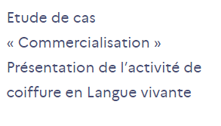
An example of digital competence with hairdresser
Hairdresser
Activity reference framework : Design of communication tools and vectors targeting private individuals and professionals (canvassing, brand awareness, etc.)
Skills reference framework : Setting the company's external communications strategy…
Assessment reference framework : marketing case study…

Slide 4
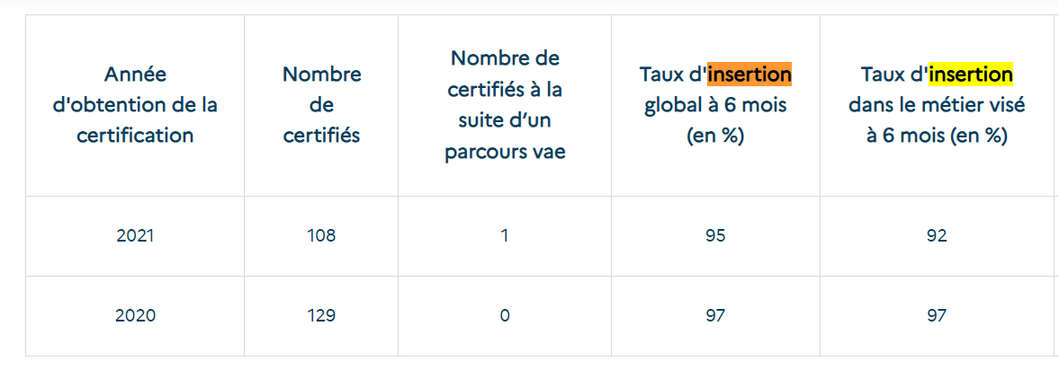
An example of occupational integration with hairdresser
Year of certification
Number of certified
Number of certified
With validation of prior learning
Integration rate after 6 months
Job entry rate after 6 months

Slide 5
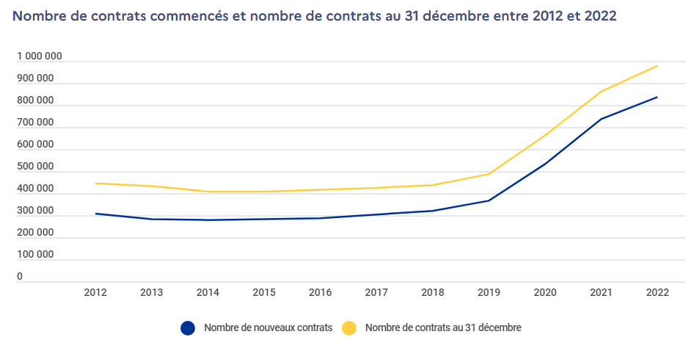
An increase of 82% of the number of beneficiaries
Number of contracts started and number of contracts on 31 december between 2012 and 2022
Some reasons :
- The implementation of a reform aimed at developing apprenticeships by facilitating the creation of CFA, mobilizing the players involved and changing its image
- Exceptional financial aid for the recruitment of apprentices, introduced in the summer of 2020
- Apprenticeship is a response to companies' recruitment needs
- A financial incentive for apprentices and their families: the training is free and the apprentice is paid

Slide 6
SPENDING ON APPRENTICESHIPS IN 2021 : 0.8% OF GDP
The total cost of apprenticeships is made up of three main items :
  30% to finance apprentice training centres : €6.6 billion
  State aid to apprentice employers 24% : €5.2 billion
  Support and resources for apprentices and their families 44% : €9.6 billion, including apprentices' pay
Funding comes mainly from the state : 26%
and employers : 42%

Slide 7
A legal framework for distance learning
Law no. 2016-1088 of 8 August 2016 : CFA were able to offer apprentices distance training
Decree no. 2020-373 of 30 March 2020 : Details on distance learning provided by an apprentice training centre (CFA)
Further details : March 2022 // Ministry of National Education // Vademecum Supervision of apprenticeship training courses
National quality reference « qualiopi » : July 2019 : an operating instruction and an owner's manuel
Notes:
https://www.centre-inffo.fr/site-droit-formation/apprentissage-publication-de-deux-decrets-dapplication-de-la-loi-avenir-professionnel#:~:text=dur%C3%A9e%20de%20contrat-,Le%20d%C3%A9cret%20n%C2%B0%202020%2D373%20du%2030%20mars%202020,%C3%A0%20la%20derni%C3%A8re%20ann%C3%A9e%20d'

Slide 8
Findings : a widespread use of digitisation
Example of practices "4Digital"
In higher education, a label recognises the mastery of digital technology, particularly for teaching and distance learning
Let's take a cutting-edge sector that requires safety: the nuclear industry. This industry is set to recruit one hundred thousand people over the next ten years
Thanks to virtual reality and the emergence of digital mock-ups of buildings, learners can carry out tasks in complete safety, enter highly technical premises, repeat industrial gestures and follow teaching scenarios in rare conditions to remove any hesitation the day they are carried out in real conditions

Slide 9
Findings : a widespread use of digitisation
Example of practices : virtual reality solutions in painting
A CFA has put in place a digital virtual reality solutions that make it possible to tackle professional gestures through immersion
And therefore to learn without wasting raw materials, for example paint, and safely
From an educational point of view, it is the acquisition of skills through the possibility of making mistakes and starting over. The observation can be made that hybridisation allows a greening of the training through a reduction of the raw materials used in training
Notes:
building caretakers
buildings and civil engineering

Slide 10
Findings : a widespread use of digitisation
Example of practices : « Digitalisation of craft skills »
To avoid "the loss of certain skills" in the arts and crafts sector, with certain specialities on the verge of disappearing, the French government wants to develop the "digitisation of craft skills"
For example, with the art of lacemaking, which could have been lost if it had not been preserved in the national lace factories of Le Puy-en-Velay and Alençon, a preservation that is now enabling the sector to flourish once again
Preserving this patrimony is therefore essential, and new technologies offer new possibilities. The creation of a digital gesture bank will support this strategy by ensuring the conservation of know-how through the digitisation of ancestral gestures and techniques threatened with extinction. Future apprentices will be able to rehearse rare gestures in virtual universes before mastering them fully in contact with the material

Slide 11
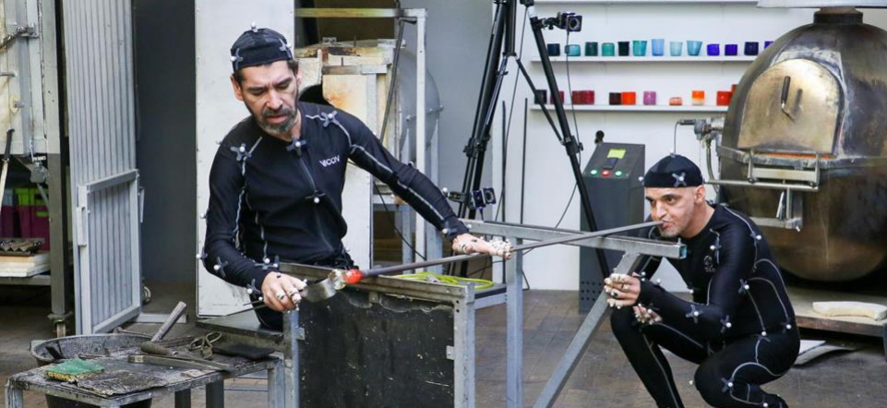
Digitalisation of craft skills
: a picture

Slide 12
Positive feedback
From CFA :
Designing training scenarios that would be impossible to implement in real-life situations- Assess learning outcomes
Individualise training paths
Monitor the development of trainees and assess their skills
Combining training initiatives and making them more attractive
From apprentices :
Training is active, felt differently, with a new pedagogy that will favour a playful approach
Perform safe tasks, make mistakes safely
Develop an understanding of how a machine, tool, situation, production line or workshop works. Understand what is happening or could happen, consider problem solving scenarios
Develop digital literacy skills
Be more independently trained, have permanent access to teaching resources

Slide 13
Others factors to keep in mind
Digitalisation is a technical challenge for apprentice training centres, it can take a long time to design the training materials and can be an expensive investment
Digitalisation cannot solve all the problems faced by apprentices, who sometimes face social difficulties
Digitalisation requires apprentices to master some skills, tools : keyboard, Office suite software
Educational innovation does not always involve digital technology alone
Digitalisation alone cannot guarantee successful assessment, skills acquisition or professional integration
Notes:
layoffs

Slide 14
Methodology
The research was based on various official reports, books on apprenticeship training, articles published by the Centre-Inffo, and interviews with apprenticeship stakeholders.

Slide 15
Links
National arts and crafts strategy
https://presse.economie.gouv.fr/
Call for projects “Strengthening skills in the nuclear industry”
https://www.monavenirdanslenucleaire.fr
« Qualiopi » Framework
https://travail-emploi.gouv.fr
RCNP
https://www.francecompetences.fr/recherche_certificationprofessionnelle/
Apprenticesechip data
https://dares.travail-emploi.gouv.fr/donnees/le-contrat-dapprentissage

