Slide 1
Get ready for the recovery
A higher-skilled and better motivated workforce is crucial for rebuilding the EU economy
Jürgen Siebel, Executive Director a
26.5.2020, Employment Committee of the European Parliament

Slide 2


Cedefop response to the COVID-19 crisis
INSTANT RESEARCH
new pieces of evidence through Cedefop networks and resources
EVIDENCE-BASED REFLECTIONS
key trends and policy pointers
IN-DEPTH ANALYSES
international surveys and forthcoming results

Slide 3
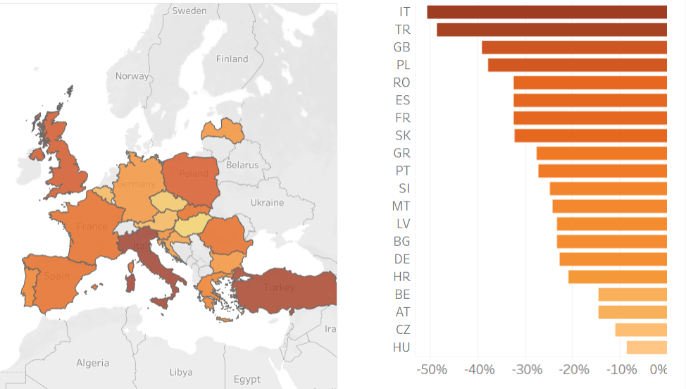
Instant research (1/6)
Impact of COVID-19 on the use of Europass
CVs generated in
March 2020* compared to March 2019
*Based on expected
figures without COVID-19
Top 20 countries

Slide 4
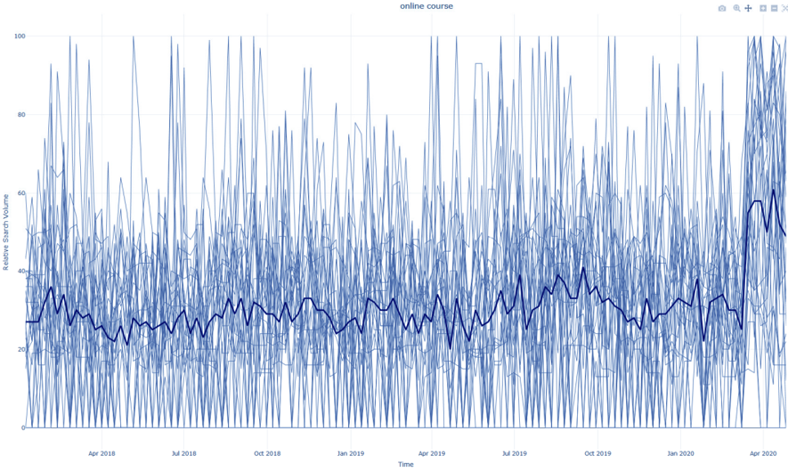
Instant research (2/6)
Search volume of online course/training in Google

Slide 5
Instant research (3/6)
How EU countries manage apprenticeships
All providers make efforts to move learning online, but its use is piecemeal and used for different purposes (keep in touch with students, access to resources (videos, etc.), or actual teaching).
  The crisis emphasised the importance of cooperation at provider-company level; apprentices who still go to companies, are occasionally allowed – in cooperation with schools – to make up for parts of learning meant to be delivered in schools.
VET PROVIDERS
Not going to school does not always mean discontinuation of company attendance. Attendance varies by sector: continuity in ‘essential’ sectors (healthcare and food); discontinued in sectors shut down by regulation (hospitality, wellbeing, tourism).
  If companies close, apprentices with contracts regulated by the labour code, are covered by labour market measures; apprentices without such contracts, receive a State grant/subsidy. Otherwise, apprentices are paid as usual.
COMPANIES

Slide 6


Instant research (4/6)
Impact of COVID-19 on lifelong guidance in Europe
Career guidance crucial in supporting transitions
Consultation with Cedefop’s CareersNet experts
  Leap to digitalisation of guidance services
  Increasing diversification of communication channels
  Ensure universal access to reach all user groups
  Importance of digital competences, practitioner training
  Increase cooperation among stakeholders
Cedefop coordinating a forthcoming full-scale international survey

Slide 7
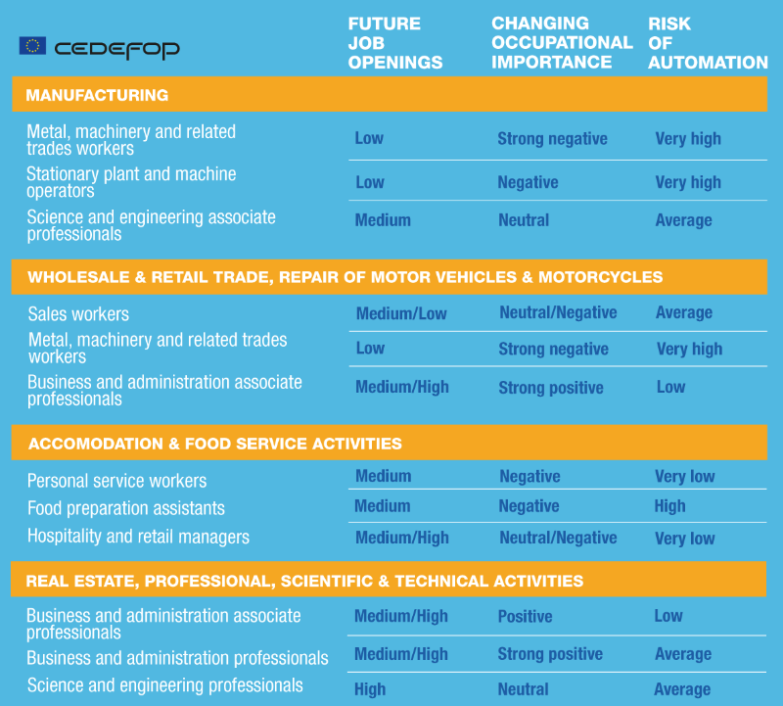
Instant research (5/6)
Impact on sectors and the future of occupations

Slide 8

Instant research (6/6)
Digital gap during COVID-19 for VET learners at risk in Europe
KEY QUESTIONS
  How do VET schools closures affect learners at risk?
  To what extent are VET teachers and trainers supported to teach in new e-learning environments?
  How does COVID-19 affect VET teacher and trainer wellbeing?
AMBASSADOR RESPONSES
  Vulnerable learners now more than ever are at higher risk of dropping out of VET
  Many of them are disconnected, lacking appropriate digital devices and internet connection
  Examined countries to introduce measures to support learners at risk and engage them with distance learning
  VET teachers and trainers require further training on digital skills, effective e-pedagogies and creating teaching content appropriate for e-learning

Slide 9
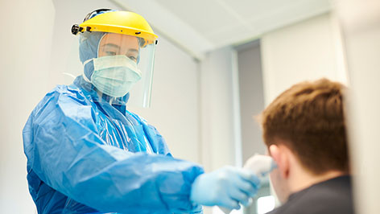




Evidence-based reflections key trends and policy pointers
© UNHCR/Roger Arnold
April 2020
Why our heroes will never be automated: investing in healthcare
May 2020
Jobs at risk: coronavirus impact
on EU tourism sector
April 2020
Will the human capital potential of refugees be better used and acknowledged after COVID-19?
April 2020
Has the coronavirus crisis made
us all crowdworkers?
May 2020
Coronavirus, automation and the future of work

Slide 10
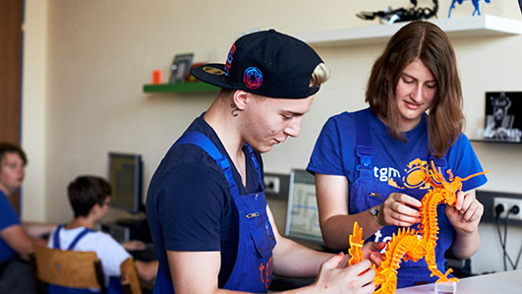


In-depth analyses
International surveys and forthcoming results
Coronavirus: learning the lessons − Preparing for the future
European countries’ response to coronavirus challenges
Will coronavirus have lasting labour market effects?
Global survey on the impact
of the pandemic on learning
in companies launched in cooperation with main international organisations
Ongoing work for a ReferNet survey on national responses to the pandemic launched
The future Cedefop ESJS survey will include questions related to the coronavirus pandemic

Slide 11
Photos: slides 1, 3, 7, 10 © Cedefop/slides 2, 9 © iStock/slide 10 © Shutterstock

