Slide 1
SWPP and WIL Digital: A case study on using apprenticeship to close the digital skills gap
The Information and Communications Technology Council
Namir Anani, President and CEO

Slide 2
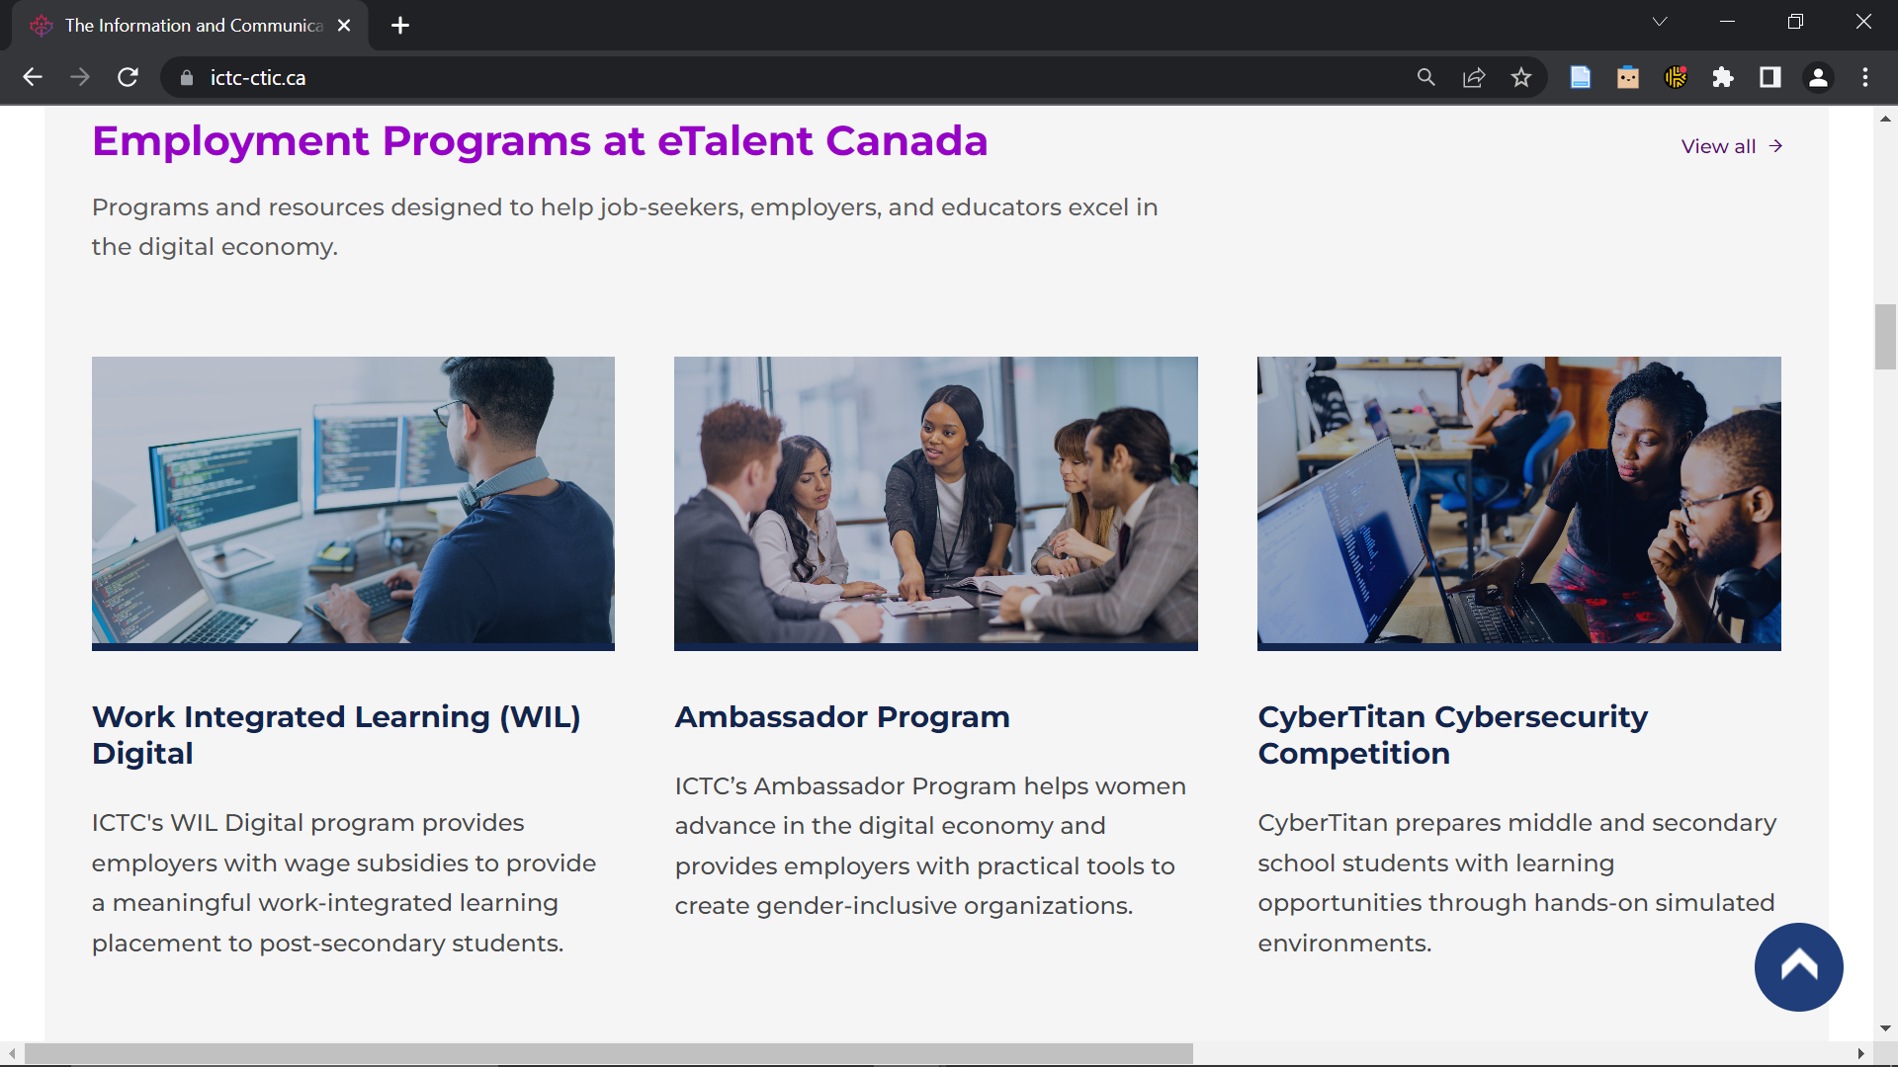
Introduction to the Information and Communications Technology Council (ICTC)
Our mission is to strengthen Canada's digital advantage in the global economy.
Our goal is to ensure technology is utilized to drive economic growth and innovation, and that Canada's workforce remains competitive on a global scale.
We help Canadians of all backgrounds acquire the skills they need to be successful in Canada’s economy.
We partner with a vast network of industry leaders, policymakers, and academic institutions.

Slide 3
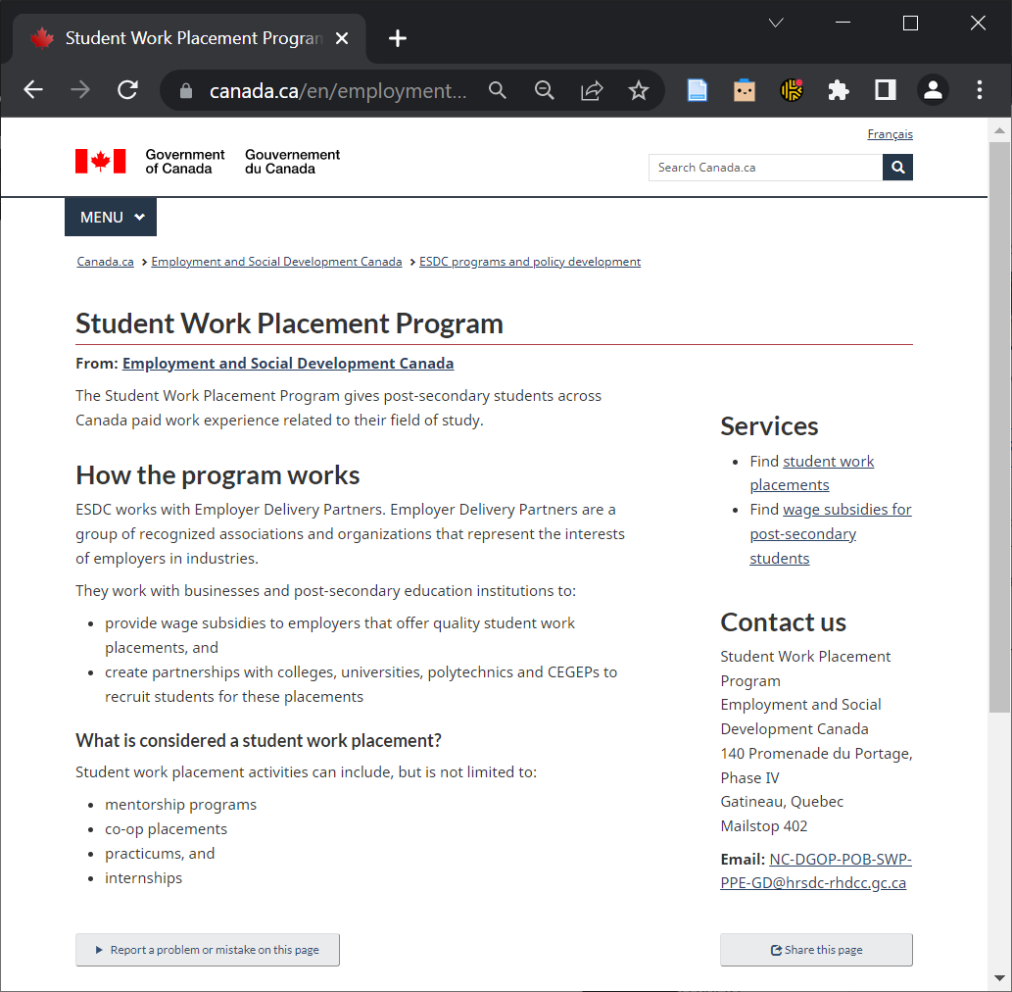
Intro to Paper: A Case Study on Apprenticeship for Digital Skills Training
The paper provides a case study of a program that uses apprenticeship for digital skills training.
It discusses differences between the program and traditional definitions of apprenticeship.
It identifies benefits, challenges, and lessons learned.

Slide 4

Intro to Paper: Methodology
Literature review
→ to define key terms (apprenticeship)
→ to determine impact of digitalization on labour
market/training needs
→ to identify challenges with existing approaches to
digital skills training
Survey, interviews, document analysis, secondary data
→ to assess suitability of apprenticeship for digital
skills training
→ to highlight benefits, areas for improvement, and
lessons learned

Slide 5
Background: Apprenticeships in Canada
In Canada, formal apprenticeships:
Are regulated by the provinces
Are delivered through formal/regulated apprenticeship programs
Lead to a nationally-recognized certification
Primarily focus on the skilled trades (e.g., electrician, technician, etc.)
Do not provide training for digital roles (e.g., software developer, data scientist, UX/UI designer, machine learning developer, etc.)

Slide 6
Case Study: The Government of Canada’s Student Work Placement Program (SWPP)
SWPP was created to increase student employability and employment and better align labour supply with industry needs.
SWPP is a program run by the Government of Canada through 18 Employer Delivery Partners.
The program provides post-secondary students with paid work experiences related to their field of study.
Post-secondary = college, university, polytechnic
Work experience = mentorship program, c-op placement, practicum, internship

Slide 7
Case Study: ICTC’s WIL Digital Program
WIL Digital is one program funded through SWPP. It was designed to address labour market challenges associated with digitalization:
  Growing demand for job-ready tech workers (amid a talent shortage)
  Growing demand for digital skills across all roles (e.g., physicians who understand computer assisted diagnosis; agronomists who understand GIS)
  Digital skills needs that constantly change (due to the pace of tech)
To do this, WIL Digital provides employers with wage subsidies, to provide meaningful work placements to students.

Slide 8
What are different program stakeholders responsible for?
ICTC is responsible for…
  Incentivizing ICT businesses to employ students for a work integrated learning experience
  Vetting students and employers for quality assurance
  Coordinating contract and training plan, and overseeing midpoint check in
  Conducting labour market research to identify training needs
  Providing supplementary training through coaching and ICTC’s eLearning courses

Slide 9
What are different program stakeholders responsible for?
Employers are responsible for…
  Assigning a mentor/supervisor to the student
  Designing the student’s training plan
  Paying the student for their work
Training institutions, such as colleges and universities…
  Are not directly involved
  However, students must be registered in a post-secondary program to participate in WIL Digital, so complementary academic training is assumed

Slide 10
What characteristics of apprenticeship do SWPP and WIL Digital utilize?
SWPP and WIL Digital DO…
  Combine learning in education institutions with work-based learning
  Require an agreement between the student (apprentice), employer, and training institution
  Require students (apprentices) to be paid for their time
SWPP and WIL Digital DO NOT…
  Lead to a nationally-recognized qualification

Slide 11
Findings: What benefits did participating employers gain from SWPP and WIL Digital?
Access to new talent and skills: Employers gained access to a new talent pool (students), and new creativity, knowledge, and skills.
Improved organizational capacity and talent pipeline: Employers learned how to attract, hire, onboard, and retain students, and strengthened relationships with PSIs.
Improved productivity and services: 60% of employers felt SWPP had helped them enhance their productivity and service delivery.
Diversity, equity, and inclusion: Employers felt that WIL Digital increased their
access to a more diverse talent pool.
Reduced financial burden: The wage subsidy enabled employers to
reduce financial burden while expanding organizational capacity.

Slide 12
Findings: What benefits did participating students gain from SWPP and WIL Digital?
Net-new employment: Participating students gained access to net-new employment.
Employment outcomes: Participating students improved their future employability and salary expectations.
Skill development: Both students and employers felt that participating students had improved their skills, including time management, critical thinking, problem solving, and communication.
Improved confidence: when surveyed, students who had participated in SWPP
were more likely to than students who had not to rank their skills positively.
Overall satisfaction: 92% of students report being very satisfied with
their WIL experience.

Slide 13
Findings: What benefits did SWPP and WIL Digital provide the economy, more generally?
Better skills alignment: According to employers, participating students (1) improved their business, technical, and communication skills; (2) were able to self-direct and work more independently; and (3) better understood employer expectations.
Increased employment opportunities for students: 38% of SWPP employers indicated that without financial support, they would not have been able to provide a work placement.
Diversity, equity, and inclusion: WIL Digital’s additional wage subsidy gave employers an incentive to hire underrepresented groups.

Slide 14
Findings: What challenges did SWPP and WIL Digital participants experience?
Employers…
Felt the work placement was too short for their needs, possibly limiting skills development.
Sometimes did not have the capacity to provide oversight and quality assurance for student work
Sometimes did not know what work to provide students.
Students…
Sometimes were not provided relevant tasks by employers, limiting skills development.
Do not receive a nationally-recognized certification

Slide 15
Lessons Learned: Recommendations to Design Effective Apprenticeship Programs for Digital Skills Training
Apprenticeship-like programs, which adopt only some apprenticeship criteria, are an effective method for digital skills training.
Employers and students have equal potential to reduce the quality of the WIL experience. A neutral third party can address this risk by vetting student and work placement quality and mediate the student-employer relationship
Short-term placements can minimize training outcomes; increasing the work-based learning component can help address this challenge.
SMEs may have limited capacity to provide training and assign tasks: supplementary courses, informed by LMI, can address this barrier.
Nationally-recognized certifications can improve a training
program’s impact and reach

