Slide 1
Analysing and comparing qualifications for review and renewal of qualifications
Isabelle Le Mouillour
Introduction to session 1
Workshop on analysing and comparing VET qualifications
18 June 2021, virtual event

Slide 2
Defining the context of the analysis
A lot of data is being collected, even more is being expected
  The more the better?
Data collection for which purpose?
  Change / innovation / monitoring at system level
  Feedback on existing / forthcoming qualifications
  Ex. DfE employer survey (UK EN); recruitment practices (FR)
VET Graduate tracking; EU / National skills surveys
The link to qualifications
  „the requirements for an individual to enter, or progress within an occupation“ (Cedefop 2003)
  ➔ VET occupation, regulations ➔ Format, content, structure influenced by VET institutions and structures ➔ co-construction
Apprenticeship
  VET providers = apprenticeship companies and VET schools/centres
  DE: 328 apprenticeship occupations; full professional

Slide 3
Qualification standards
VET institutions and structures are important to understand and compare qualification standards, as well as to design analysis
QS as central regulating instruments
  Germany: 328; Austria: 192, Switzerland: 225; Denmark: 83
  Standardisation: More or less extensive; Focusing on sector/multi-vocation approach or single vocations
QS are diverging in their norm setting role
  More or less prescriptive through their content
  Including assessment requirements (or not)
  Set from the perspective of school-based vocational training (or not)
QS as results of multi-level actors involvement
  Federal – regional – local levels actors
  State – Employers‘ organisations – Trade unions
  But with differentiation: Social partners; Local actors‘ involvement (see Switzerland, Denmark); Role of VET schools (see Slovakia)
Cooperation for QS – QS as meeting points
  All actors of education and work worlds are cooperating: Level of trust; rooms for negotiations; role of agreements; Agreement on meaning of vocational proficiency and employability still on-going; Opportunity for planning within vocational training systems
Source: eb_15313.pdf (bibb.de); to be published in English

Slide 4
BIBB/BAuA Employment Survey since 1979
The Employment Surveys have established themselves in science as a central survey in the field of qualification and vocational (education) research: representative sample of core employed in Germany
Occupation held + supplemented by information on contents of occupation and occupational requirements + information on occupation learnt
Strengths and special features:
Unique indicators on work and occupation and on the use of vocational qualifications, Task-approach
Detailed recording of all vocational qualifications (type and duration, incl. advanced training),
Coding of occupations exercised and learned (KldB3 2010, 1992, ISCO4 2008, 1988),
Possibilities of vocational differentiation due to the high number of cases (approx. 20,000),
Possibility of follow-up surveys on special topics.
Source: BIBB / BIBB/BAuA Employment Survey 2018

Slide 5
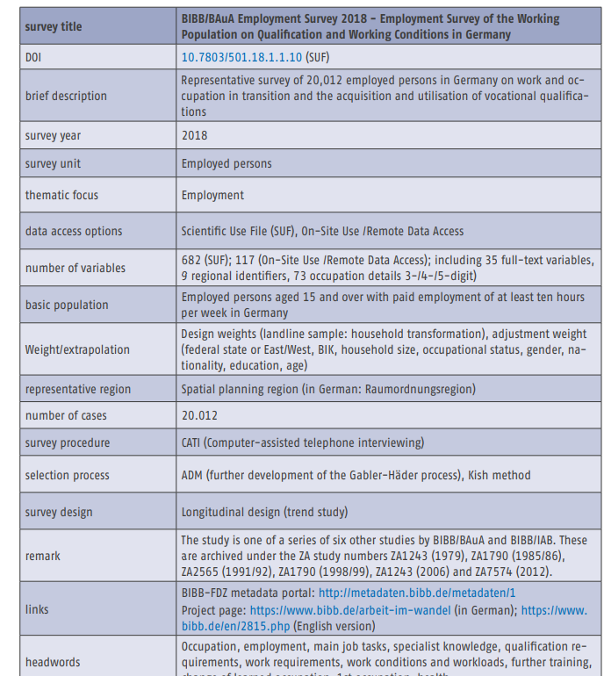

Slide 6
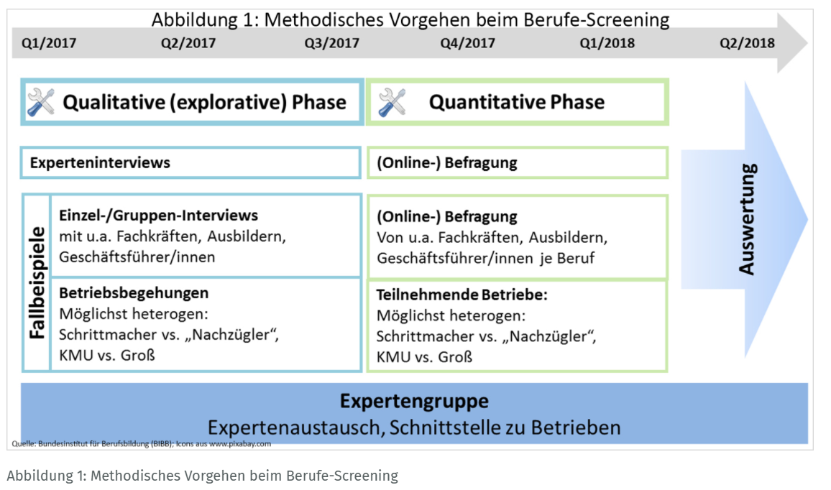
Example : Occupation and field screening

Slide 7
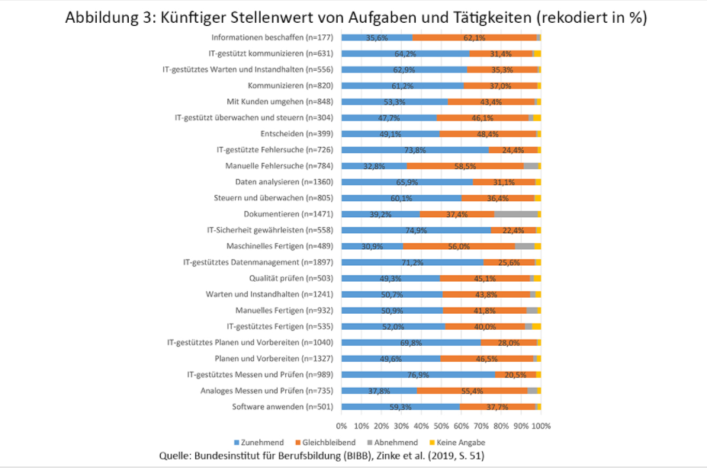
1) Changes in task profiles, activities and competences
Increase in importance : IT-supported measuring and testing (77 %), Ensuring IT security (75 %), IT-supported troubleshooting (74 %), IT-supported data management (71%) and IT-supported planning and preparation (70 %).
No change: Obtaining information (62 %), manual troubleshooting (59 %), mechanical production (56 %) and analogue measuring and testing (55 %).
Decline: Documentation, machine production and manual troubleshooting.
2) Follow-up for apprenticeship regulations
The disparity of digitisation according to companies and occupations increases the diversification of requirement profiles at workplaces; the effects of digitalisation on central competences of occupational action ability must be taken into account; the expected accelerated pace of innovation has an impact on the processes by which occupational profiles are further developed (cf. Zinke 2019: p. 104)
ZINKE, Gert: (2019). Berufsbildung 4.0 - Fachkräftequalifikationen und Kompetenzen für die digitalisierte Arbeit von morgen: Branchen- und Berufescreening: vergleichende Gesamtstudie. Wissenschaftliche Diskussionspapiere; 213 , 136 S. weiterlesen

Slide 8
Some impulses for our workshop session
No multiplication of surveys and analysis running in parallel; re-focus on occupations!
Comparative aspects? Between qualifications? Nationally? European?
Which timescale for data collection in terms of timespan to VET course?
Which data?

