Slide 1


Comparing and analysing VET qualifications
Applying methodological lessons
Monika Auzinger
3s, Austria
Karin Luomi-Messerer
3s, Austria
Simon Broek
Ockham-IPS, Netherlands
Cedefop Workshop, 18 June 2021

Slide 2
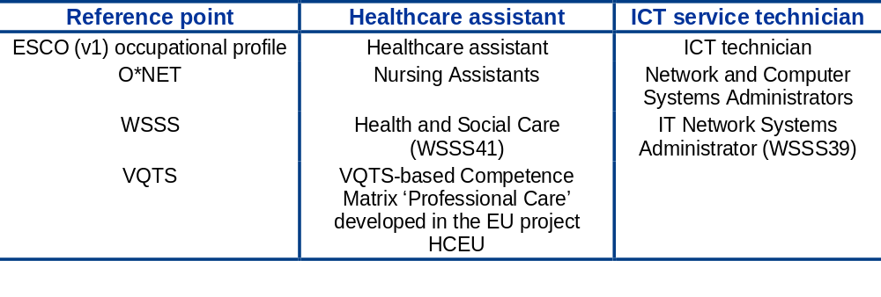


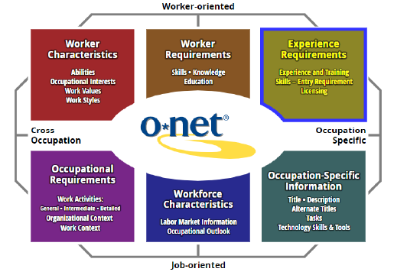
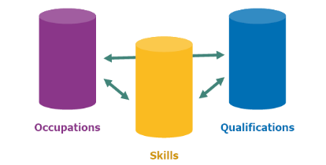




Comparing ICT Technicians and Health Care Assistants Qualifications in 10 European countries – what did we learn?
Notes:
ESCO: at a later stage in teh project we have used also ESCO (v1.0.5 )
WSSS are now called: WSOS (WorldSkills Occupational Standards)

Slide 3
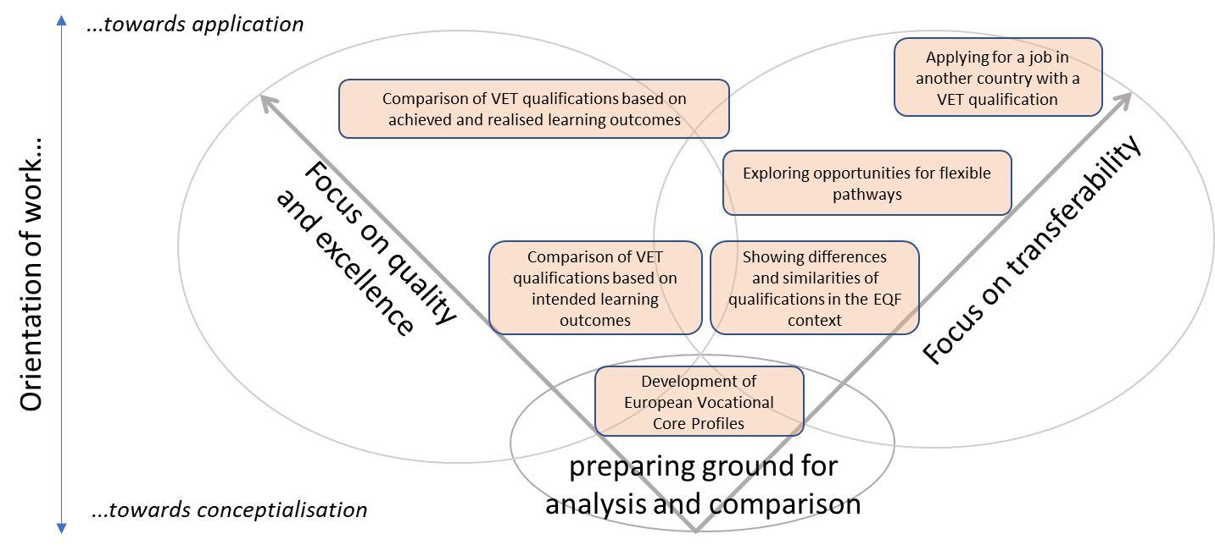
Potential applications and use cases situated within the analytical framework
Session 1
Session 2
Session 3
Notes:
With this ppt we are kind of settng the scene for the three break-out sessions later.

Slide 4
Potential applications and use cases situated within the analytical framework
Session 1
Notes:
Supporting quality, relevance and excellence of VET qualifications
Simon –he will start with comparison of intended LO!

Slide 5
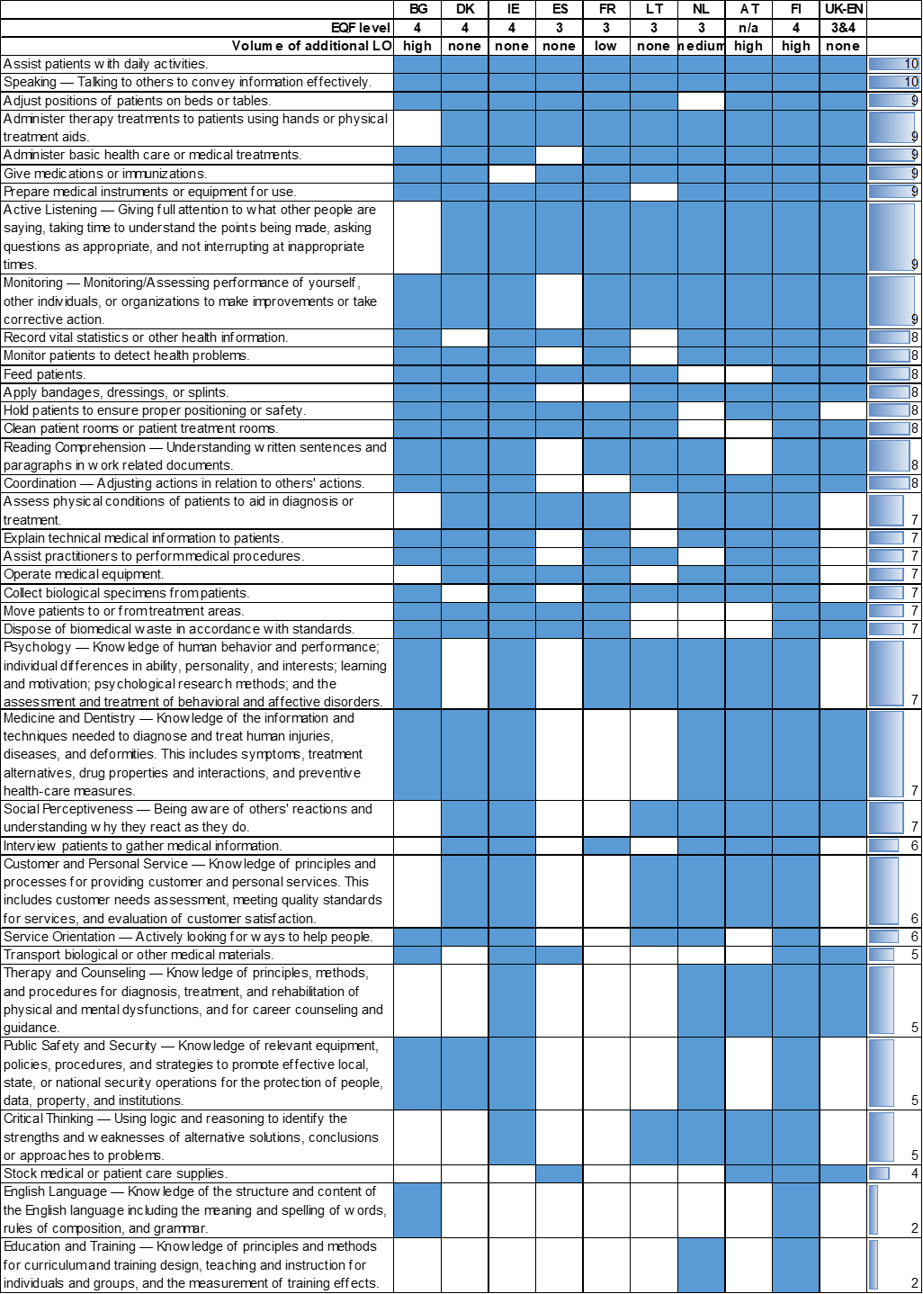
Supporting quality, relevance and excellence of VET qualifications
Analysis and comparison of VET qualifications based on intended LO
Reflection on own priorities and solutions, gaining inspiration from other countries’ choices for revising, improving, further developing own qualifications
Mapping table for healthcare assistant– O*NET
Notes:
Supporting quality, relevance and excellence of VET qualifications – Example 1

Slide 6
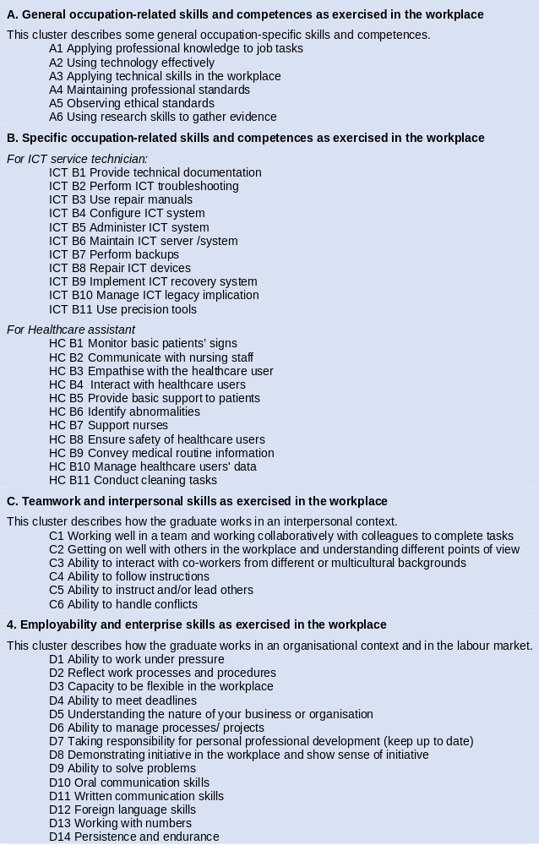
Supporting quality, relevance and excellence of VET qualifications
Analysis and comparison of VET qualifications based on achieved and realised LO
Comparison of and reflection on intentions of qualifications and achieved LO as QA mechanism at provider level
Employer Reflection Survey – reference point based on Australian ESS and ESCO OSP
Notes:
Supporting quality, relevance and excellence of VET qualifications – Example 2
__Employer reflection survey: pre-test in NL and LT
__3 questionnaires: for VET providers, graduates and their employers
__Interesting results and opportunities as well as challenges

Slide 7
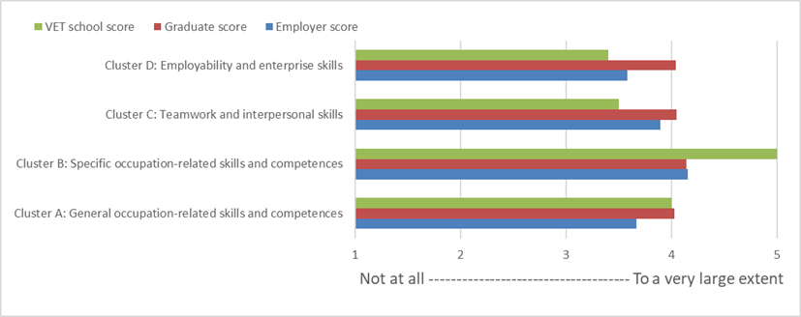
Analysis and comparison of VET qualifications based on achieved and realised LO
Comparison of and reflection on intentions of qualifications and achieved LO as QA mechanism at provider level : Pre-test - clusters of skills provided by the VET programme (NL)
Notes:
This cluster overview shows that employers and graduates are most positive about seeing specific occupation-related skills and competences and that this is also recognised by the VET provider. Employers are of the opinion that the skills in the employability and enterprise skills cluster have been the least offered. Compared to the VET provider, the employers and graduates are generally more positive on employability and enterprise skills, such as meeting deadlines and persistence and endurance. This might not be a core competence offered by the VET programme, but in the labour market, these skills are well recognised. On the other hand, more data-related learning outcomes (manage data, work with numbers) are assessed as being less present compared to what the VET provider assumes. Besides asking whether the graduates actually have obtained the skills, the pre-test survey also asked about which learning outcomes are considered most and least important.
To conclude, while there is an overall high level of satisfaction among the employers and the graduates concerning the learning outcomes provided by the VET provider, there are learning outcomes that need further reflection and discussion between the employers, graduates and the VET provider in terms of whether they are sufficiently acquired during the programme and/or related to their importance.

Slide 8
Potential applications and use cases situated within the analytical framework
Session 2
Notes:
Monika: Supporting the transferability of LO and flexible learning pathways

Slide 9
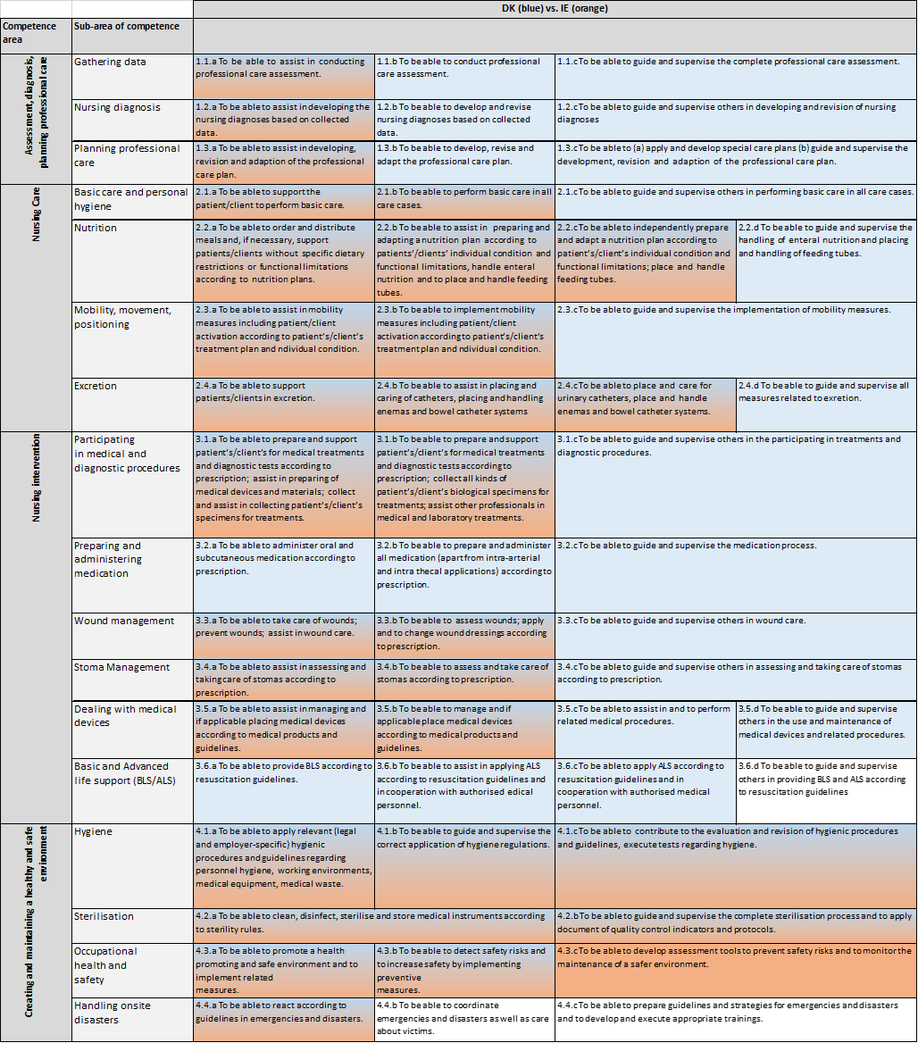
Supporting the transferability of LO and flexible learning pathways – national & international context
Supporting the levelling of VET qualifications and discussions on the consistency of levelling decisions
Mapping based on VQTS/HCEU matrix
(DK-IE; excerpt)
Notes:
Supporting the transferability of LO and flexible learning pathways - Example 1: national and institutional level:
Supporting the levelling of VET qualifications: Comparing VET qualifications can help to identify the levels of qualifications and to better understand the allocation decisions (EQF context). To this end, it is necessary to gain a deeper insight into the content of the qualifications.

Slide 10
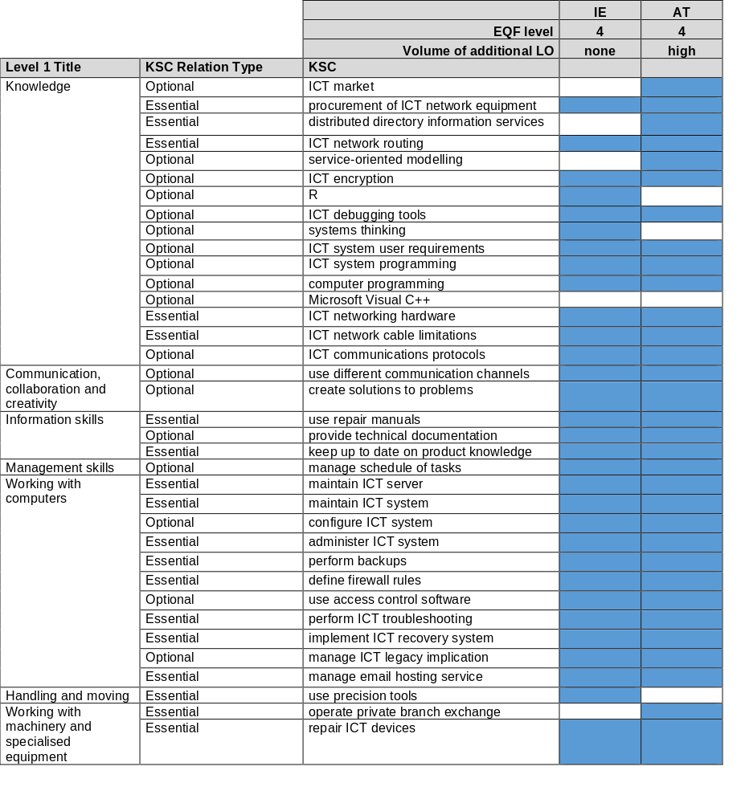
Supporting the transferability of LO and flexible learning pathways – national & international context
Identifying qualifications with similar LO and opportunities for changing pathways; supporting the decision whether it is worth applying and which additional LO would be required; supporting RPL…
ESCO-mapping IT technician qualification (AT-IE; excerpt)
Notes:
Supporting the transferability of LO and flexible learning pathways - Example 2: Individual level
Exploring opportunities for flexible learning pathways: Comparing VET qualifications can help to show opportunities for individual and flexible learning pathways within the national context as well as at the international level.

Slide 11
Potential applications and use cases situated within the analytical framework
Session 3
Notes:
Karin: Development of European Vocational Core Profiles – for potentially supporting
transparency, transferability, recognition
Review and renewal of qualifications
VET excellence

Slide 12
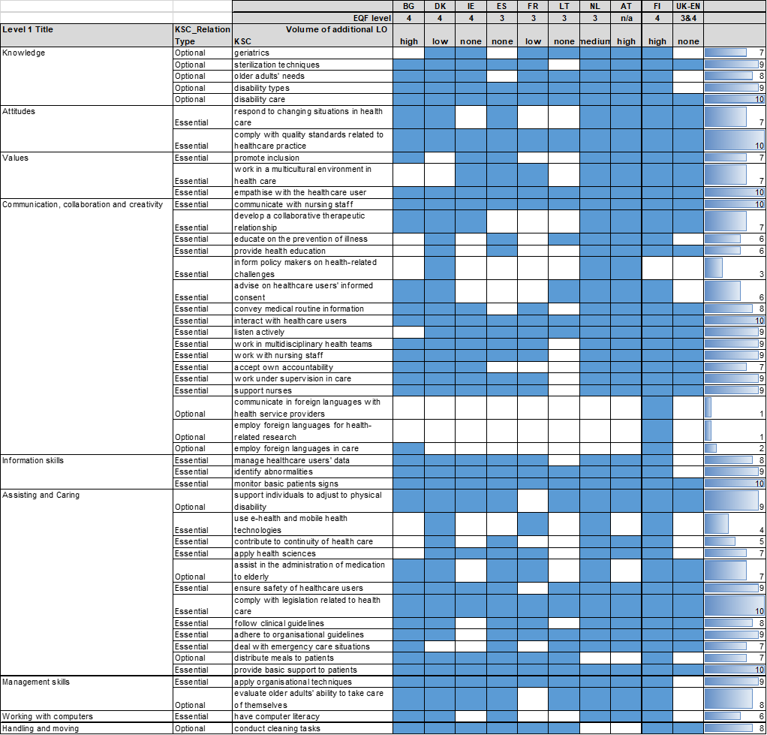
Development of European Vocational Core Profiles
Possible approach:
identifying a set of LO common in VET qualifications across MS (manually or supported by the LO linking tool
https://lo-linking.esco-projects.eu/upload)
Mapping table for healthcare assistant – ESCO (v1.0.5 )
(excerpt; only occupational KSC)
Notes:
The 2020 Council Recommendation on introduces the concept of European Vocational Core Profiles:
The VET Recommendation calls for ‘supporting the goal of gradually establishing and developing European Platforms of Centres of Vocational Excellence and exploring European Vocational Core Profiles together with Member States and relevant stakeholders, as part of Europass platform and complemented, where possible, by vocational digital content developed in the framework of European transparency tools, with a view to facilitate mobility of learners and workers and the transparency and recognition of qualifications’.
Exploration activities are ongoing and some ideas are reflected in the final report of this Cedefop study.

Slide 13
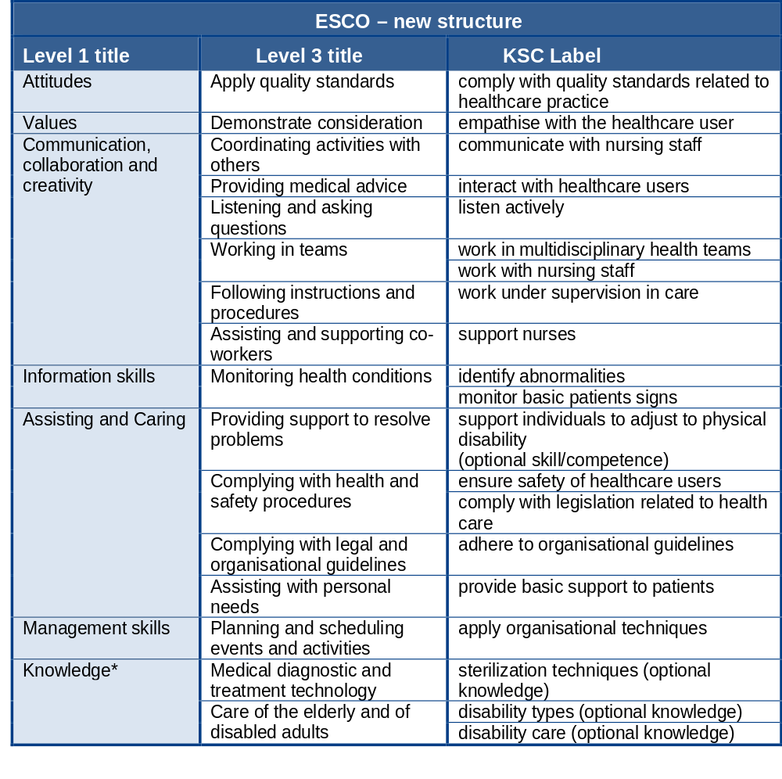
Development of European Vocational Core Profiles
‘Core learning outcomes’ resulting from the mapping against the healthcare assistant profile – ESCO (v1.0.5 )
(only occupational KSC)
Based on mapping for healthcare assistant – ESCO (v1.0.5 )
(only occupational KSC)
Notes:
The table shows the set of KSC items resulting from the mapping against the ESCO occupational profile ‘healthcare assistant’. It includes those KSC concepts that are covered (either explicitly or implicitly) in at least nine out of the ten qualifications that were mapped to the profile in the first part of the study.
This set of KSC items might thus be considered as a set of ‘core learning outcomes’ across the ten qualifications covered.
The notion of 'core learning outcomes' needs to be used with caution here since the result of the mapping exercise only reveals the lowest common denominator; however, it says nothing about the relative importance of these skills in the respective qualifications. Furthermore, it is quite possible that learning outcomes that are of particularly high importance in the context of a qualification are not included in these 'core learning outcomes’.
Thus, mapping to an OSP has its limitations.

Slide 14



Thank you!
Monika Auzinger
monika.auzinger@3s.co.at
Karin Luomi-Messerer
karin.luomi-messerer@3s.co.at
3s Unternehmensberatung GmbH
www.3s.co.at
Simon Broek
Ockham-IPS, Netherlands
s.broek@ockham-ips.nl
https://ockham-ips.nl/

Slide 15
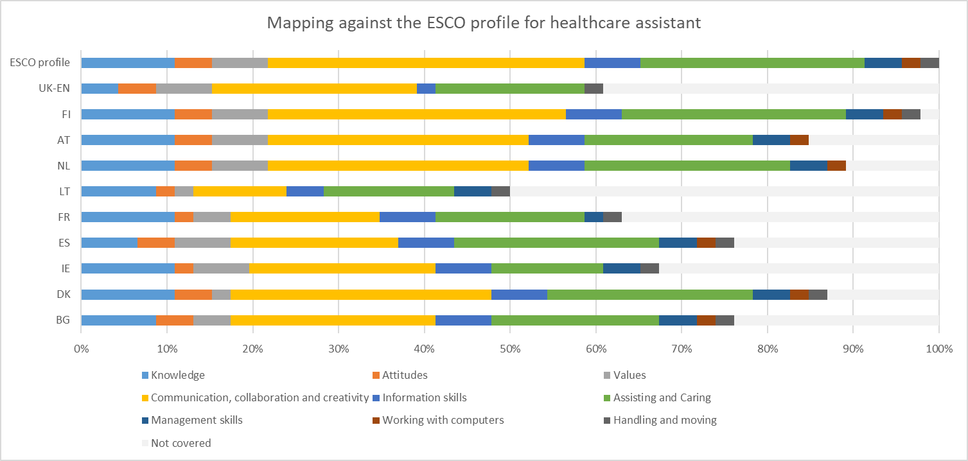
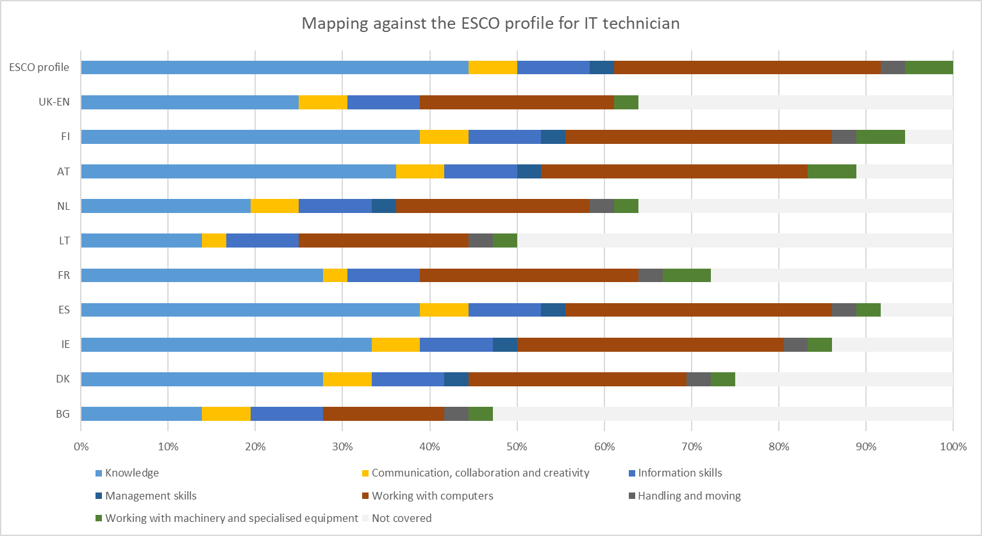
ESCO (v1.0.5 ) (only occupational KSC)
Notes:
ESCO (v1.0.5 )
The bar chart provides a visualisation of the mapping against the ESCO occupational profile and also highlights the key benefit of the new structure for this particular exercise, in that it allows to present the outcomes of the mapping exercise in a generalised and comparable manner. The use of bar charts to illustrate the outcomes of the mapping has, however, a considerable drawback in that it suggests an (undesirable) benchmarking aspect. It is important to re-iterate that the resulting country profiles are the outcome of the mapping against the ESCO occupational profile. The country profile as such does not provide any information on the scope and breadth of the underlying qualification.
For the healthcare assistant, the visualisation using bar charts illustrates the focus on KSC related to communication, collaboration and creativity as well as assisting and caring. Using the same illustration, the bar chart for the ICT technician confirms the focus on KSC related to working with computers (see figure below).

Slide 16
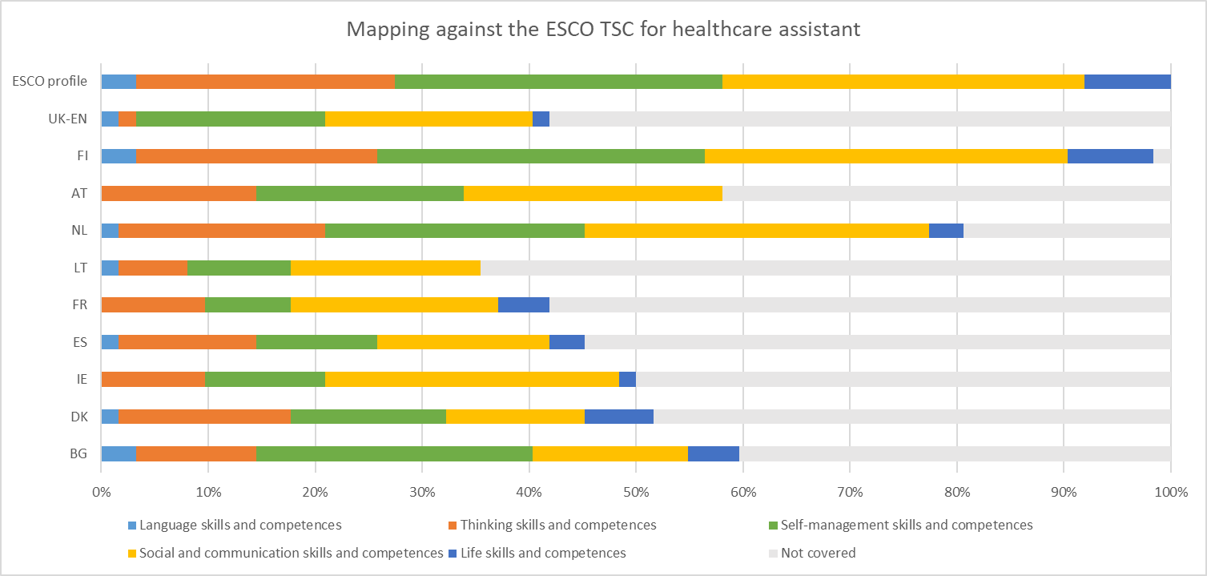
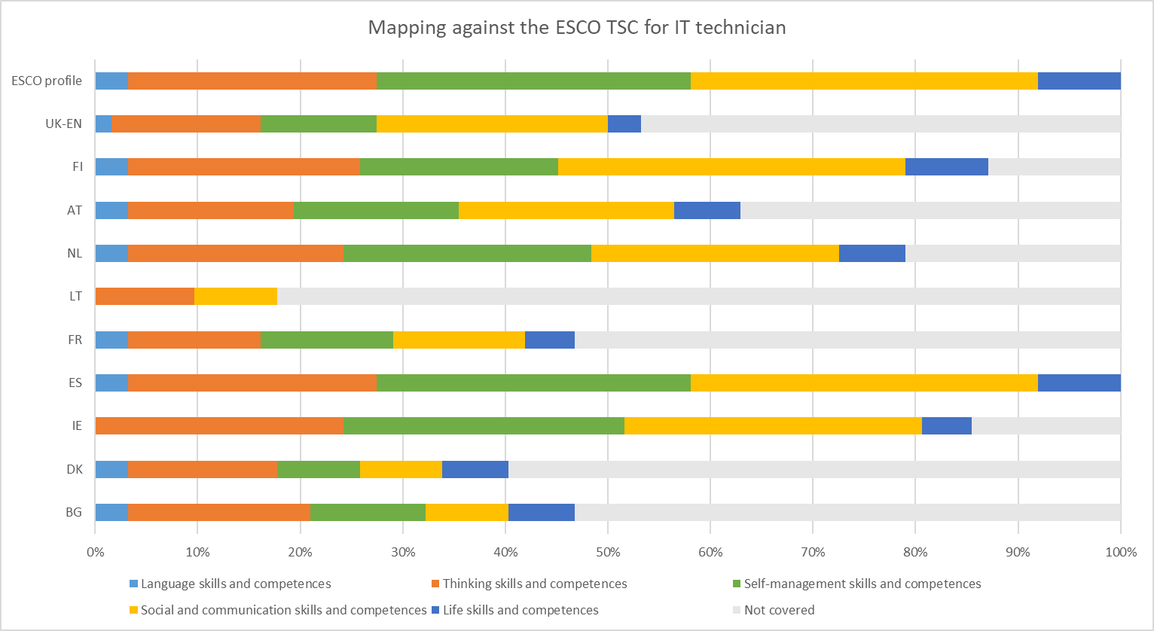
ESCO (v1.0.5 ) (transversal skills and competences)
Notes:
The two bar charts present a different illustration of the mapping against ESCO transversal skills and competences, offering another perspective at the weight of different KSC categories, as the following examples show. The Bulgarian healthcare assistant qualification used for the mapping shows an overall coverage slightly above the median value, but a comparatively high coverage of KSC pertaining to the ‘thinking skills and competences’ category. Conversely, the Irish health assistant qualification shows an overall coverage slightly below the median value, but a comparatively high coverage of KSC pertaining to the ‘social and communication skills and competences’ category (depicted in the yellow section of the bar). For the UK qualification, a very low coverage of KSC pertaining to the ‘thinking skills and competences category can be observed’.

