Slide 1


Comparing and analysing VET qualifications
Methodological lessons
Monika Auzinger
3s, Austria
Karin Luomi-Messerer
3s, Austria
Simon Broek
Ockham-IPS, Netherlands
Cedefop Workshop, 18 June 2021

Slide 2
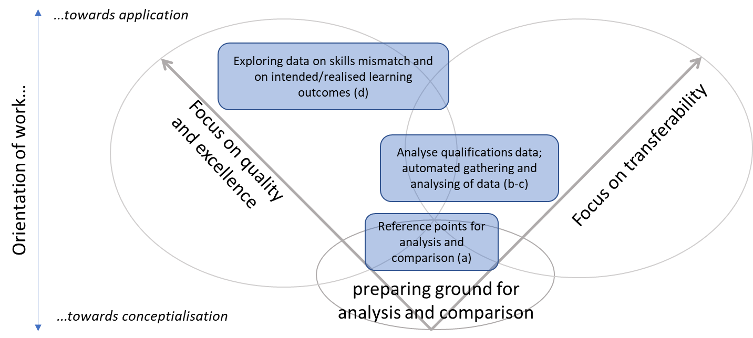
Analytical Framework - Overview
Notes:
The analysis and comparison of qualifications can on the one hand contribute to quality improvement in VET and the pursuit of excellence, and on the other hand to more transparency of qualifications from different countries and thereby facilitate transferability of qualifications and mobility. These two orientations form the basis for situating the reflections on:
Reference points for analysing and comparing VET qualifications;
Data sources for national VET qualifications and their learning outcomes;
The use of digital technologies to support comparison of VET qualifications;
Methodologies for closing the feedback loop between VET and the labour market (with a particular focus on Employer Reflection Surveys).
The figure situates these methodological reflections in relation to the above orientations for the analysis and comparison of VET qualifications. It also points to the focus of the methodological reflections, on the conceptualisation or application of analysis and comparison, as some reflections are more related to conceptual considerations, while others are directly focused on improving the quality of national VET qualifications and supporting transferability of learning outcomes and mobility.

Slide 3
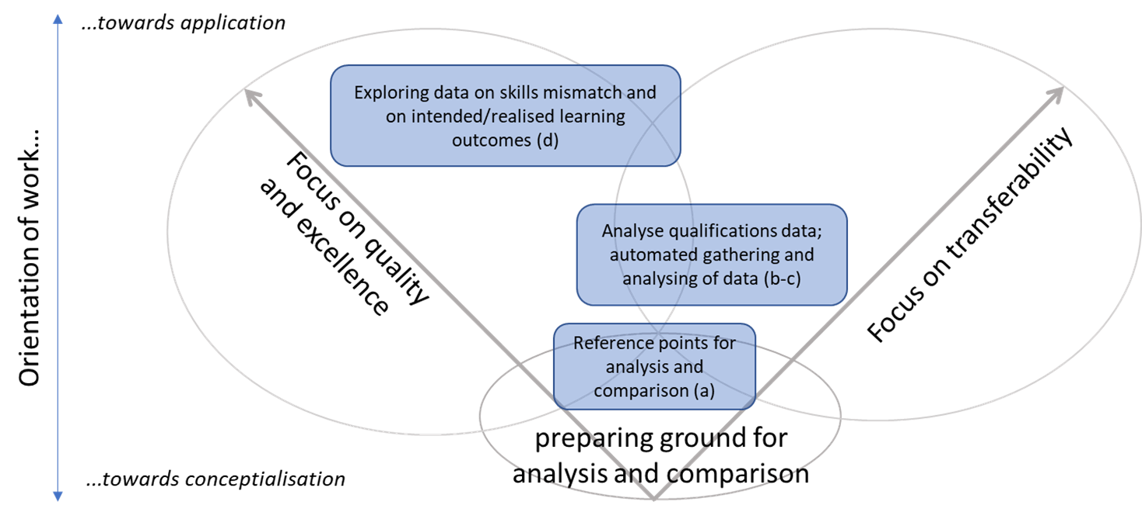
Reference points for analysis and comparison of qualifications – which one exist and what is required?

Slide 4
Reference points
__A conceptual fixed point for mapping learning outcomes included in national qualifications in order to analyse and compare them and identify commonalities and differences of their content and profile – ‘translation device’
__A reference point itself does not necessarily have to use learning outcomes, but descriptors to which learning outcomes contained in qualifications can be mapped.
__Different objectives and use contexts require different levels of abstraction of reference points.
LO
LO
LO
LO
X
X
X
X
LO
LO
LO
LO
LO

Slide 5
Examples of reference points or systems
__ World Reference Levels (WRL);
__ Qualifications Frameworks: EQF, other RQF, NQF, SQF
__ Competence frameworks (such as e-competence framework, competence framework for languages);
__ Occupational skills profiles (OSP):
- profiles that describe the requirements or essential characteristics of
occupations in terms of knowledge, skills, competences,
professional interests, work values, etc.
- can be independent profiles or part of a more complex ‘reference
system’ (a systematic approach to develop and maintain OSP for
different economic sectors and occupational fields)
Notes:
Only the latter ones are usually at a level of detail that allows for mapping of learning outcomes and comparing the content of individual qualifications. Qualifications frameworks can be used for comparing the levels of qualifications but usually do not go deeper and the WRL only provide a rather broad picture (see description in the box below). Competence frameworks are more detailed but typically focus on a specific competence area and are therefore of limited use for comparing more comprehensive VET qualifications.

Slide 6

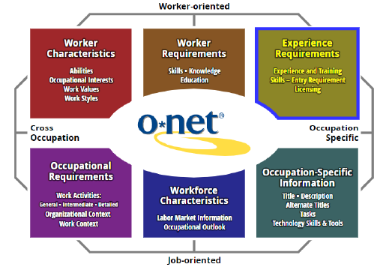
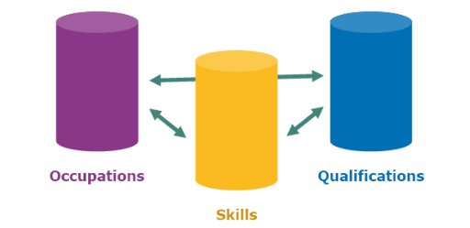





Reference points or systems tested
Notes:
WSSS – now called WorldSkills Occupational Specifications
Testing: healthcare assistant, ICT service technician
Mapping LO of VET qualifications from 10 countries: Austria, Bulgaria, Denmark, Finland, France, Ireland, Lithuania, the Netherlands, Spain, and United Kingdom-England

Slide 7
Lessons learned & Recommendations
Reference points need to be adapted to applications in different contexts and for different purposes.
General requirements include:
__solid conceptual foundation to ensure consistency
__structure, hierarchy - classification of concepts
__different national contexts - different linguistic versions
__sufficient level of comprehensiveness and relevance to capture the scope of the national qualifications
__coverage of different types of skills (occupational or transversal ones)
__ weighting of KSC within the overall profile, i.e. systematically indicating the importance of specific learning outcomes (e.g. distinction between ‘core’ and ‘supplemental’, ‘essential’ and ‘optional’)
__expression of performance levels
Notes:
Reference points need to be adapted to applications in different contexts and for different purposes. E.g. when using it for gaining feedback on realized LO (Employer Reflexion Survey) it needs to be reduced – see next ppt.
The reference point can be assessed related to its comprehensiveness and its relevance: An indication of how well a reference point is able to reflect the learning outcomes of a national qualification is whether all learning outcomes of the qualification are represented in the reference point (‘reference point is comprehensive’). A second aspect is whether the reference point does not exceed too much the learning outcomes of national qualifications (‘reference point is relevant’).

Slide 8
Data and data sources – what exist and what is required?

Slide 9

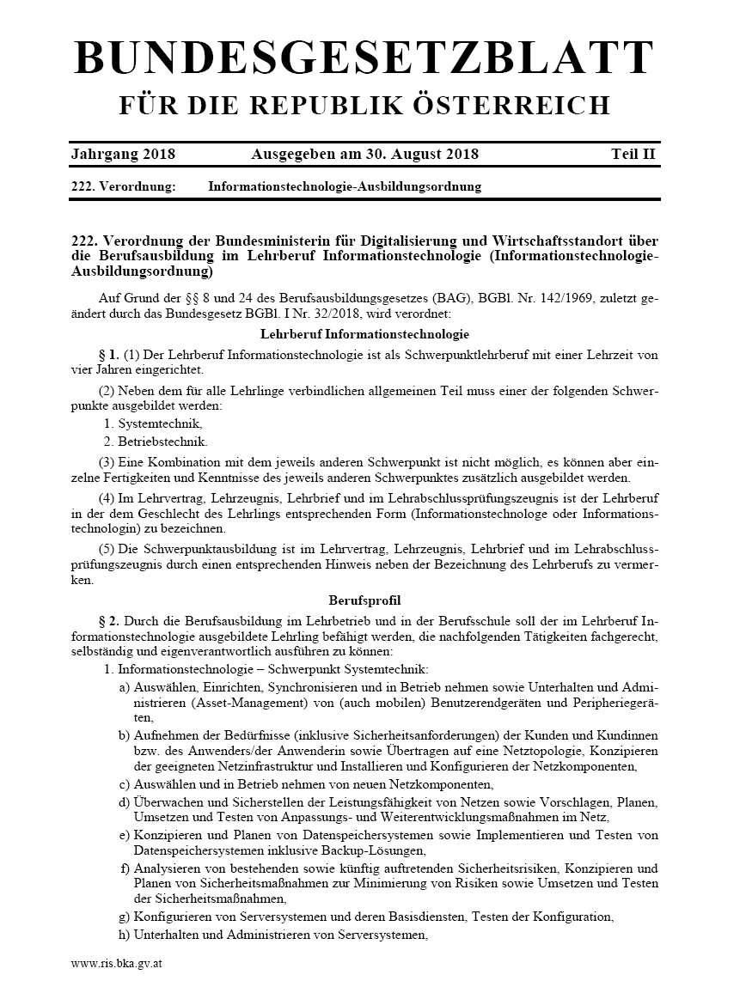
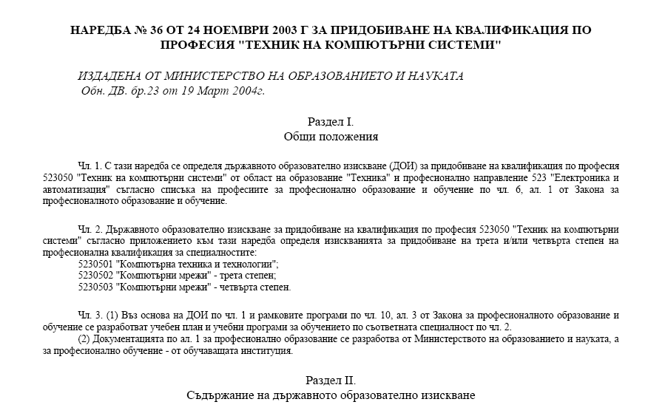
Documents as key data sources for presenting qualifications and their learning outcomes (‘national reference documents’)

Slide 10
Opportunities and challenges
Increasing transparency: description of learning outcomes, indication of the NQF or EQF level and additional contextual information.
Challenges:
__LO structured and expressed in a wide variety of ways
__different types of LO (general, occupation-specific, transversal): mixed approaches, seldom identified separately
__LO structured in terms of different levels of specificity
__very rarely a systematic approach for expressing the complexity of LO (performance level, i.e. ‘vertical dimension’)
__variation regarding the degree of autonomy within systems to adapt elements of qualifications (e.g. to local needs)
__ optional elements and electives are often included
__qualifications data accessible and traceable

Slide 11
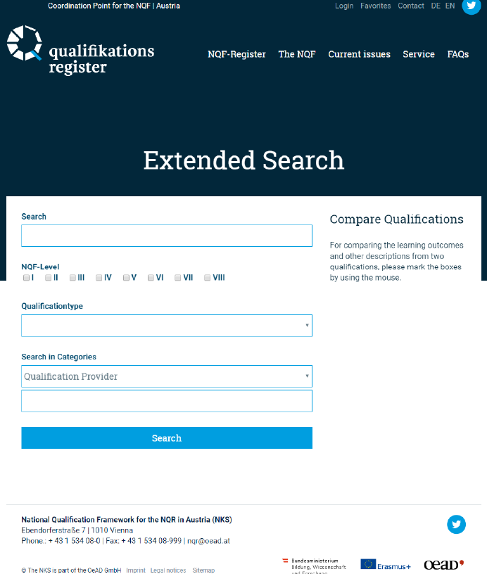
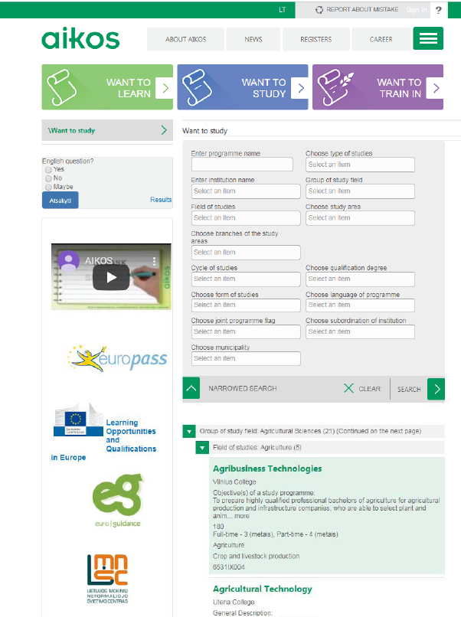
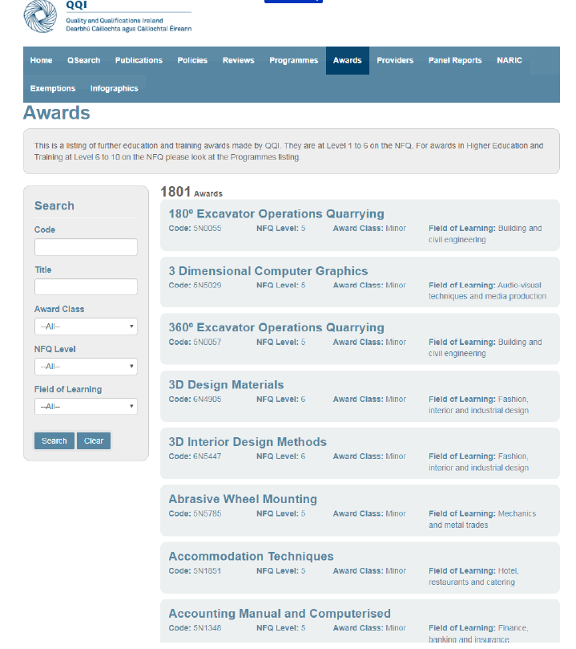
National qualifications databases presenting qualifications and their learning outcomes

Slide 12
Opportunities and challenges
Ongoing development of qualifications databases, newer ones are being set-up in relation to the elements of data fields suggested by the EQF Recommendation
Challenges:
__huge variations across countries – no commonly agreed definition of what can actually be considered to be a ‘qualifications database’
__common principles for presenting learning-outcomes-based qualifications in databases, suggested by Cedefop (2017), are rarely used
__only few databases are linked to the European portal
__ generally support the cross-country comparison of qualifications only to a limited extent

Slide 13
Lessons learned & Recommendations
__Improving access to data on qualifications;
__Improving transparency: short, not too detailed presentations of qualifications (not the full account of the LO, but a synthesised and structured description of their core profiles)
__Following the Cedefop handbook on learning outcomes (e.g. using suggested components as a basic structure to formulate LO statements, expression of the level of complexity or proficiency)
__Further exploring the development of common principles and a common structure for developing qualification profiles for the European context
Notes:
These common principles and the common structure could be based on the elements of the Europass Certificate Supplement; the data fields for the electronic publication of information on qualifications (Annex VI in the EQF Recommendation); as well as the common principles for presenting learning-outcomes-based qualifications as proposed by Cedefop. It is suggested developing standardised learning-outcomes-based descriptions of national qualifications (of about 2,500 to 3,500 characters). These descriptions should follow a predefined structure and syntax; refer to a sensible and flexible way of clustering types of learning outcomes; and should be based on a standardised terminology, including lists of action verbs (which should not be used too rigidly). This would mean a more harmonised approach for presenting learning outcomes statements in the European context, which in turn would enhance the comparability of qualifications.

Slide 14
Digitalising analysis and comparison – what is required and possible?

Slide 15
Digital technologies and their potential for supporting automated gathering, structuring and analysing of data on qualifications
Conditions for a tool:
process different text formats
labelling of key words (levels of complexity)
deal with natural language (text parsing)
process different languages
Open Access software packages to maximise inclusivity / Lay-men use
Conditions for the reference point:
Lists all essential and optional KSCs comprehensively
Highlights occupation-specific as well as transversal components
Structures the learning outcomes within the profile into a hierarchy
Indicates the level of complexity associated with individual KSCs
Notes:
Methodology:
__Small-scale testing of a workflow for automated comparison
__Expert interviews
In the project we also explored the potential of digital technologies for supporting automated gathering, structuring and analysing of data on qualifications. For this we developed a workflow for a tool to really test what are conditions for automated comparison and what are challenges. We consulted key experts on automated comparison; and conducted a small testing exercise on how to use national qualification descriptions and ESCO lists of KSC for automated comparison. On the basis of this, we identified some conditions for realising automated comparison and some recommendations for the future.
Ideally, the digital tool should have the ability to process different text formats (prior conversion or automated); should allow extraction or labelling of key words; have the ability to deal with natural language (text parsing); and process different languages. Furthermore, the digital tool should use open-access software packages, to maximise inclusivity and should not be too demanding to operate.
The proposed workflow for automated comparison of learning outcomes (of VET qualifications), contains several sub-tasks, in a more or less chronological sequence (i.e. pipeline): First of all, access to national VET qualifications in machine readable form (tap relevant sources, transform pdfs into txt, point the parser at the spot where the learning outcomes are being described etc.) has to be provided. Then, the included national learning outcomes descriptions need to be parsed (text segmentation, part-of-speech-tagging); and the segmented text parts of national learning outcomes descriptions need to be mapped onto the reference vocabulary (PTs as well as NPTs), representing the meaning contained therein, in terms of the reference vocabulary (normalisation of learning outcomes). In the final step, the ‘translated’ national learning outcomes descriptions have to be mapped onto most suitable occupational skills profiles (‘reference point’) of the reference system, registering overlap and divergence.

Slide 16
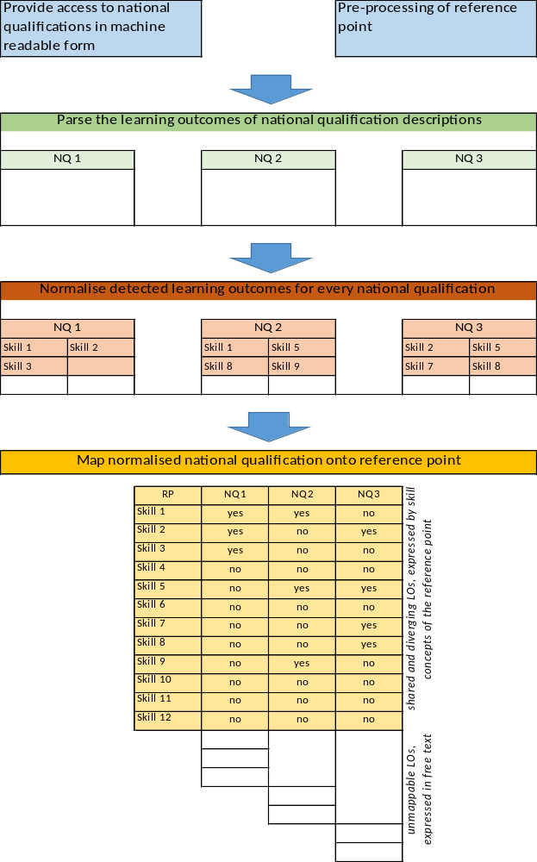
Workflow for testing:
Step 1: Provide access to national qualifications in machine readable form; pre-processing of national qualifications (and reference point for comparison)
Step 2: Parse the LO of national qualification descriptions
Step 3: Normalise detected LO for every national qualification by mapping it onto the reference system's vocabulary
Step 4: Mapping of most suitable occupational skills profile (OSP, ‘reference point‘) with normalised national qualifications, registering overlap and divergence

Slide 17
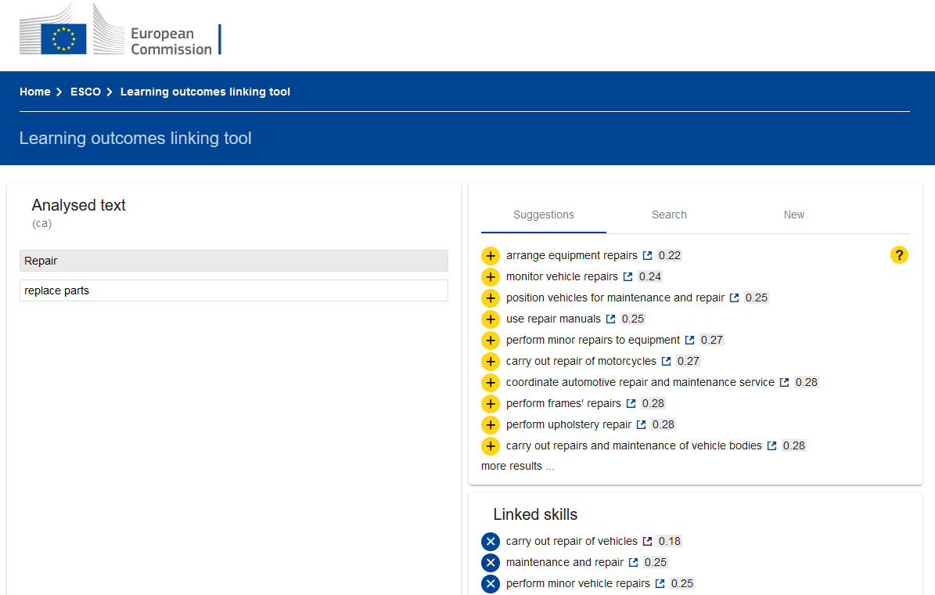
Lessons learned & Recommendations
__The heterogeneity in how KSCs are phrased and structured hamper automated comparison
__Too little qualification data is available for the training of an automated system for comparing qualifications.
__The national qualification descriptions and the selected reference point differ too much to allow sensible matching, based on automated processes.
__There are some tools that support automated comparison such as Learning outcomes linking tool to ESCO: https://lo-linking.esco-projects.eu/link
__Further development and testing is needed
Notes:
. Too little qualification data is available for the training of an automated system for comparing qualifications (i.e. machine learning is not a feasible approach). There is a limited number of national qualifications to be processed (‘mapped’) for the scope of this study, but equally for the whole set of qualifications in Europe. The amount of data needed to train a machine learning model (per reference point, per language that can detect and classify skills – at reasonable quality – is far larger than the number of national qualifications available. Furthermore, these national qualifications differ greatly in the way how KSC are described; the linguistic diversity even further complicates the setting up of a machine learning system.
The national qualification descriptions and the selected reference point differ too much to allow sensible matching, based on automated processes.
Firstly, the ESCO KSC classification, significantly differs from the language used in the descriptions present in national qualifications – regardless of their (shared) labour-market focus and relatively high use of field-specific terms.
Secondly, KSC in national qualification descriptions and the reference point are too contextualised (combining KSC elements and very specific contexts within one statement) to allow for accurate matching based on the occurrence of individual words.
Even when the data is enriched, through linking individual words with synonyms, matching still leads to imprecise matches. Even if this fundamental obstacle could theoretically be solved, the workload involved in establishing an automated comparison between a national qualification and a reference point is far greater than doing this manually. Furthermore, even though processing more qualifications as they are created over time might eventually reduce the workload needed per qualification slightly – this would not substantially reduce the overall efforts needed, thus rendering it not be feasible to put machine learning in place (as explained above).
All in all, the resources needed to support automated comparison do not substantially reduce the manual work to support this process. Still you need an expert to interpret…
The heterogeneity of how KSCs are phrased and structured presents an even bigger challenge for an automated process. When manually comparing qualifications (as done in Work Assignment 1), these challenges are met by experts because these do not merely ‘read’ the texts but also interpret and, if necessary, supplement (e.g. for implicit KSCs) national learning outcomes descriptions and the reference points. Hence, they do not perform an exact, computed match, as it involves also a certain degree of subjectivity (indeed, it is highly likely that two experts looking at the same qualification might come up with varying interpretations of individual or groups of learning outcomes). The automated process, on the other hand, cannot conduct an expert assessment of skills profiles but instead relies on matching words (tokens) and combinations of words. This, however, does not lead to satisfactory and meaningful results – as in results providing complete insight into the content of qualifications, as well as the differences and similarities between qualifications from different countries
Recommendation 1 on transparency and accessibility of data
Transparency and accessibility of data on national qualifications are important aspects for the comparison of qualifications. Further efforts are needed to find solutions to improve access to data on qualifications; and to improve transparency to support the comparability of qualifications and their learning outcomes.
Recommendation 3 on a basic structure of formulating learning outcomes
It is suggested to follow the Cedefop handbook on learning outcomes, which suggests to use the following components as a basic structure to formulate learning outcomes statements: action verb and object of the verb, as well as a statement specifying the depth/breadth of learning to be demonstrated, and complete with an indication of the context (which can be related to learning, work or other relevant social contexts).
Recommendation 4 on expressing the level of complexity in learning outcomes
The comparison of qualifications is supported by expressing the level of complexity or proficiency in learning outcomes statements (i.e. the ‘vertical dimension’ of learning outcomes). Taxonomies and the action verbs included can be used for this purpose but should serve mainly as a reflective tool - to support dialogue in the development and description process of qualifications, and not in a too rigid way.
Recommendation 5 on a EU standardised format for LO summaries
It is recommended to further explore the development of common principles and a common structure for developing qualification profiles for the European context. These descriptions should follow a predefined structure and syntax; refer to a sensible and flexible way of clustering types of learning outcomes; and should be based on a standardised terminology, including lists of action verbs (which should not be used in a too rigid way, as indicated above). This would mean a more harmonised approach for presenting learning outcomes statements in the European context, which in turn would enhance the comparability of qualifications.
Recommendation 6 on structuring ESCO
In line with the ongoing developments of ESCO (establishing a structure and reducing the number of terms used), it would help if this taxonomy would adopt a more structured approach to how KSCs are described (vocabulary control); as well as a better alignment with the expressions found in qualification descriptions or vacancies, e.g. including these as synonyms. The suggested changes particularly refer to enriching the vocabulary – with stemmed versions of skills phrases via generating skills phrases from existing texts (e.g. vacancies or qualifications) or via incorporating suitable resources from existing projects that process such texts; supplementing the semantic structure to enable aggregations; dissecting complex skills into enabling skills components to make implicit components visible and to gain insight into performance levels; and consolidating terminology (e.g. summarising skills expressing the same meaning with different words under one concept).

Slide 18

Overarching conclusions
__using LO offers a lot of opportunities for analysing and comparing the content of qualifications
__sole focus on LO constitutes a certain restriction as does the fact that words can mean different things in different contexts and that shifts in meaning are also possible in translations
__reference points/systems as well as qualification descriptions need to be improved
__there are interesting development paths but also limitations of using digital technologies to support automated gathering, structuring and analysing data on qualifications, and to support the comparing of qualifications – improvements are possible
__analysis and the comparison of the contents of VET qualifications can be used for different purposes and reveal interesting results
more in the next presentation!

Slide 19



Thank you!
Monika Auzinger
monika.auzinger@3s.co.at
Karin Luomi-Messerer
karin.luomi-messerer@3s.co.at
3s Unternehmensberatung GmbH
www.3s.co.at
Simon Broek
Ockham-IPS, Netherlands
s.broek@ockham-ips.nl
https://ockham-ips.nl/

