Slide 1

Setting Europe on course for a human digital transition
Evidence from Cedefop’s ESJS2
Konstantinos Pouliakas
Expert, Cedefop
Cedefop-OECD ‘Apprenticeships and digital transition’
15 June 2023

Slide 2









Strengthening
skills intelligence
for Europe
Skills
OVATE
Matching
skills
© iStock/piranka

Slide 3
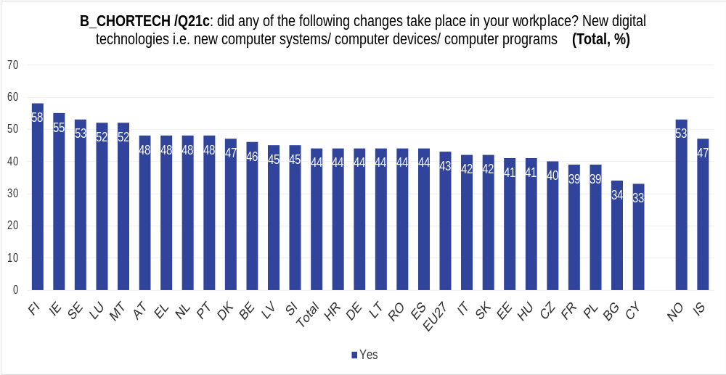
Digital upskilling in EU jobs is unequal
35% of EU+ adult employees had to learn to use new digital technologies to do their main job in 2020-21
ESJS2: In the last 12 months, did any of the following changes take place in your workplace?
New digital technologies i.e. new computer systems/computer devices/computer programmes (Total, %)
FI IE SE LU MT AT EL NL PT DK BE LV SI EU+ HR DE LT RO ES EU-27 IT SK EE HU CZ FR PL BG CY
NO IS

Slide 4
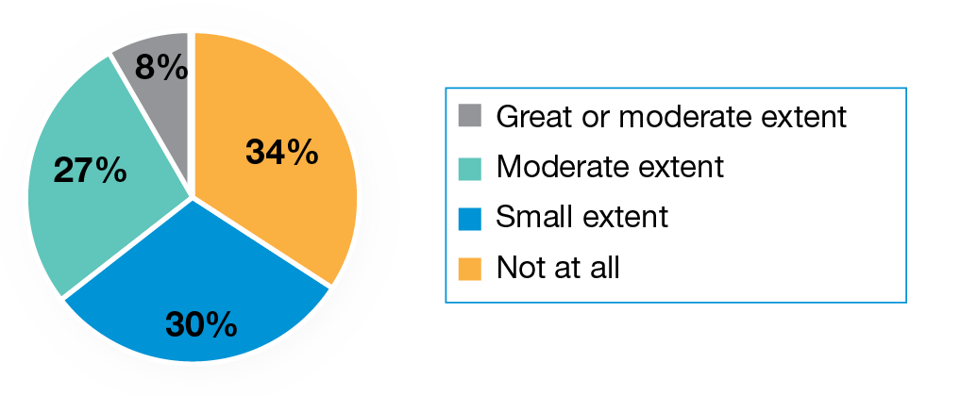
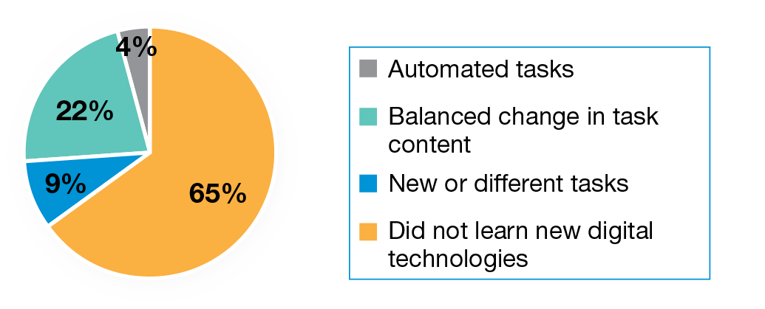
Task automation – fear vs. reality
(a) Extent to which adults think digital technology can
or will do their main job partly or fully
45% of the EU+ workforce believe that they need or will need new knowledge and skills because of the new digital technologies in their workplace
Mostly affected by task automation
Males
Lower-educated
Manual and low-skilled, elementary, jobs
Routine jobs
Larger-sized firms
Agriculture, finance, utilities sectors
(b) Actual change in job tasks resulting from new digital
technology
Notes:
For most other European workers affected by digitalisation, digital transformation implies task content redesign rather than job displacement. Although there will be job and task destruction by machines or robots in some labour market segments, digitalisation first and foremost leads to massive skilling needs

Slide 5



Learning potential in digital skills is vast despite modest digital skill demand
Cedefop Digital Skills Intensity (DTI) index, EU+ countries
13%
28%
43%
16%
non-users
low
medium
high
Low
Medium
High
Internet browsing, email, social media | 20%
Write or edit text | 28%
Use spreadsheets | 38%
Use specialised software | 50%
Prepare presentations | 60%
Advanced spreadsheets | 74%
Manage or merge databases | 81%
IT systems, hard/software | 87%
Programme or code | 92%

Slide 6

Despite extensive skill gaps, those who need digital skills training the most don’t get it
EU+ population groups in need of digital skills training …
  Females
  Low educated
  Lower skilled jobs
  Routine, manual work
  Temporary contracts
  SMEs
  Rural areas
% EU+ workers who did digital skills training
© iStock/style-photography

Slide 7
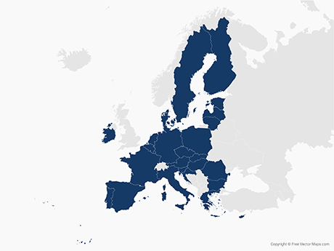
Adapting VET for AI
AI strategy
AI observatories
AuroraAI network
Main response pillars
Planning for AI
Developing AI
Learning about AI
Applying AI
Learning for AI
Coping AI
R&D
Innovation spaces
AI learning platform
Teacher training 4AI
Elements of AI
  Analysing vacancies / training curricula
Right to CVET
STEAM
New IVET degrees
National retraining scheme
  Programming in IVET
Source: Cedefop (2020) VET for future of work
Notes:
The Cedefop thematic insights reports identified several key response areas addressed by EU Member States in their efforts to adapt their VET systems to AI and automation, specifically by:
planning for AI: adopting specific AI strategies and revising IVET and CVET strategies, developing multi-stakeholder expert groups and public-private partnerships to map AI capabilities;
developing AI-based learning solutions for classrooms and enterprises: innovation labs and other pilot AI projects for knowledge exchange between companies and different stakeholders;
applying AI: using AI methods for the development of new skills classifications or analysis of training curricula and VET programmes based on their match/mismatch to labour market needs;
learning (about) AI: teaching teachers and the public about AI capabilities via user-friendly online courses;
adapting VET systems to AI: considering the introduction of new or revised education and training curricula and programmes (such as robotics, computational thinking, machine learning, data science, cybersecurity, automation engineering);
coping with AI: developing continuing VET programmes to support workers affected by automation and structural labour market changes.
DE: Innovation spaces (in-company) – test human-centred AI applications in companies / learning between companies – Min Labour and social affairs
Right to CVET: regardless of qualifications, age or company size, automation or structural change (DE); UK: national retraining scheme
AI strategies: DE, ES, FI (AuroraAI): worlds’ best public services, link actors and public admin services; pilots, public consultations, intergovernmental and stakeholder partnerships
3IAs (FR): interdisciplinary AI institutes
R&D: EE to raise to 1% of GDP
ES: School of computational thinking and AI – from early childhood to upper secondary schools
Skill shortages e.g. FR: commitment to double number of doctoral graduates trained in AI

Slide 8
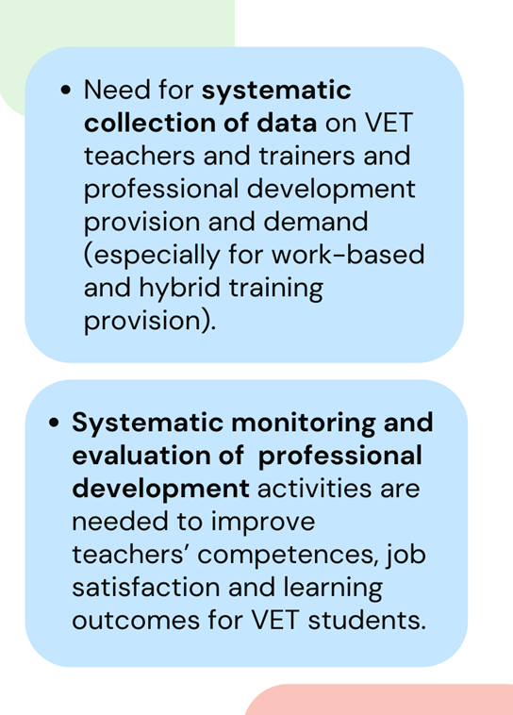
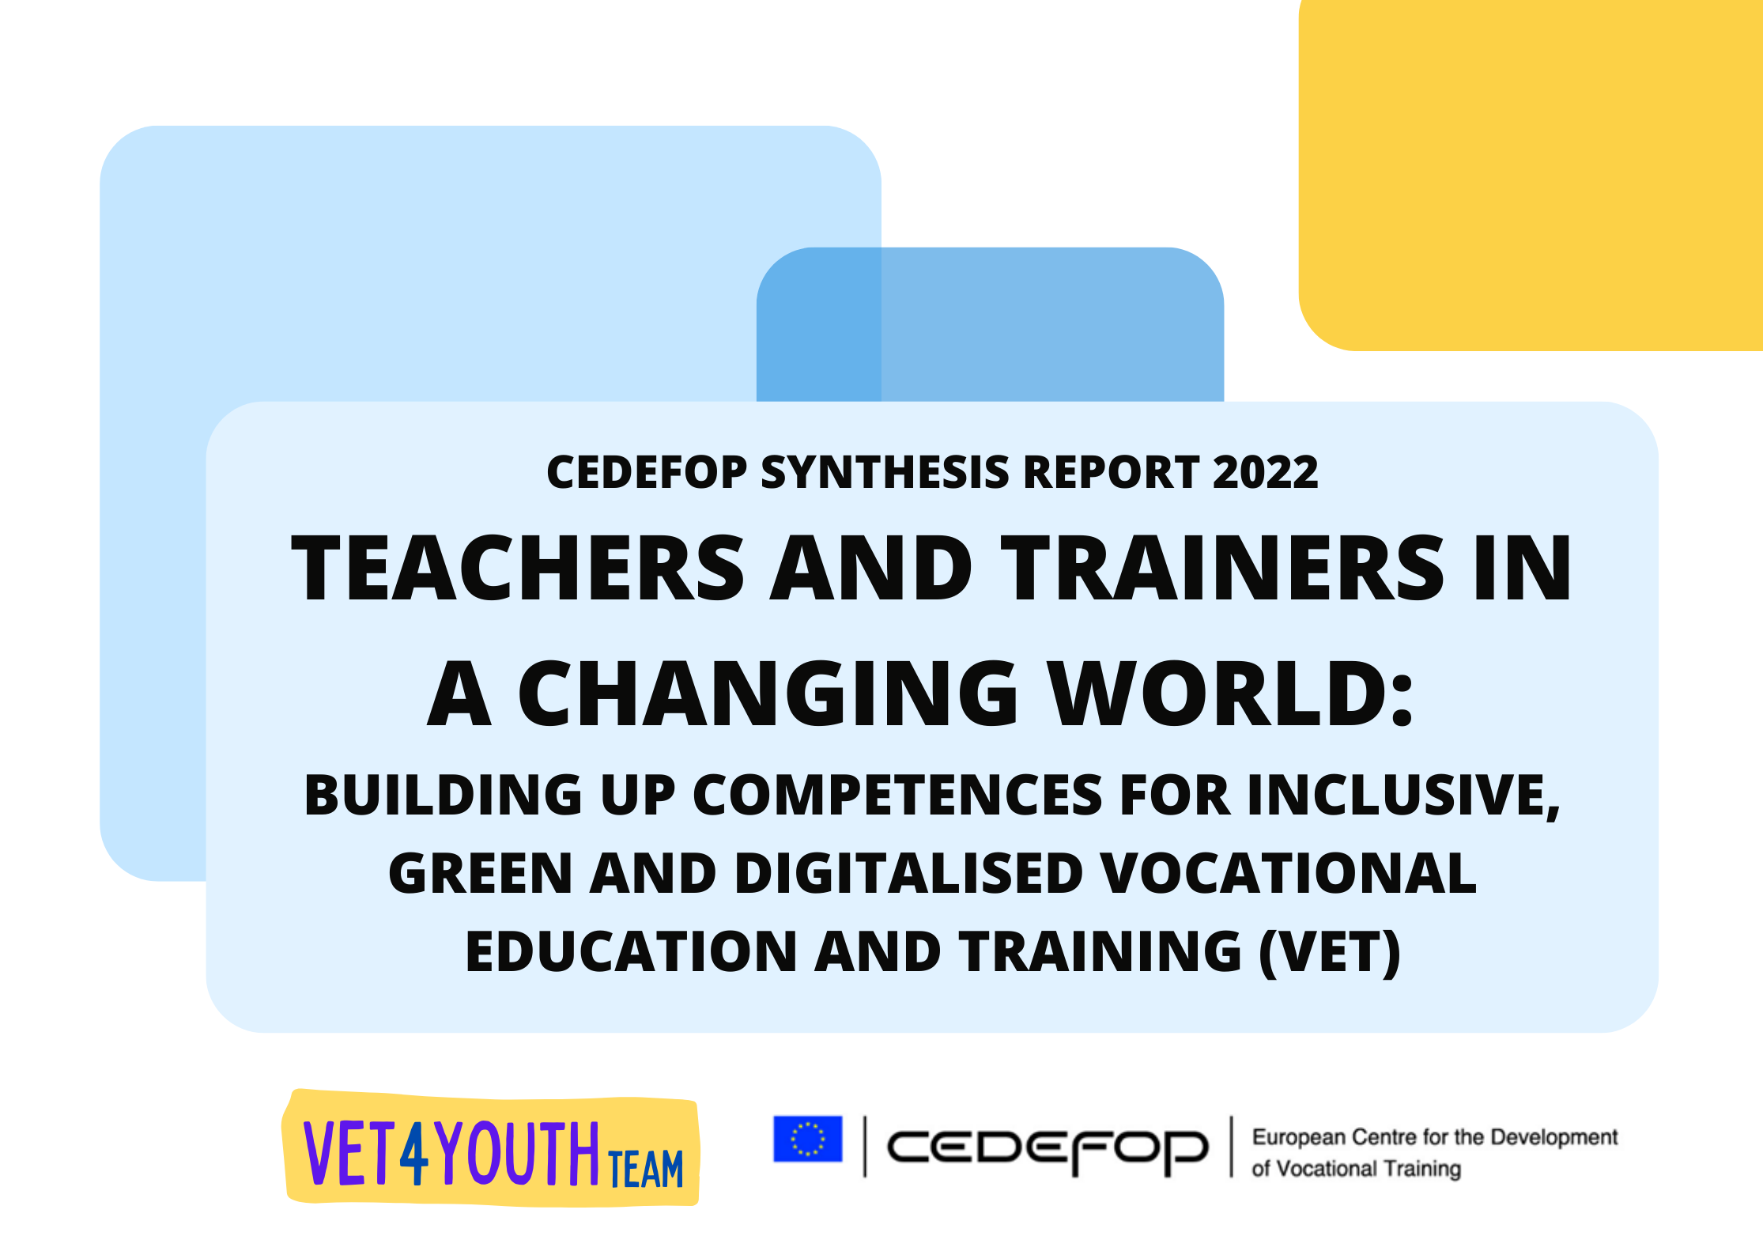
Training teachers for digital future
Drawn from 29 ReferNet country reports
New European VET Teachers Survey (EVTS)

Slide 9


Young workers need apprenticeships for quality jobs
Jobs and skills match
Digital skills, work and learning
Source: Cedefop 2nd European Skills and Jobs Survey (2021)
Notes:
Evidence from 1st ESJS : WBL graduates less mismatched, more skill intensive jobs, more learning and skill development

Slide 10

What is to be feared is not the replacement of man from machines…but their treatment as machines
Notes:
Such concerns have been heightened by Covid-19 pandemic.

Slide 11



For more information
Konstantinos.Pouliakas@cedefop.europa.eu

